Slide 1

Phonics and Reading in Year 1

Slide 2
Overview of the session…
What is phonics?
Why do we teach phonics?
Phonics terminology
How phonics is taught at Raglan – Unlocking Letters and Sounds
Year 1 Phonics Screening Check
Reading at Raglan
https://raglanprimary.school/phonics-reading/

Slide 3
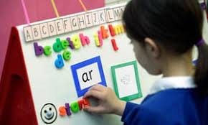
What is Phonics?
Phonics is a way of teaching children how to read and write.
Phonics teaches children to listen carefully and identify the smallest units of sound (phonemes) that make up words.
Children learn how to link these phonemes with graphemes (the letters used to represent these sounds).

Slide 4
Why do we teach phonics?
Children should be taught to use phonic knowledge and skills as the route to decode words
National Curriculum in England 2014

Slide 5
Why do we teach phonics?
Using phonics is the most efficient way to decode words and so we should be teaching children to tackle print using phonics as their primary strategy.

Slide 6
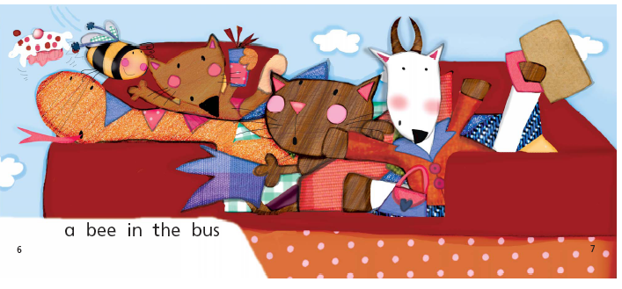
What caption do you think would go with this picture?

Slide 7
What caption do you think would go with this picture?

Slide 8
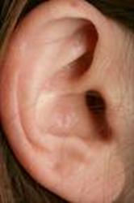
Phonics Terminology
Phoneme
A phoneme (sound) is the smallest unit of sound in a word. There are approximately 44 phonemes in English.
/c/ as in c-a-t, or /sh/ as in sh-i-p

Slide 9

Grapheme
A grapheme is a letter or sequence of letters that represent a phoneme (one sound).
s t ch igh

Slide 10
Grapheme Phoneme Correspondence
Grapheme Phoneme Correspondences (GPCs) are the relationships between phonemes (sounds) and graphemes (written letters).
t ai igh

Slide 11
Digraph
A digraph is a single sound (phoneme) that is made up of two letters, e.g.
ai ee sh oa ch
Examples of words that contain digraphs can be found below:
rain
feet
shop
boat
chip

Slide 12
Trigraph
A trigraph is a single sound (a phoneme) that is made up of three letters.
igh ear air
Examples of trigraphs can be found below:
light
hear
hair

Slide 13
Pronunciation
Phoneme and example word
s | sit | a | ant | t | tin | p | pip
i | ink | n | nap | m | map | d | dig
g | got | o | on | c | cot | k | kit
ck | pick | e | peg | u | up | r | run
h | hot | b | bat | f | fan | l | lap
j | jog | v | vet | w | web | x | mix
y | yap | z | zip | zz | buzz | qu | quiz
ch | chop | sh | shed | th | thin | th | then
ng | ring | ai | rain | ee | feet | igh | night
oa | boat | oo | boot | oo | look | ar | park
or | sort | ur | curl | ow | cow | oi | coin
ear | dear | air | fair | ure | sure | er | better
It is important to articulate pure phonemes without the ‘schwa’.
    tin

Slide 14
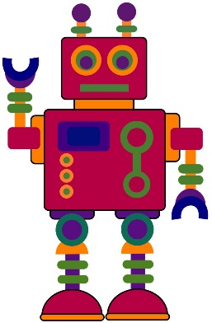
Oral Blending and Segmenting
Oral blending is hearing spoken sounds and merging them together to make words. For example, ‘m-a-t’ makes ‘mat’.
Oral segmenting is splitting a word into its individual phonemes in order to spell it.
These skills are taught before learning the letters and continue through their phonics learning.

Slide 15
Blending for Reading & Sound Buttons
To be able to read a word children need to be able to:
1. Identify the grapheme-phoneme correspondences in a written word: c oa t
2. Blend them in the correct order to pronounce the word: ‘coat’
Sound buttons help recognition of GPCs. A dot shows that the sound is made from a single letter and a line shows that the sound is made from a digraph or trigraph.
sheep chick
Chunking for longer words flowers

Slide 16
Segmenting for Spelling
Segmenting is the opposite of blending. Segmenting a word is to break the word down into its phonemes, e.g. hat= h-a-t. Segmenting enables children to break down words they are trying to spell.
p | i | g
What sounds can you hear in ‘pig’?
‘Stretch it out’
‘Phoneme fingers’
‘Write the corresponding graphemes’
Chunking for longer polysyllabic words

Slide 17
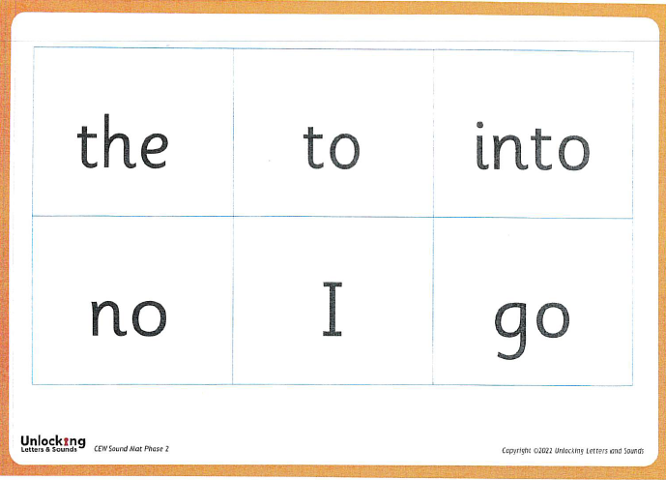
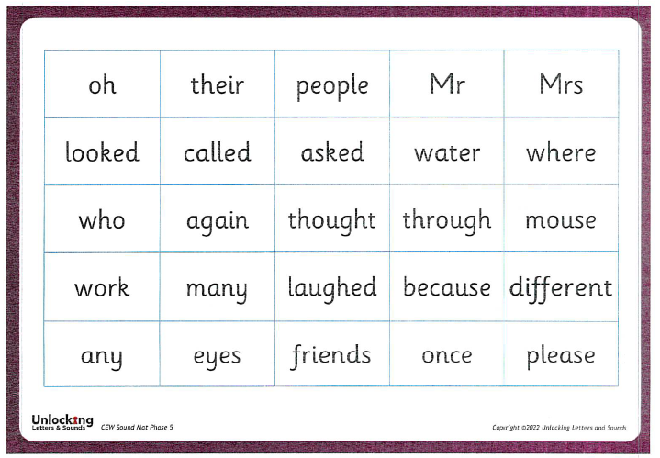
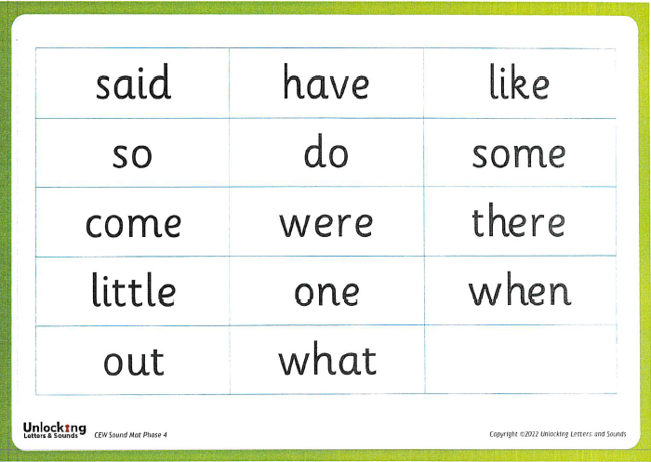
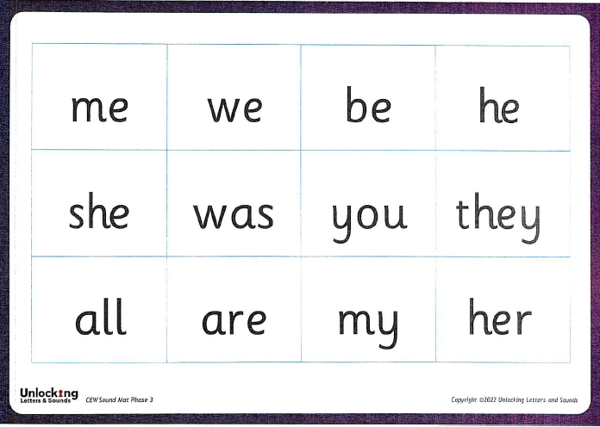
Common Exception Words
Common exception words (CEW) are words that contain one or more irregular or unusual letter phonemes that the children may not yet have been taught. These parts are the tricky parts.

Slide 18
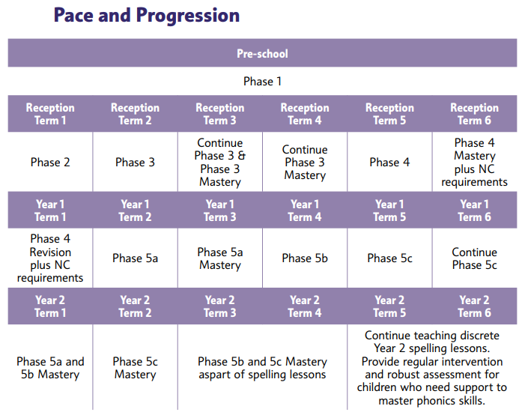
Expected
Progression

Slide 19
Phase 1: How it all starts
Phase 1 should be covered in a nursery or pre-school setting before a child starts school. We continue practising these skills throughout Reception. It focuses on:
Developing listening skills
Discriminating between environmental sounds, instrumental sounds and body sounds (e.g. clapping).
Rhyme
Alliteration
Then finally oral blending and oral segmenting

Slide 20
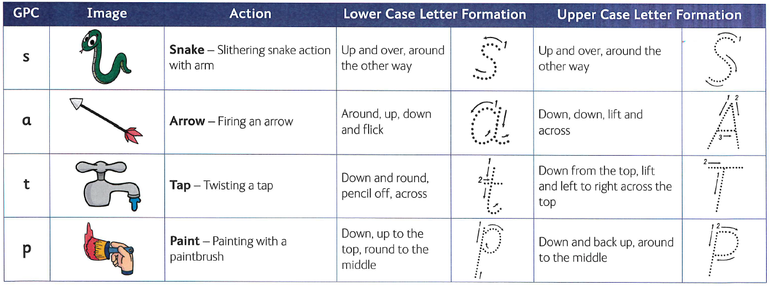
Images, Actions and Letter Formation
ULS Phase 2 Actions ULS Phase 3 Actions

Slide 21
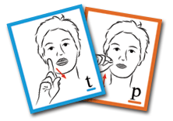
Language Provision
The children in Sharks and Frogs use cued articulation and Makaton signing to help them identify sounds and read words.
Cued Articulation was developed by a speech and language therapist called Jane Passey. It is a set of hand cues for teaching the individual sounds in a word. The hand movements are logical – each hand movement represents one sound and the cue gives clues as to how and where the sound is produced.

Slide 22
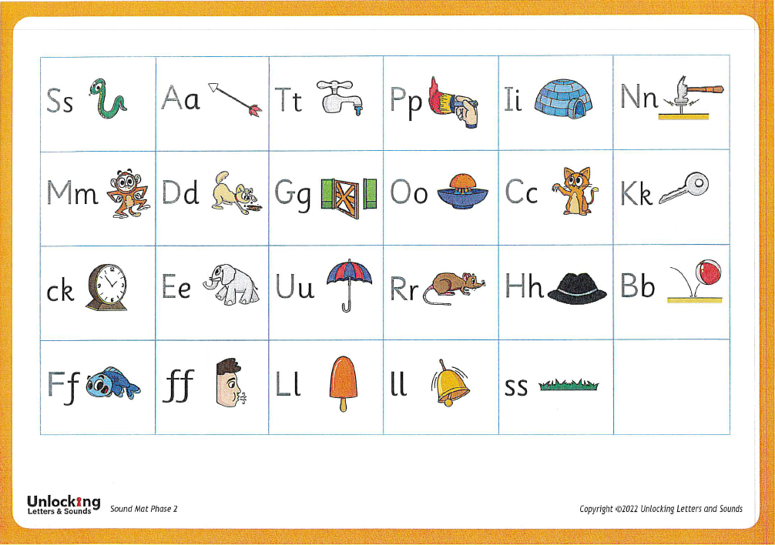
Phase 2
Letter names are also taught but the phonemes are the most essential.

Slide 23
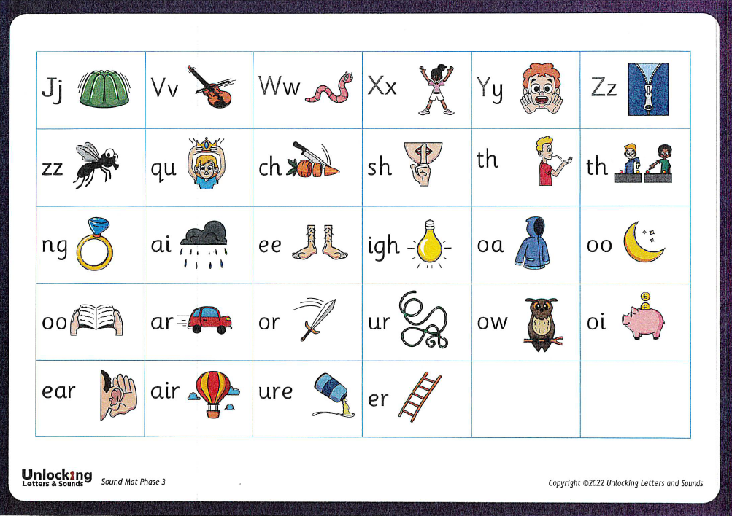
Phase 3
ring

Slide 24
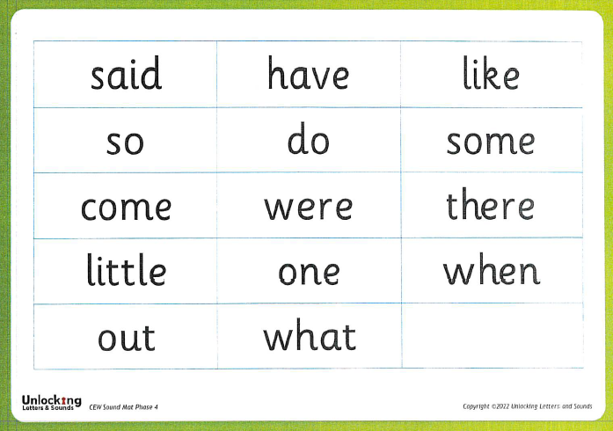
Phase 4
Adjacent consonants
Words containing adjacent consonants have two consonant sounds before and/or after a vowel sound. They are known by these spelling/sound patterns. Learning these patterns can support both reading and spelling.
CCVC words e.g. trap, drip, slip.
CVCC words e.g. milk, pink, sand.
CCVCC words e.g. black, grasp, stamp.
Polysyllabic words
A syllable is a unit of speech that contains a vowel sound and that makes up part of a word. For example:
two-syllable word – farm/er
three-syllable word – ham/bur/ger
We use ‘chunking’ to help to read and write these longer words.
thunder

Slide 25
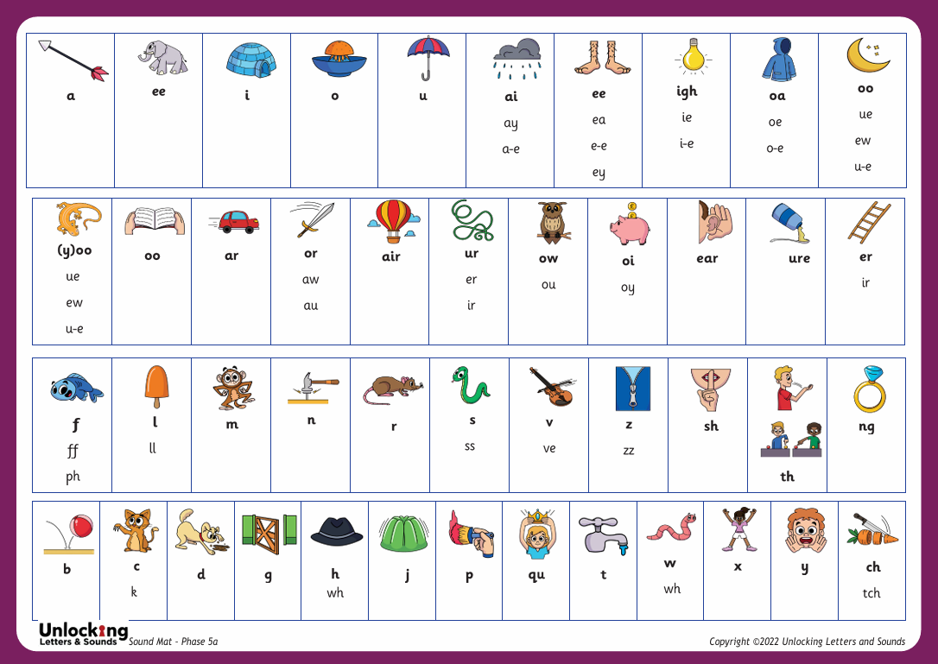
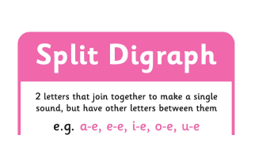

Phase 5a
Children learn that the same phoneme can be represented by different graphemes.

Slide 26
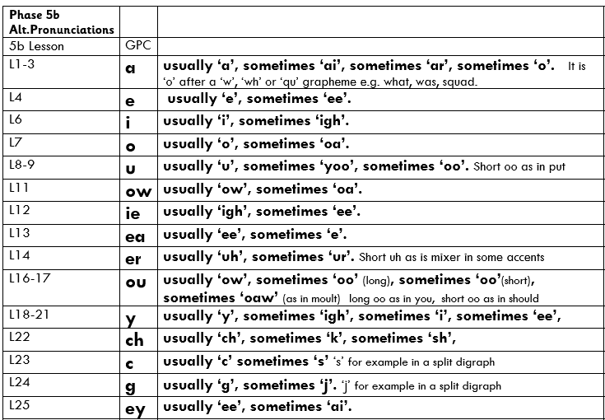
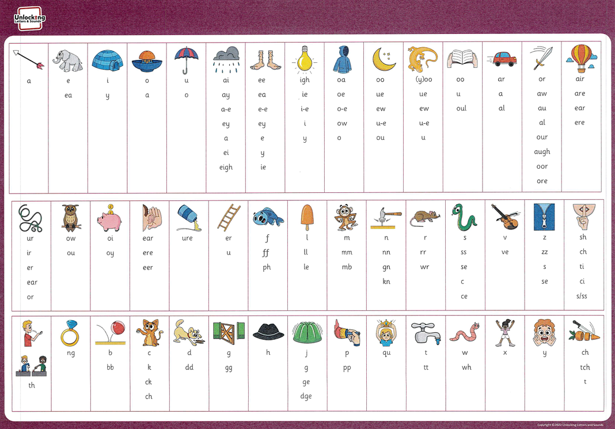
Phase 5b and 5c
Continue to learn that the same phoneme can be represented by different graphemes
AND that the same grapheme can be pronounced in different ways.
kid kind
yet hairy

Slide 27
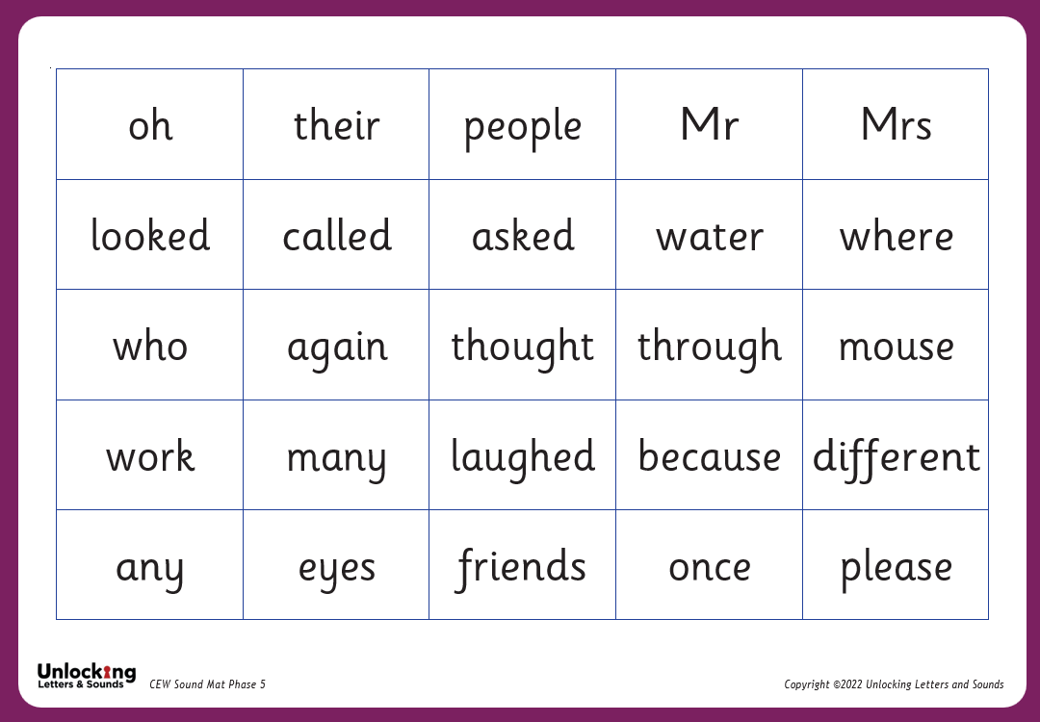
Phase 5 Common Exception Words

Slide 28
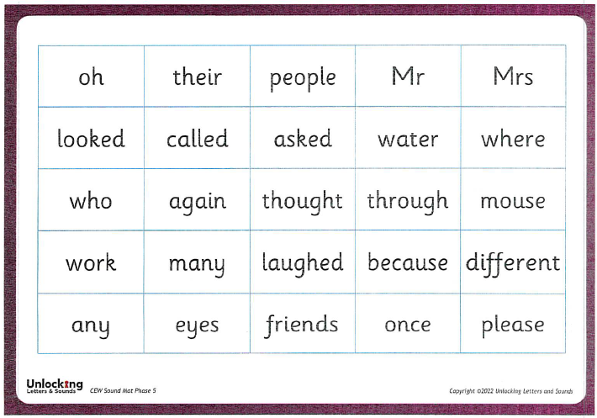
Teaching Common Exception Words
Explore the word:
  Sound it out. Does it make sense?
  Pick out the tricky phoneme.
  Explain that the letter is making a different sound, it can’t just be sounded out.
  Are there any phonic clues from other common exception words? E.g. come- some, any- many
  Repetition is the key as it needs to go into their visual memory.

Slide 29
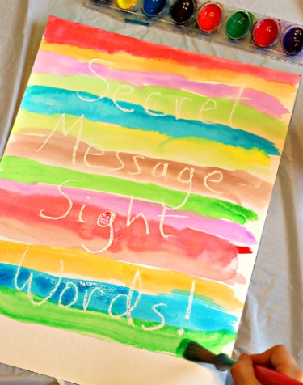
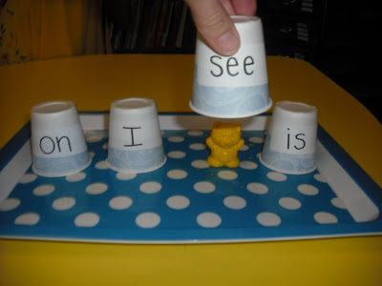
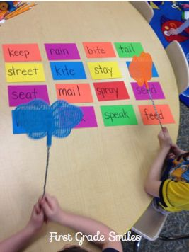
Practising Common Exception Words
  Reading the CEW mat
  Point out when you see the word in books, out shopping, etc.
  Write it (or get your child to) and pin it up to read each time
      they see it.
  Make it fun, you could:
      Have a word hunt and try to spot the word in environmental print. How many times can you find ‘was’?
      Make secret words or messages.
      Labelled cups. Where is the toy hiding?
      Play splat the word!
      Create a tricky word pairs game.

Slide 30
What Happens in Phonics Lessons?
Revisit
Teach
Practise
Apply
Revise

Slide 31
REVISIT
Activating prior knowledge, sing alphabet song, Recall of phonemes and common exception words, practise blending or fluent reading.
TEACH
Teach new grapheme-phoneme correspondences; skills of blending and segmenting; new common exception words.
PRACTISE
Practise blending for reading and segmenting for spelling (words).
APPLY
Using new learning to read and write captions or sentences.
REVISE
Revise new learning (new GPC and CEWs).

Slide 32
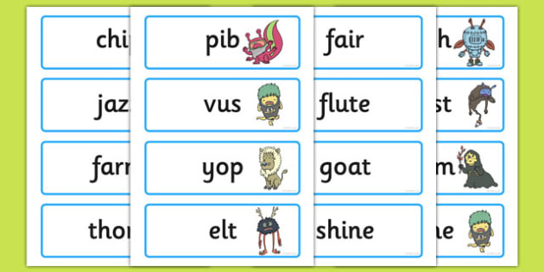
Year 1
Phonics Screening Check
At the end of Year 1, children will complete the Phonics Screening Check.
The children will read 20 real words and 20 ‘alien’ words using phonemes from Phase 2, 3 and 5.
For example:
  cheek tantrum diving strom thrand foib
Children work one to one with their teacher.
They see it as a game or extra reading time with their teacher.
There is no pressure and they are not told what words they got right or wrong.

Slide 33
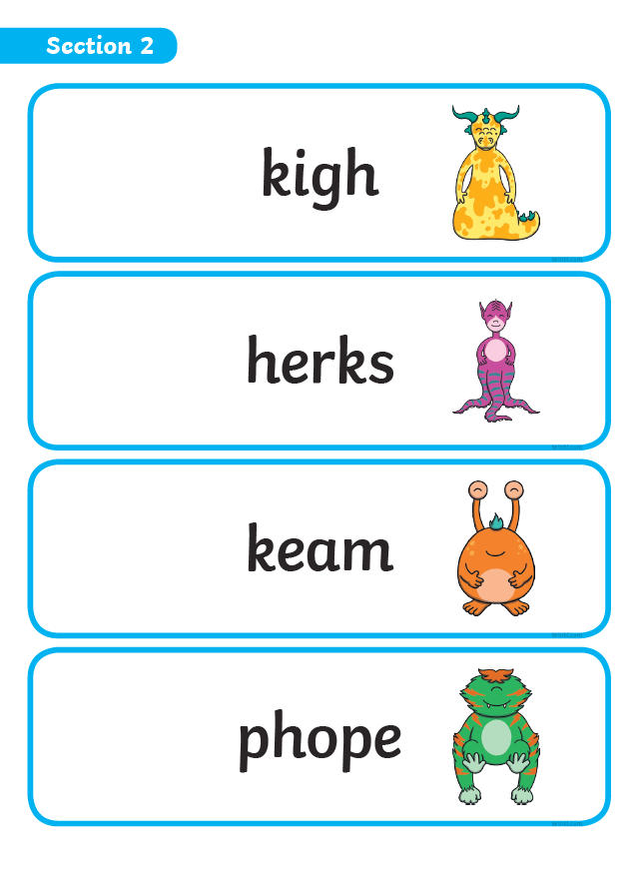
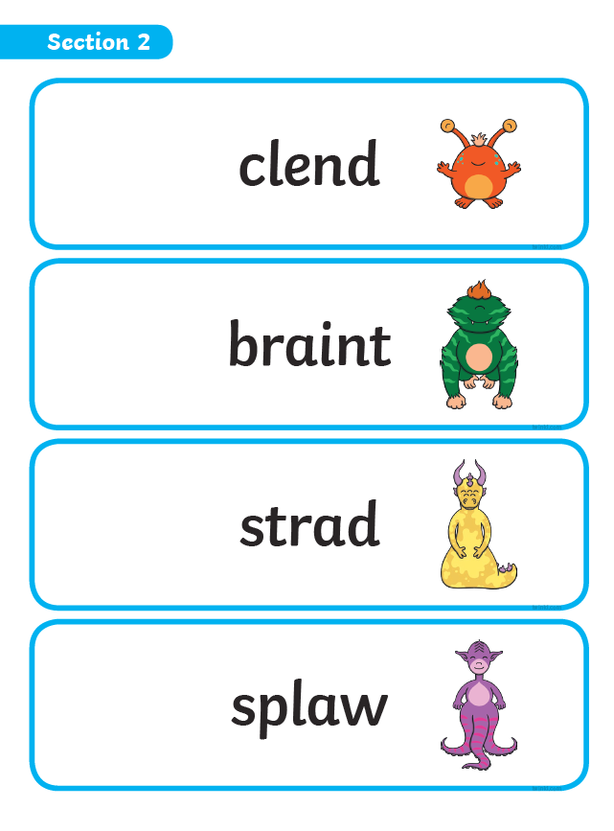
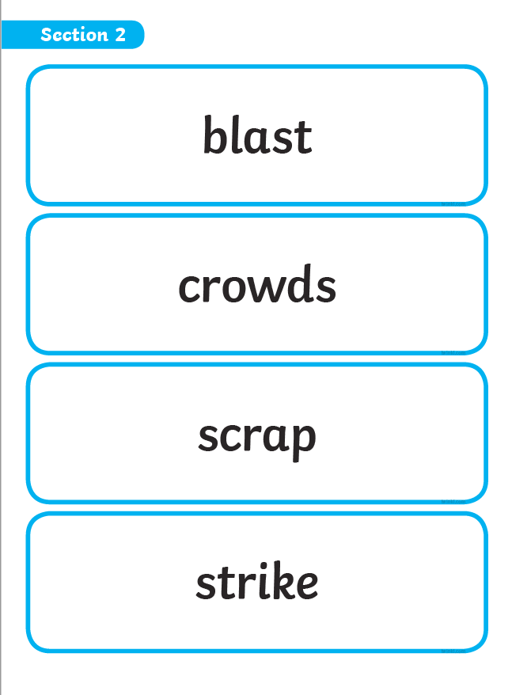
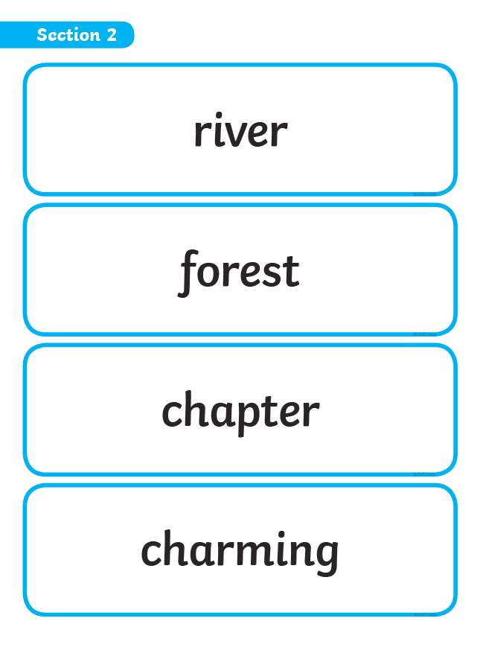
Example of the Phonics Screening Check

Slide 34
Year 1 Phonics Screening Check
Historically children need to read 32 out of the 40 words accurately to pass (however, this may change and last year is was 33).
Results are shared with parents in the end of year reports and are sent to the Bromley Local Education Authority.
If they don’t pass, extra support will be put in place in Year 2 and they will be retested at the end of the year.
This year the Phonics Screening check will take place in the two weeks beginning Monday 14th June 2027.

Slide 35
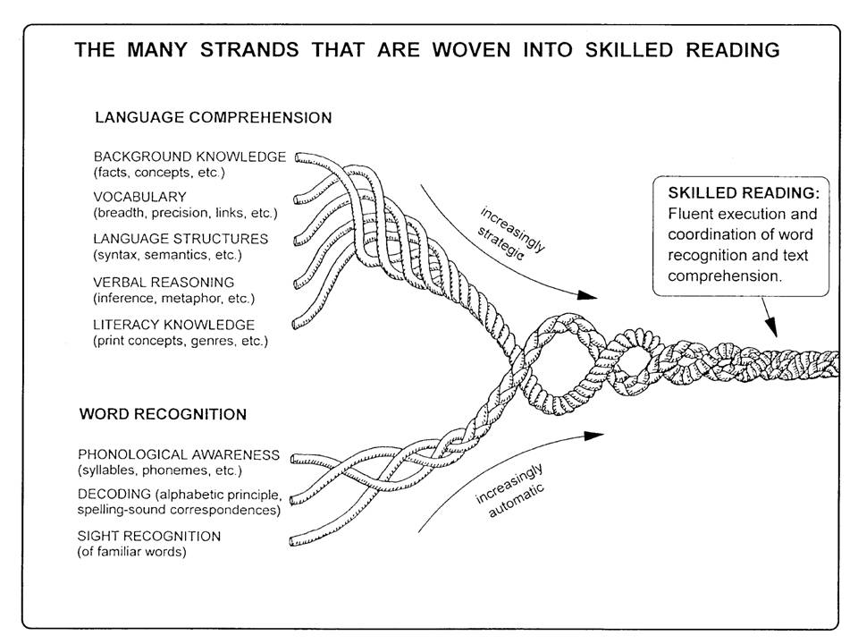
Reading

Slide 36
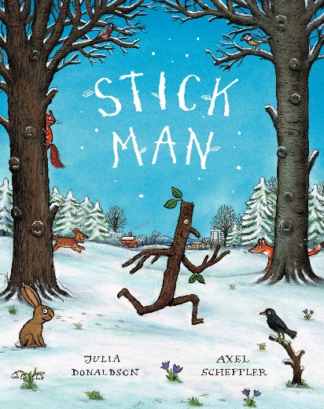
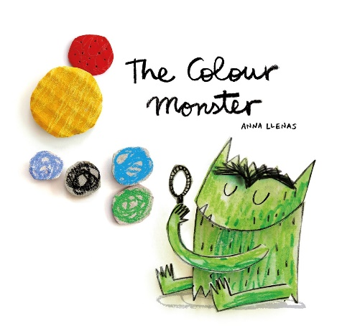
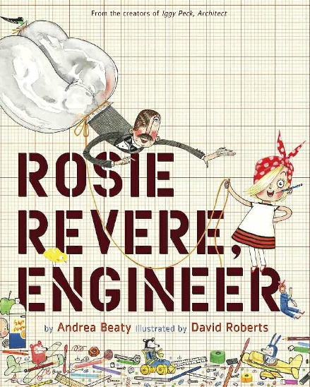
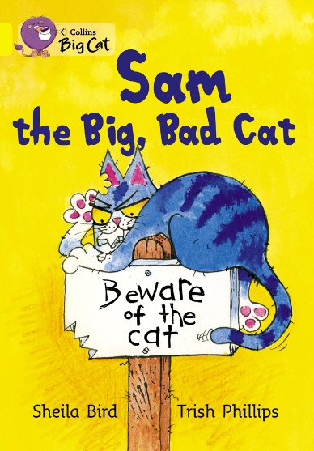
Reading in School
We believe in creating a love and excitement for reading and books.
Children have story time everyday, we explore books in our English sessions and books are available in our class libraries for children to access during ‘busy learning’ time.
We will hear each child read a colour banded reading book which matches their phonic knowledge once a week. This is usually through guided reading but might be individual reading.

Slide 37
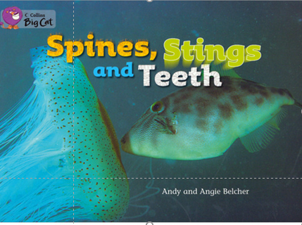
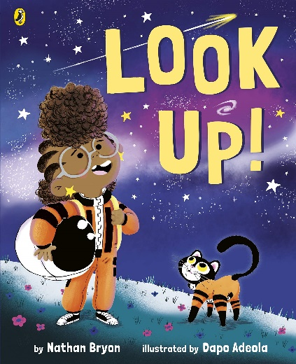
Reading at Home
In Year 1 the children change their books once a week, on set days.
The children take home:
  A colour banded reading book which is decodable and matches their phonic knowledge. They choose which book they read from a selection.
  A ‘free choice’ book they have selected from the school library for you to share at home.
Choosing books supports the development of reading for pleasure and helps the children to develop their opinions. Please ask your child: ‘Why did you choose this book?’

Slide 38
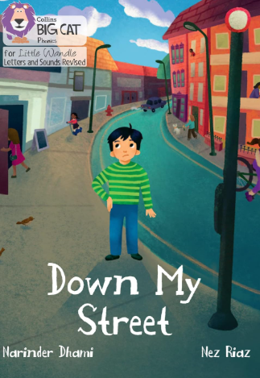
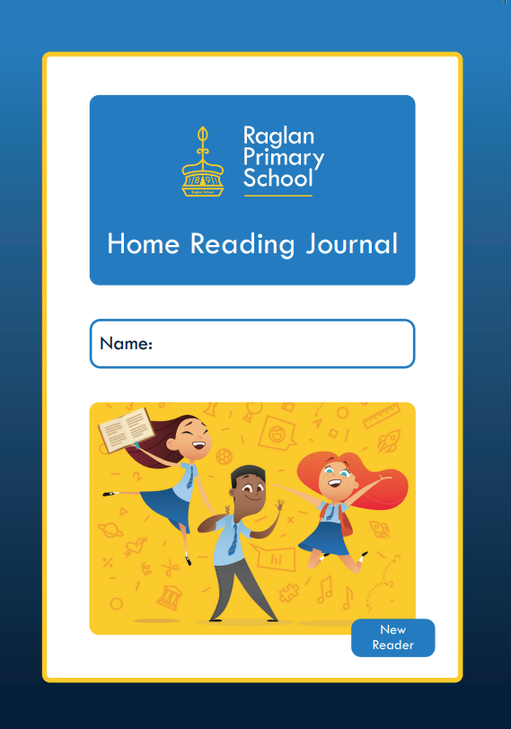
Reading at Home – Colour banded reading books
  We suggest someone at home hears the child read 3 times a week, but preferably everyday.
  Please read the book at least twice - once for word reading and at least a second time to develop prosody and comprehension skills.
  Record this is in the Home Reading Journal - write the date, title and pages read pages together with a comment e.g. “great reading” or just a signature.
  Please bring ensure their Home Reading Journal and reading book is in their bag everyday.
  The ‘free choice’ library book is not written in the Home Reading Journal.

Slide 39
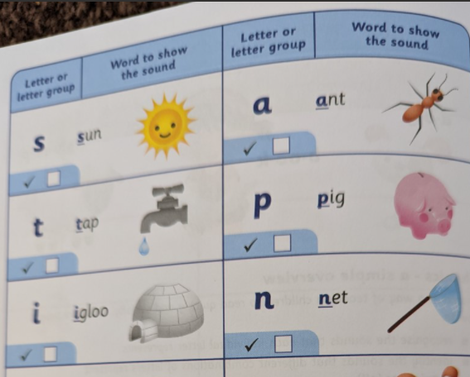
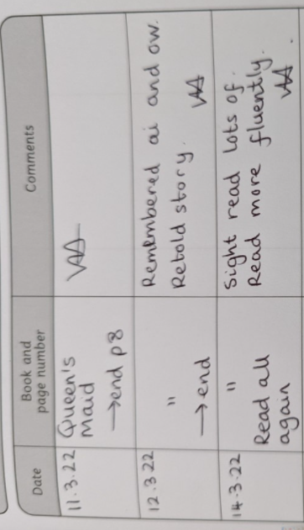
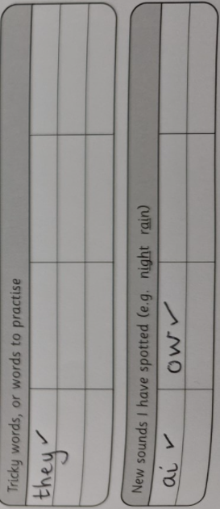
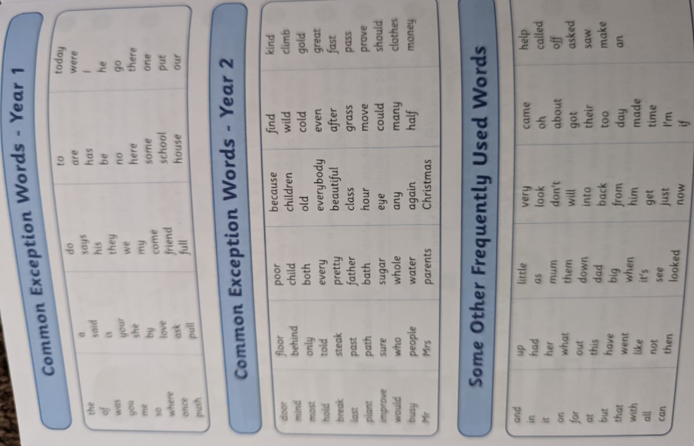
Home Reading Journal

Slide 40
Reading Books
Children are expected to:
  Read aloud accurately books that are consistent with their developing phonic knowledge (90-94% accuracy).
The teacher will assess their book bands throughout the term and make any changes they think are appropriate.

Slide 41
Developing prosody: the ‘storyteller voice’
By the end of Year 1, children are expected to:
  Re-read books to build up their fluency and confidence in word reading.
Encourage them to take note of punctuation as they read. Ask them, ‘What do you need to do when you reach a full stop?’
Encourage them to develop their expression by asking, ‘What kind of voice can you read that in?’ and ‘How might a character say that?’
Can they read their book to a sibling so that they will enjoy the story or information?
When you read to your child, model clear reading with fluency
  and expression.

Slide 42

Ask lots of questions!
Reading is not just about word reading but also about comprehension: understanding and responding to the text.
Before, during and after reading, ask them lots of questions to support their understanding and develop their discussion of books.
Encourage your child to use information from the text to answer questions and discuss the book. Remind them not to guess but to find the information and re-read if necessary
  What happened?
  How do you think they were feeling? Why?
  Why do you think they did that?
  What do you think will happen next?
  Did you enjoy this book? Why/why not?
  What was your favourite part? Why?

Slide 43

Year 1 Questions for Reading
By the end of Year 1, children are expected to:
  Discuss the significance of the title and events
  Link what they read to their own experiences
  Retell key stories, fairy stories and traditional tales
  Discuss the meaning of words
  Make inferences based upon what is being said and done
  Predict what might happen next
  Participate in discussion about texts

Slide 44

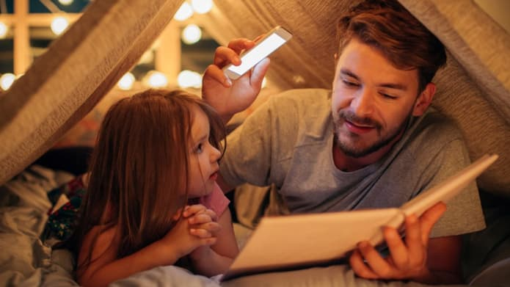
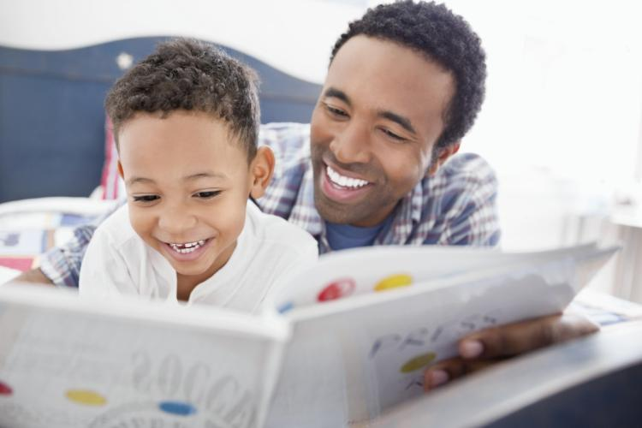
Reading at Home
Make it fun by giving characters funny voices or actions and engaging with the pictures.
Have a special time or place for reading together.
Read the books from school but also visit the library to choose new books.
Try to read a range of different texts – stories, information texts, poems, recipe books, nursery rhymes, instructions, leaflets, traditional tales and fairy stories.
By the end of Year 1, children are expected to:
  Listen to and discuss a wide range of stories, poems and non-fiction texts at a level beyond that which they can read independently.
  Recognise and join in with predictable phrases – “Come on, say it with me”
  Become very familiar with key stories, traditional tales and fairy stories – retelling the main events of the story.
Also encourage your child by ensuring they see you reading too! For both pleasure and during daily routines (recipes, instructions, signs, in the supermarket).
You can tell the children have regular opportunities to read and be read to as they experience new vocabulary which supports their writing too!

Slide 45
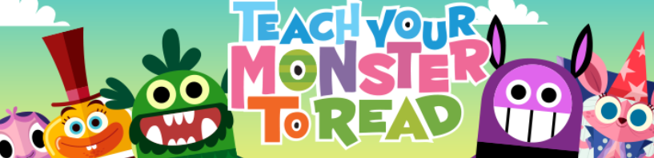
‘Teach Your Monster to Read’ is an award-winning phonics and reading game which helps children to master the key first stages of reading.
It’s free to play on a PC and laptop, or you can download the Teach Your Monster to Read app from the app store for phones and tablets. We will let you know if we find out any dates when the app is free to download.
Your child’s password card in glued inside the cover of their reading journal.

Slide 46
More information
For further information and to find today’s presentation, please visit our website and select the Phonics and Reading page. Scroll down to the bottom where you will find lots of information about reading and phonics at Raglan.
https://raglanprimary.school/phonics-reading/

Slide 47
Thank you for coming. Please do come and speak to us if you have any questions.

