Slide 1

Strong Foundations in the First Years of School

Slide 2
What are the key findings of The strong foundations in the first years of school research?
Some schools are not making sure that all children learn the foundational knowledge that they will need later. This makes it harder for children to learn at key stage 2.
Curriculums are often overloaded with activities that do not focus on helping children to build fluency in foundational knowledge and skills.
Schools do not always allocate enough time for children to practise what they have been taught so that they remember it.
Curriculums, particularly in some Reception classes, leave children’s learning too much to chance. When there is a choice about whether to take part, some children, often those who need the most teaching and practice, opt out.
When schools identify weaknesses in children’s knowledge, skills and behaviour, they do not always consider carefully enough how the curriculum or teaching approaches might need to be adapted to compensate.
Schools introduce complex reading and writing tasks too early. They do not give children enough teaching and practice for them to become fluent in foundational knowledge and skills, such as in handwriting and composing simple sentences.

Slide 3
What are the recommendations of The strong foundations in the first years of school research?
Schools should:
make sure that the curriculum clearly identifies the foundational knowledge and skills, as outlined in the EYFS and national curriculum, that children will need for later learning
give children sufficient high-quality opportunities to practise using foundational knowledge and skills so that they become fluent – “Practice makes permanent.”
choose teaching methods that are suited to what is being taught and what children already know
make sure that assessment picks up children’s misunderstandings quickly and gives teachers early opportunities to help children who need extra teaching and practice

Slide 4
Foundational knowledge and skills in writing
Handwriting: Fine motor skills, gross motor skills, correct pencil grip, correct writing position, letter and number formation.
Sentence composition: Oral composition and rehearsal, understanding that a sentence needs a subject (who) and verb (what doing), using appropriate vocabulary (say it better).
Spelling: Common exception words and using phonics/spelling knowledge to spell words.
Demarcation: Capital letters, finger spaces and full stops.
What are the most important foundational knowledge and skills children must secure in your year group?

Slide 5
Responsive teaching
Taking account of the children’s starting points and meeting their next steps. “As fast as possible but as slow as needed.”
How have you adapted the curriculum/learning for all of the children’s next steps?
How are you ensuring the children are gaining extra practice at the foundational skills they need?
In the moment feedback: responding to misconceptions/ mistakes in the foundational skills through immediate verbal feedback. Purple Pen. Addressing:
Pencil grip/sitting position
Sentence composition through oral composition and rehearsal
Letter formation
Capital letters, finger spaces and full stops
Spelling – common exception words and using phonics/spelling knowledge.

Slide 6
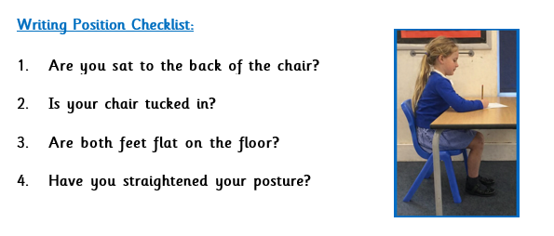
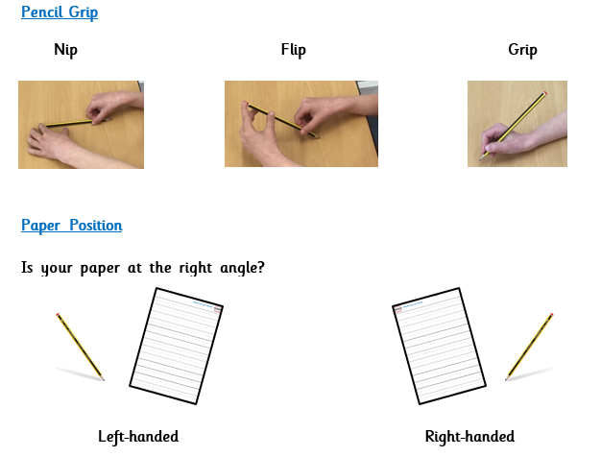
Ensuring children are ready to write
Which children do not have the correct pencil grip?
What is in place to support them in the classroom? E.g. pencil grips.
“Nip, flip, grip”
Which children are left-handed?
Are they seated carefully? Do they have space for writing? Are they tilting their book/paper in the correct direction?
Ensure children are following the getting ready for writing routines and have the correct writing position.
“Show me you are ready to write.”

Slide 7
Oral sentence composition and rehearsal
What is your sentence?
Repeat sentence back to children and improve as necessary e.g. ensuring subject (who) and verb (what doing).
Support sentence development: Can you use an adjective/conjunction?
“My turn. Your turn.”
Ask child to repeat the sentence back to ensure they know each word they are going to write.

Slide 8
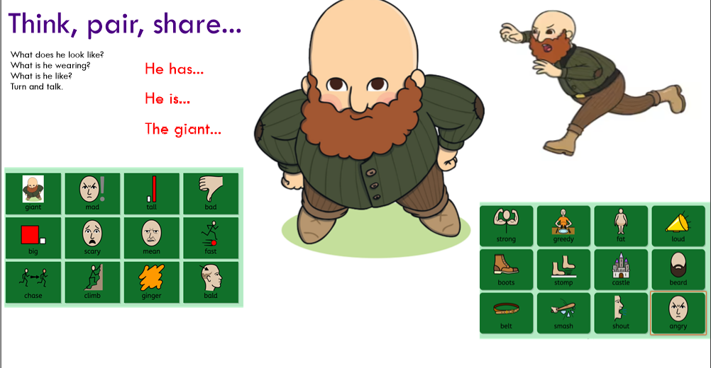

Slide 9
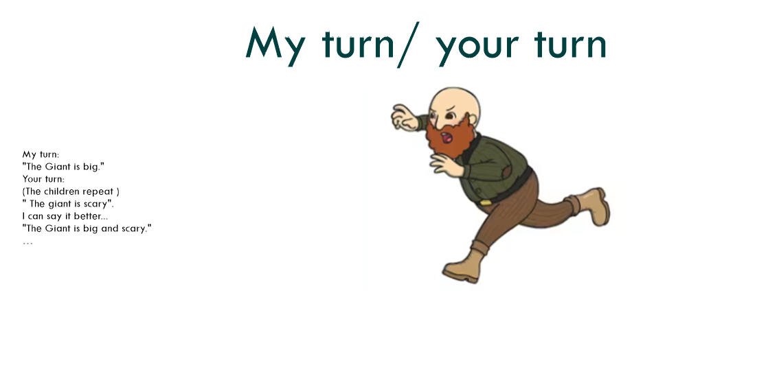

Slide 10
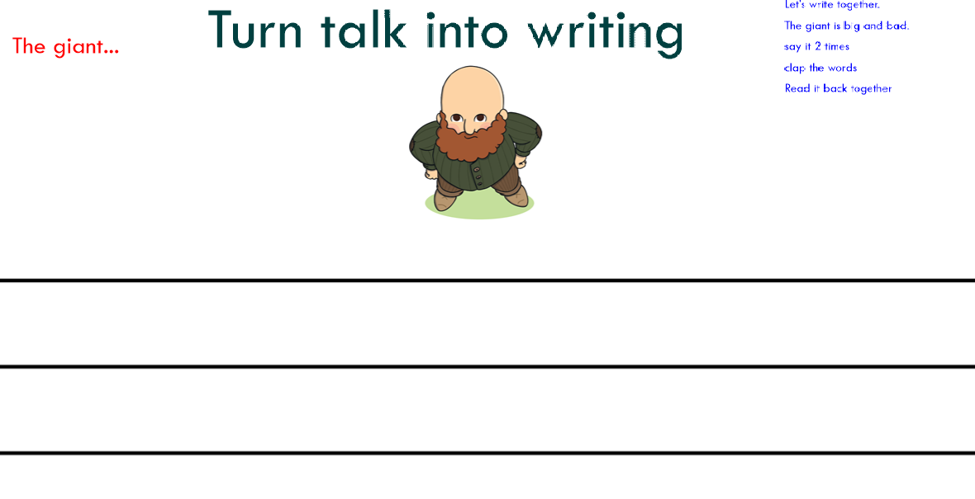

Slide 11
Complexity of the writing task
English and literacy curriculums, more than mathematics, tend to introduce complex tasks too early. Therefore, children do not learn foundational knowledge properly.
“Practice makes permanent.”
Sentence focus not a genre focus.
Break down the writing task to specific sentence goals.
Chunk the writing inputs/teacher modelling so the children only have to think of 1 or 2 sentences at a time.
Less is more
Ensure there are not too many WELLs – what skill do you want to focus on?
“As fast as possible but as slow as needed.”
Ensure time for oral composition and rehearsal.

Slide 12
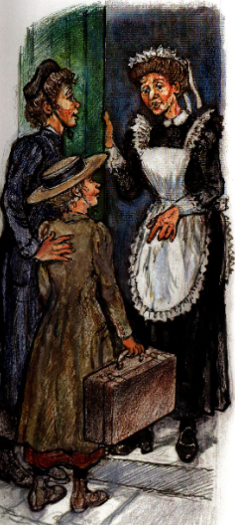
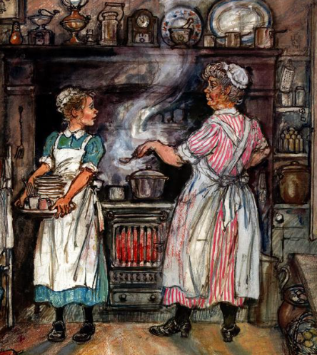
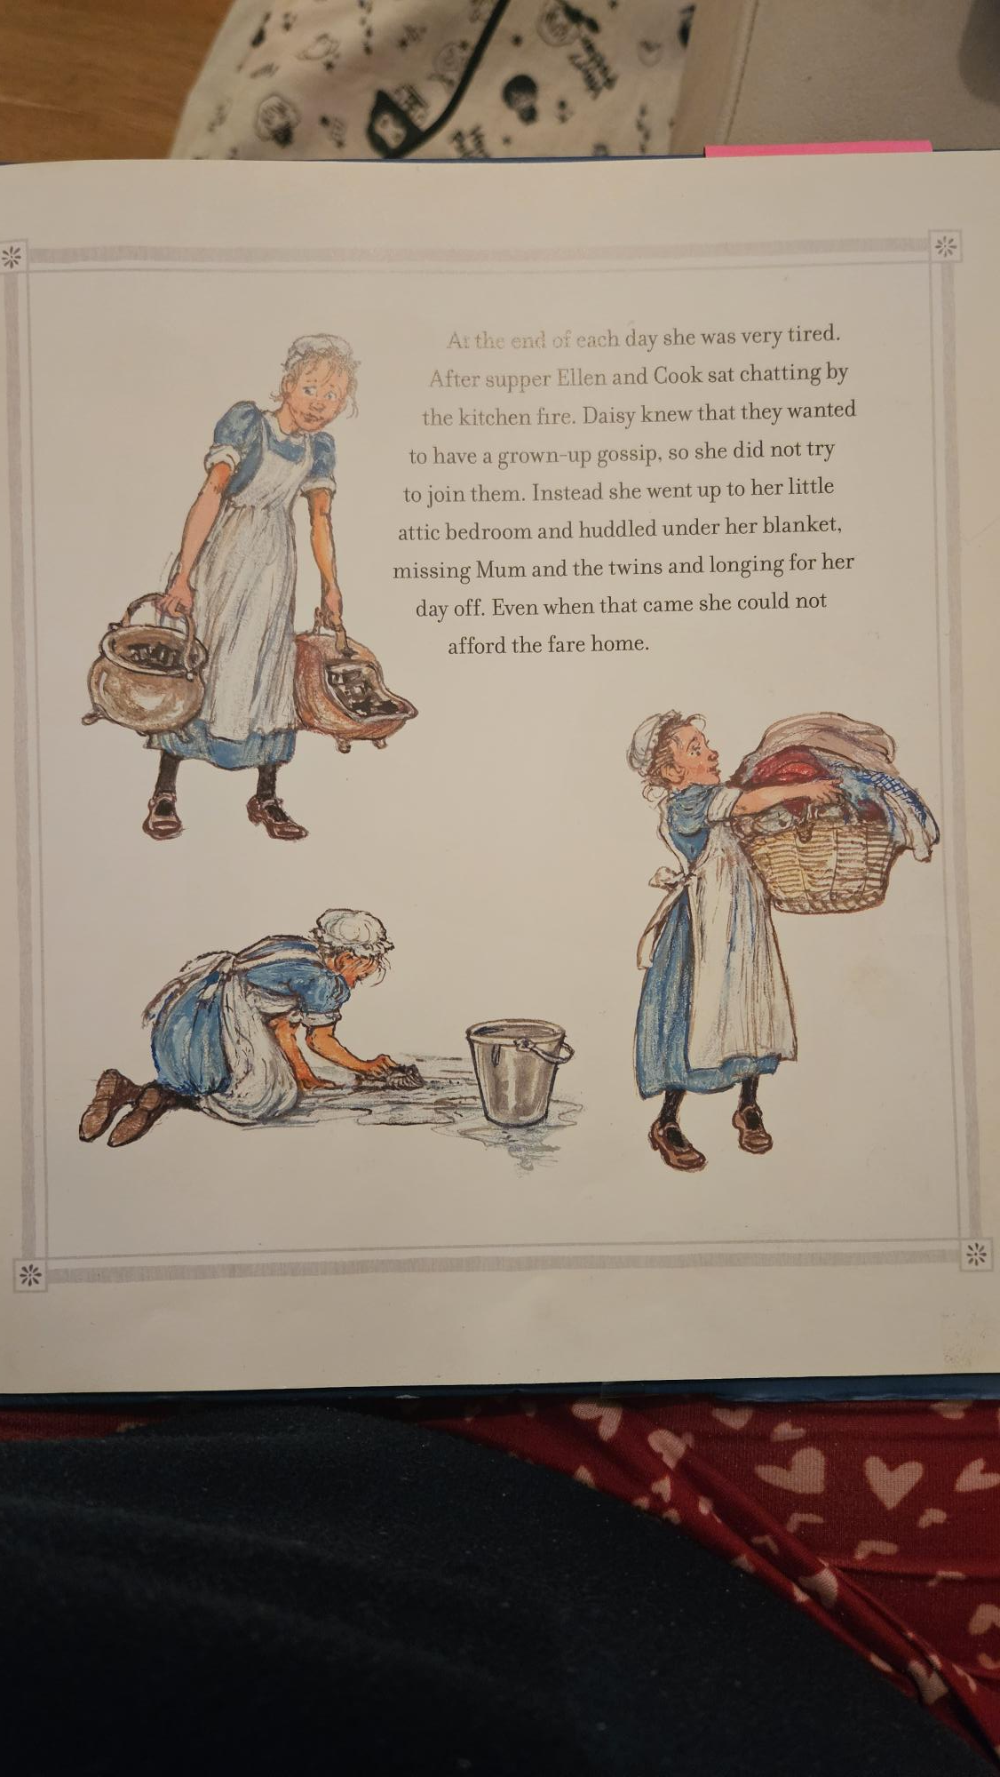
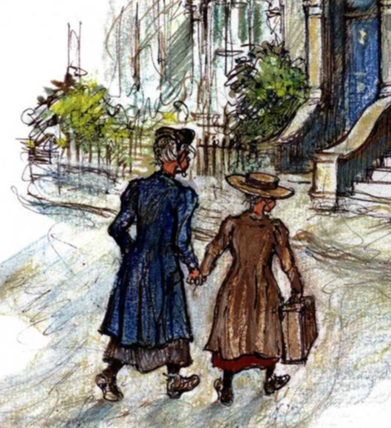
Lesson 1: To write sentences using conjunctions
1 Sentence for each picture.

Slide 13
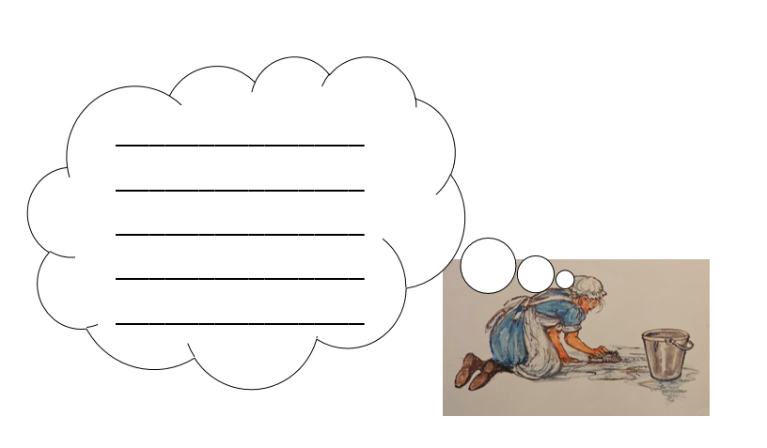

Lesson 2: To write sentences in the first person
1 Sentence for each thought bubble.

Slide 14
Lesson 3: To write in the first person as Daisy
2 sentences for each picture/event.
1 sentence explaining what I did
1 sentence explaining how I felt
Chunk the input for each picture/event.

Slide 15
Lesson 3: To write in the first person as Daisy
2 sentences for each picture/event.
1 sentence explaining what I did
1 sentence explaining how I felt
Chunk the input for each picture/event.

Slide 16
Key things to remember:
Foundational skills in writing:
Handwriting: Fine motor skills, gross motor skills, correct pencil grip (Nip, Flip, Grip), correct writing position (Show me you are ready to write), letter and number formation.
Sentence composition: Oral composition and rehearsal (My turn, your turn.), a sentence needs a subject (who) and verb (what doing), using appropriate vocabulary (Say it better.)
Spelling: Common exception words and using phonics/spelling knowledge to spell words.
Demarcation: Capital letters, finger spaces and full stops.
All adults are actively engaged.
Writing tasks are not too complex and focus on the foundational skills and sentence goals.
Responsive teaching: meeting the children’s next steps and in the moment feedback.
Opportunities for talk: developing and using appropriate vocabulary and oral composition.
Ensure support is available but not too overwhelming.

