Slide 1
Can you make some words using these sounds?
s a t p i n m d

Slide 2

Phonics and Early Reading

Slide 3
Overview of the session…
What is phonics?
Why do we teach phonics?
Phonics terminology
How phonics is taught at Raglan – Unlocking Letters and Sounds
Early Reading at Raglan

Slide 4
What is phonics?
Phonics is a way of teaching children how to read and write.
Phonics teaches children to listen carefully and identify the smallest units of sound (phonemes) that make up words.
Children learn how to link these phonemes with graphemes (the letters used to represent these sounds).

Slide 5
Why do we teach phonics?
Children should be taught to use phonic knowledge and skills as the route to decode words
National Curriculum in England 2014

Slide 6
Why do we teach phonics?
Using phonics is the most efficient way to decode words and so we should be teaching children to tackle print using phonics as their primary strategy.

Slide 7
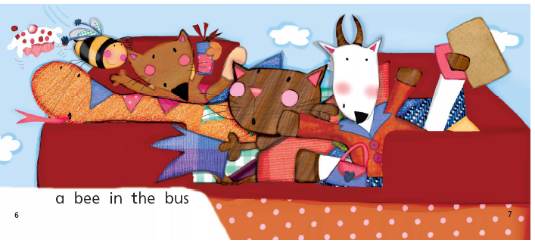
What caption do you think would go with this picture?

Slide 8
What caption do you think would go with this picture?

Slide 9
Why do we teach phonics?
Picture clues – encourages guessing through looking at illustrations as we saw in the exercise this is highly unreliable.
Semantic clues - rely on context to guess at an unknown word for example "The monkey ate a …......."
Syntactic clues - use the structure of the sentence to guess at an unknown word for example "The monkey (noun) ate (verb) a …...... (likely to be a noun)"

Slide 10
Phoneme
A phoneme (sound) is the smallest unit of sound in a word. There are approximately 44 phonemes in English.
/c/as in c-a-t, or /sh/as in sh-i-p

Slide 11
Grapheme
A grapheme is a letter or sequence of letters that represent a phoneme (one sound).
s t ch

Slide 12
Grapheme Phoneme Correspondences
Grapheme Phoneme Correspondences (GPCs) are the relationships between phonemes (sounds) and graphemes (written letters).
t ai igh

Slide 13
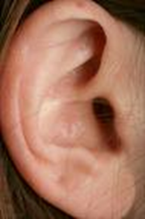

Remember…
A phoneme you hear
A grapheme you see

Slide 14
Pronunciation
Phoneme and example word
s | sit | a | ant | t | tin | p | pip
i | ink | n | nap | m | map | d | dig
g | got | o | on | c | cot | k | kit
ck | pick | e | peg | u | up | r | run
h | hot | b | bat | f | fan | l | lap
j | jog | v | vet | w | web | x | mix
y | yap | z | zip | zz | buzz | qu | quiz
ch | chop | sh | shed | th | thin | th | then
ng | ring | ai | rain | ee | feet | igh | night
oa | boat | oo | boot | oo | look | ar | park
or | sort | ur | curl | ow | cow | oi | coin
ear | dear | air | fair | ure | sure | er | better

Slide 15
CVC words
Consonants (C) and vowels (V) in CVC words relate to the phonemes (sounds) rather than the alphabetic letters.
p i n d o g s h e e p n i g h t

Slide 16
Digraph
A digraph is a single sound (phoneme) that is made up of two letters, e.g.
ai ee sh oa ch
Examples of words that contain digraphs can be found below:
rain
feet
shop
boat
chip

Slide 17
Trigraph
A trigraph is a single sound (a phoneme) that is made up of three letters.
igh ear air
Examples of trigraphs can be found below:
light
hear
hair

Slide 18
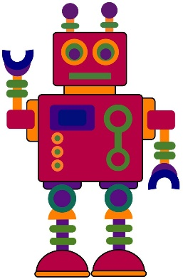
Oral Blending and Segmenting
Oral Blending is hearing spoken sounds and merging them together to make words. For example, ‘m-a-t’ makes ‘mat’.
Oral segmenting is splitting a word into its individual phonemes in order to spell it.
These skills are taught before learning the letters and continue through their phonics learning.

Slide 19
Blending for Reading & Sound Buttons
To be able to read a word children need to be able to:
1. Identify the grapheme-phoneme correspondences in a written word: c oa t
2. Blend them in the correct order to pronounce the word: ‘coat’
Sound buttons help recognition of GPCs. A dot shows that the sound is made from a single letter and a line shows that the sound is made from a digraph or trigraph.
sheep
chick

Slide 20
Segmenting
Segmenting is the opposite of blending. Segmenting a word is to break the word down into its phonemes, e.g. hat= h-a-t. Segmenting enables children to break down words they are trying to spell.
What sounds can you hear in ‘pig’?
p | i | g

Slide 21
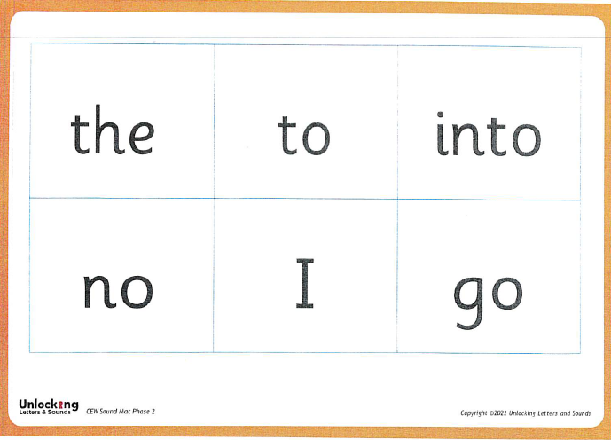
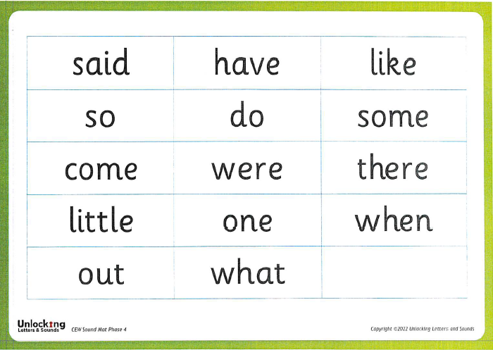
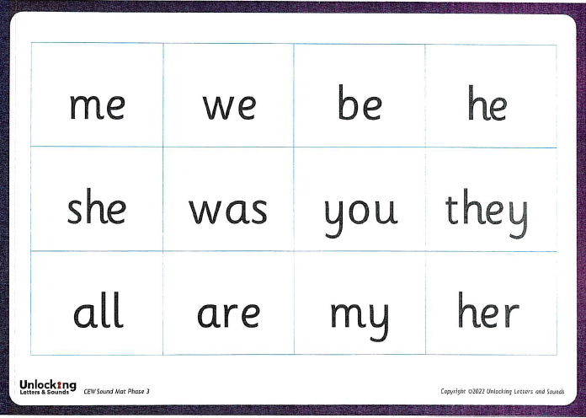
Common Exception Words
Common exception words (CEW) are words that contain one or more irregular or unusual letter phonemes that the children may not yet have been taught. These parts are the tricky parts.

Slide 22
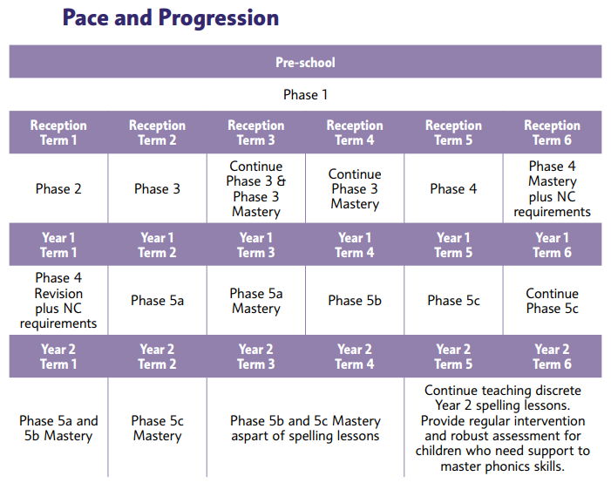
Progression

Slide 23
Phase 1: How it all starts
Phase 1 should be covered in a nursery or pre-school setting before a child starts school. We continue practising these skills throughout Reception. It focuses on:
Developing listening skills
Discriminating between environmental sounds, instrumental sounds and body sounds (e.g. clapping).
Rhyme
Alliteration
Then finally oral blending and oral segmenting

Slide 24
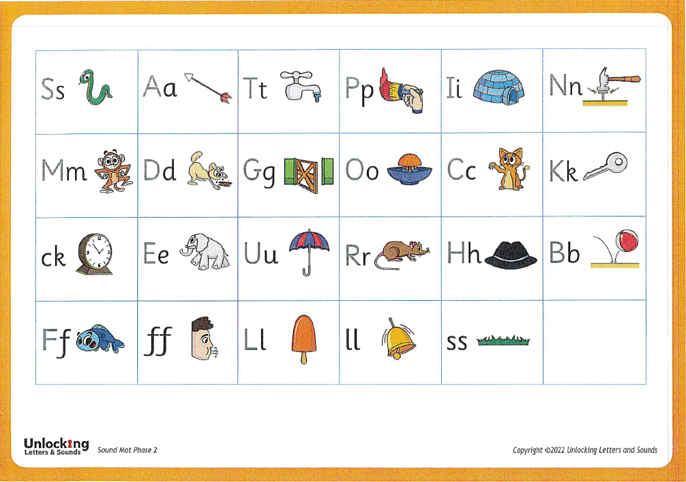
Phase 2
Letter names are also taught but the phonemes are the most essential.

Slide 25
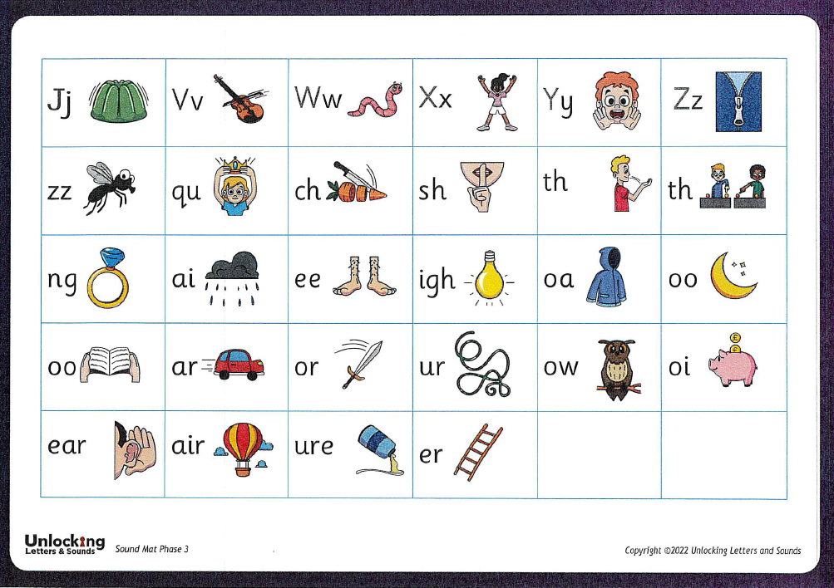
Phase 3

Slide 26
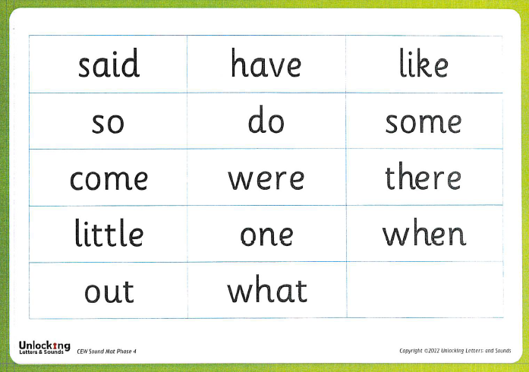
Phase 4
Adjacent consonants
Words containing adjacent consonants have two consonant sounds before and/or after a vowel sound. They are known by these spelling/sound patterns. Learning these patterns can support both reading and spelling.
CCVC words e.g. trap, drip, slip.
CVCC words e.g. milk, pink, sand.
CCVCC words e.g. black, grasp, stamp.
Polysyllabic words
A syllable is a unit of speech that contains a vowel sound and that makes up part of a word. For example:
two-syllable word – farm/er
three-syllable word – ham/bur/ger

Slide 27
Teaching Common Exception Words
Explore the word:
  Sound it out. Does it make sense?
  Pick out the tricky phoneme.
  Explain that the letter is making a different sound, it can’t just be sounded out.
  Repetition is the key as it needs to go into their visual memory.

Slide 28
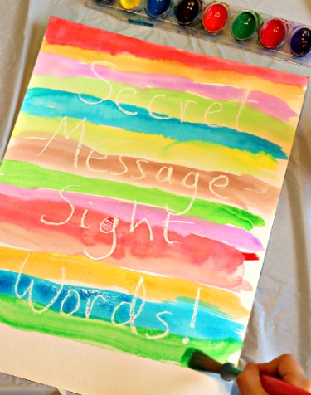
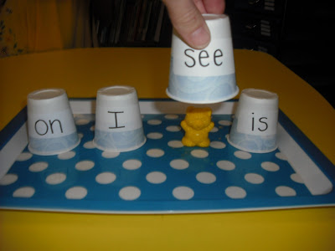
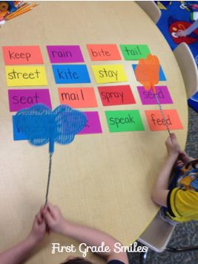
Practising Common Exception Words
  Reading the CEW mat
  Point out when you see the word in books, out shopping, etc.
  Write it (or get your child to) and pin it up to read each time
      they see it.
  Make it fun, you could:
      Have a word hunt and try to spot the word in environmental print. How many times can you find ‘was’?
      Make secret words or messages.
      Labelled cups. Where is the toy hiding?
      Play splat the word!
      Create a tricky word pairs game.

Slide 29
What Happens in Phonics Lessons?
Revisit
Teach
Practise
Apply
Revise

Slide 30
REVISIT
Activating prior knowledge, sing alphabet song, Recall of phonemes and common exception words, practise blending or fluent reading.
TEACH
Teach new grapheme-phoneme correspondences; skills of blending and segmenting; new common exception words.
PRACTISE
Practise blending for reading and segmenting for spelling (words).
APPLY
Using new learning to read and write captions or sentences.
REVISE
Revise new learning (new GPC and CEWs).

Slide 31
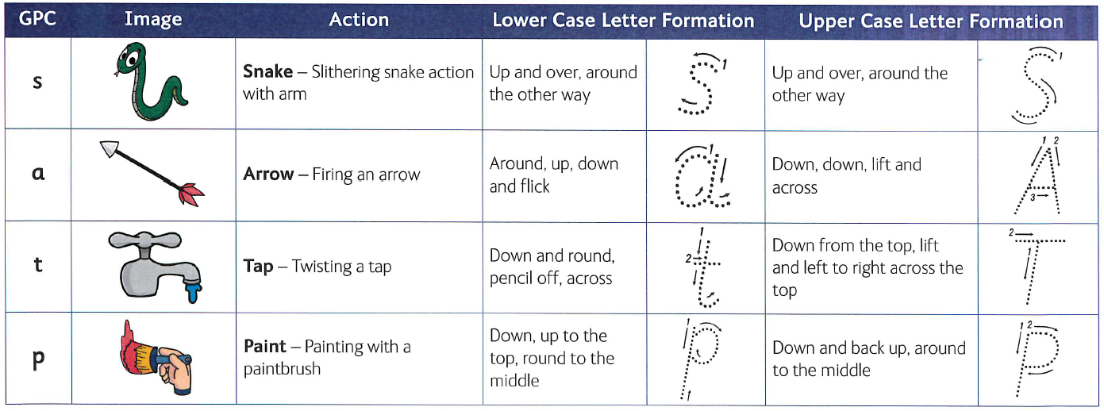
Images, Actions and Letter Formation
ULS Phase 2 Actions ULS Phase 3 Actions

Slide 32
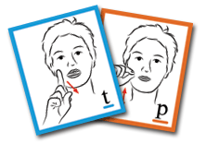
Language Provision
The children in Sharks use cued articulation and Makaton signing to help them identify sounds and read words.
Cued Articulation was developed by a speech and language therapist called Jane Passey. It is a set of hand cues for teaching the individual sounds in a word. The hand movements are logical – each hand movement represents one sound and the cue gives clues as to how and where the sound is produced.

Slide 33
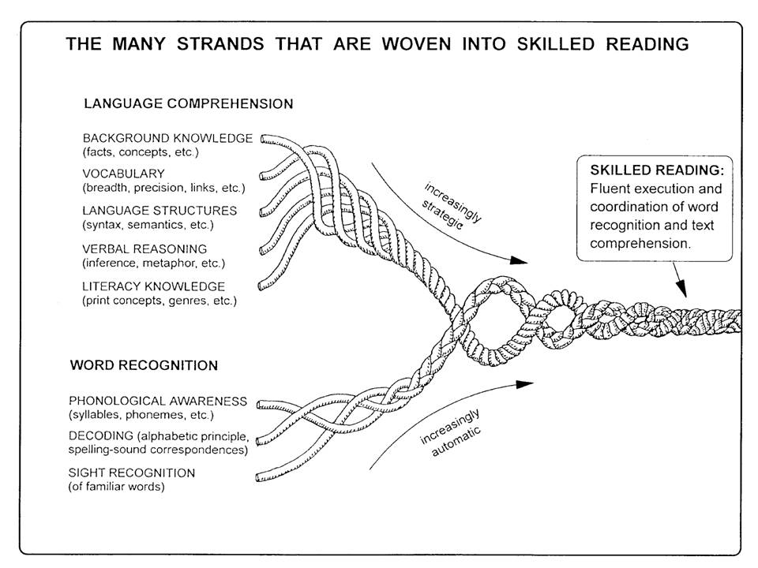
Reading

Slide 34
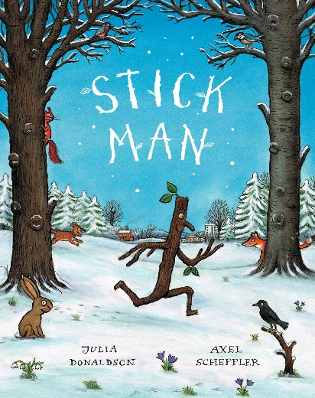
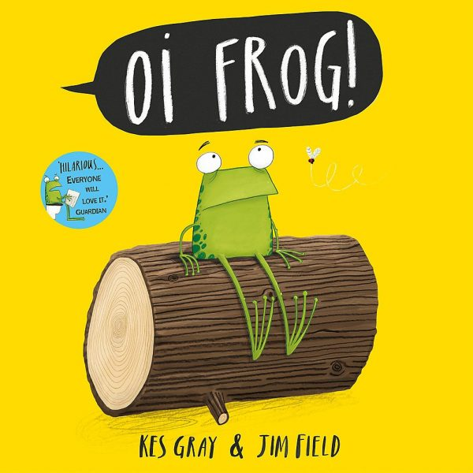
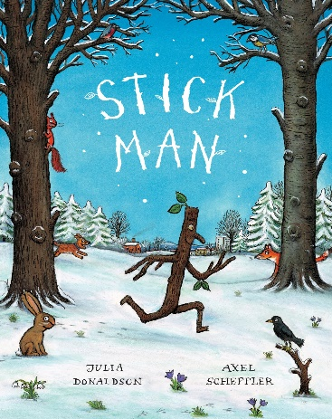

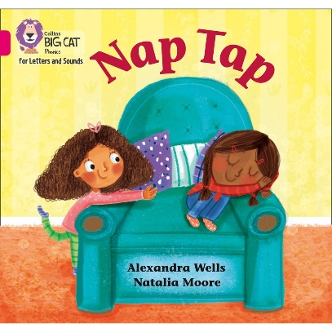
Reading in School
We believe in creating a love and excitement for reading and books.
Children have story time everyday, we explore books in our Literacy sessions and books are available in our class libraries for children to access during continuous provision.
We will hear each child read a colour banded reading book which matches their phonic knowledge at least once a week. This is usually through guided reading but might be individual reading.

Slide 35
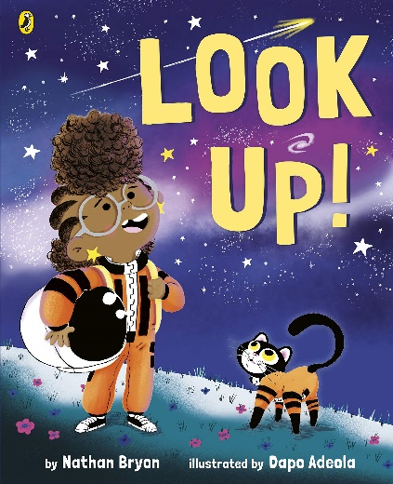
Reading at Home
In Reception and Sharks the children change their books once a week, on set days.
The children take home:
  A colour banded reading book which is decodable and matches their phonic knowledge. They choose which book they read from a selection.
  A ‘free choice’ book they have selected from the class library for you to share at home.
Choosing books supports the development of reading for pleasure and helps the children to develop their opinions. Please ask your child: ‘Why did you choose this book?’

Slide 36
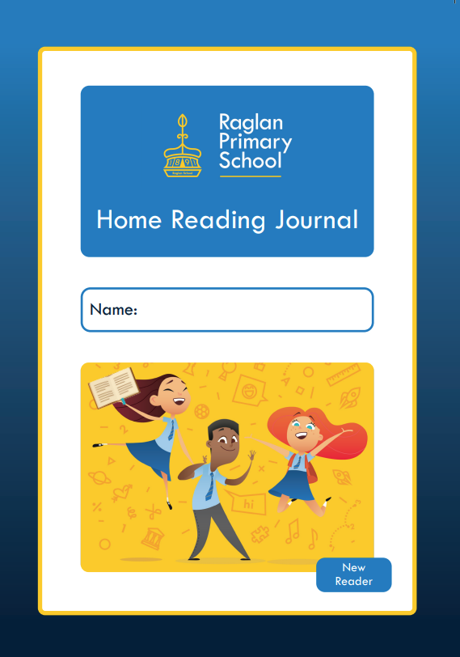
Reading at Home – Colour banded reading books
  We suggest someone at home hears the child read 3 times a week, but preferably everyday.
  Please read the book at least twice - once for word reading and at least a second time to develop prosody and comprehension skills.
  Record this is in the Home Reading Journal - write the date, title and pages read pages together with a comment e.g. “great reading” or just a signature.
  Please bring ensure their Home Reading Journal and reading book is in their bag everyday.

Slide 37
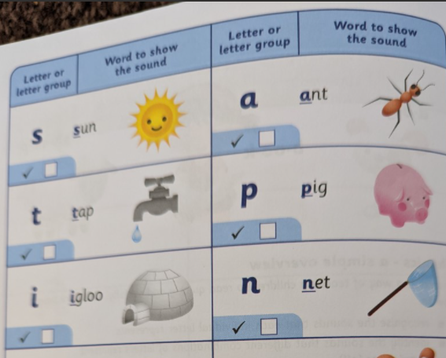
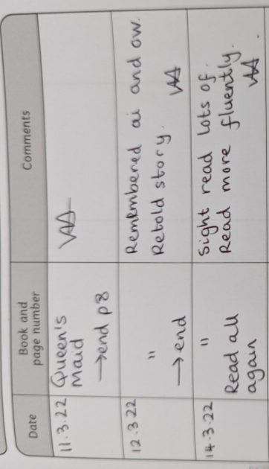
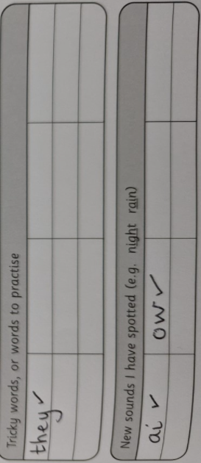
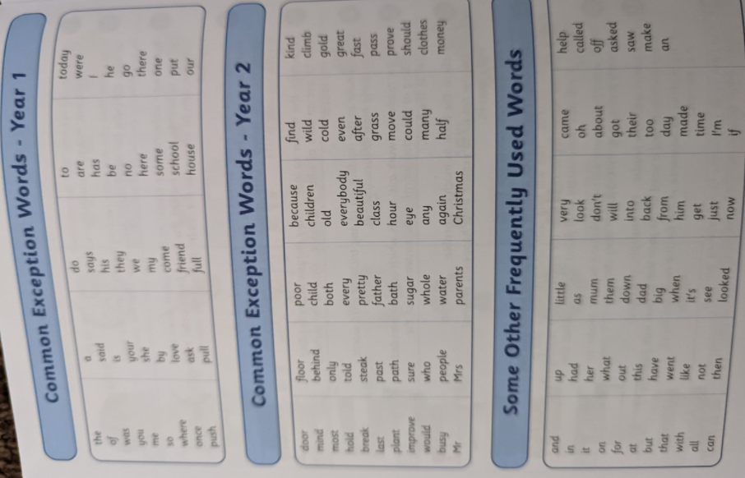
Home Reading Journal

Slide 38

Ask lots of questions!
Reading is not just about word reading but also about comprehension: understanding and responding to the text.
Before, during and after reading, ask them lots of questions to support their understanding and develop their discussion of books.
Encourage your child to use information from the text to answer questions and discuss the book.
  What happened?
  How do you think they were feeling? Why?
  Why do you think they did that?
  What do you think will happen next?
  Did you enjoy this book? Why/why not?
  What was your favourite part? Why?

Slide 39



Reading at Home
Make it fun by giving characters funny voices or actions and engaging with the pictures.
Have a special time or place for reading together.
Read the books from school but also visit the library to choose new books.
Try to read a range of different texts – stories, information texts, poems, recipe books, nursery rhymes, instructions, leaflets, traditional tales and fairy stories.
Also encourage your child by ensuring they see you reading too! For both pleasure and during daily routines (recipes, instructions, signs, in the supermarket).

Slide 40
More information
For further information and to find today’s presentation, please visit our website and select the Phonics and Reading page. Scroll down to the bottom where you will find lots of information about reading and phonics at Raglan:
https://raglanprimary.school/phonics-reading/

Slide 41

Thank you for your continued support

