Slide 1
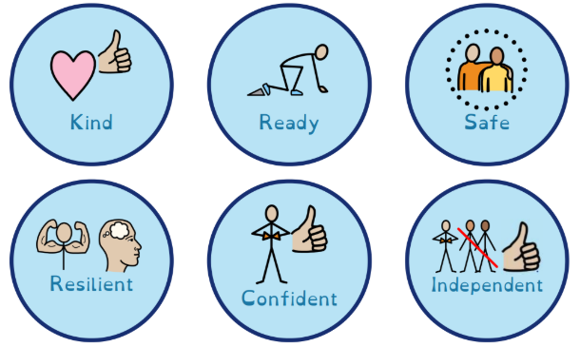
Our Raglan Character Virtues
The ‘I Can Do It’ Award
PSHE
Relation and Sex Education (‘Yasmin and Tom’)
Consent Education
Online Safety (Purple Mash)
Healthy Living
Science Learning
Physical Education and Sport Lessons
Sports Clubs at Lunchtimes, Before and After-school
Healthy Eating (Healthy Schools Award)
British Values
Assemblies and Curriculum
The Raglan Curriculum Drivers
The Raglan Character Virtues Access here
Extra Curricular Opportunities Access here
Sport, Music and the Performing Arts
Gymnastics
Robotics
Art
Raglan Primary School Personal Development Provision
Equality, Diversity and Inclusion
Agents for Change Program
The promotion of the Protected Characteristics
SEND / SEMH Children have access to all clubs and the curriculum as a whole.
Gifted and Talented
The school identifies children that show an aptitude for an area – whatever the area is
The school provides pathways for children to join external to school clubs to develop their talent
SMSC
Visits to centres of different faith/worship
Parent and Faith Leader assemblies
RE Curriculum

