Slide 1
Language Provision Assessment System

Slide 2
B Squared Assessment System
B Squared is an assessment system used to track the progress of children with SEND (Special Educational Needs).
This year, the Language Provision have started to use Connecting Steps, assessment software provided by B Squared.
It is an online assessment system that allows those working with children with SEND to track their progress.
B Squared and Connecting Steps breaks down each curriculum strand into smaller, manageable and achievable steps for those children with SEND.
Allows teachers to identify the children’s next steps moving forward.
Allows teachers to assess ALL children on one system.

Slide 3
Areas that we assess at Raglan
A broad and balanced curriculum is taught in the Language Provision.
We use Connecting Steps to assess the children in the following areas of learning:
English
Reading
Writing
Speaking and Listening
Maths
Number
Measurement
Geometry
Statistics

Slide 4
Areas that we assess at Raglan
In the Language Provision, we use the Primary Steps assessment framework.
It is based on the National Curriculum and ranges from Progression Step 1 up to Year 6.
Levels are broken down into manageable and achievable steps.
Each child has their own starting point.
We assess children each term – this informs teachers of each child’s next steps and is used to inform planning.
Children in Reception are assessed using Development Matters which helps children meet the Early Years Foundation Stage Framework.

Slide 5
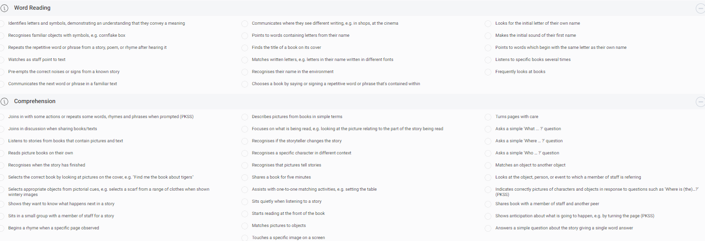
Reading Progression Step 1

Slide 6
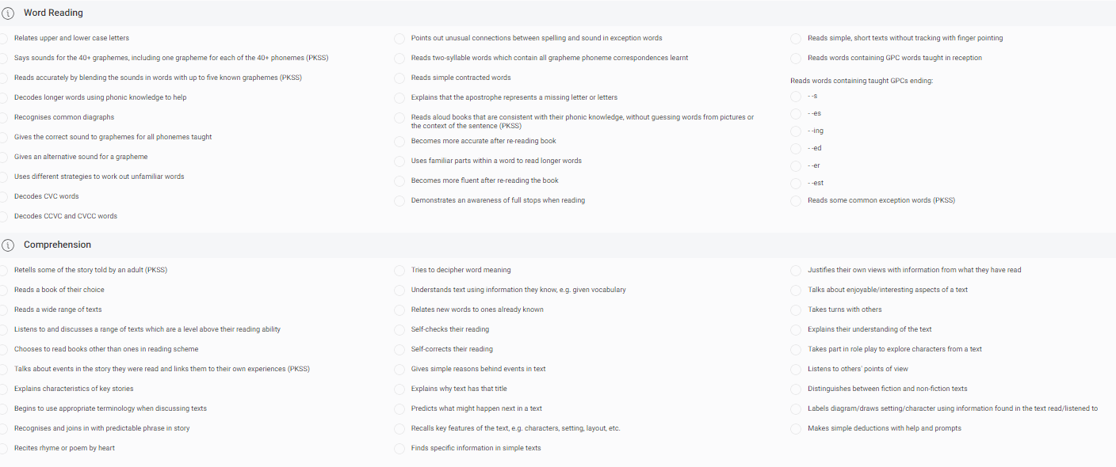
Reading Year 1

Slide 7
How we assess at Raglan in the Language Provision
Connecting Steps software – B Squared Primary Steps assessment framework.
Designed for pupils in primary settings working below age-related expectations or below Year 1.
The Primary Steps assessment framework breakdown contains end of year outcomes taken directly from the National Curriculum.
Broken down into smaller steps so that teachers can show progress and identify next steps.
The Primary Steps assessment framework includes the first three Progression Steps levels for pupils working below Year 1.

Slide 8
How we assess using Connecting Steps
Each curriculum strand for English and Maths are assessed by the class teacher, with support from the Speech and Language Therapists for Speaking and Listening.
In Sharks class, a continuous provision approach allows the children to access learning to develop their independence and confidence, as well as small focus groups, 1:1 learning and whole class teaching.
In Frogs class, children are taught in small focus groups, including 1:1 where applicable, as well as whole class teaching.
Planning for these curriculum areas is based upon the National Curriculum, broken down into the small steps provided by Connecting Steps.

Slide 9
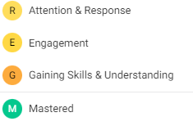
Achievement Types
We use 4 achievement types to determine when a child has “mastered” a step within their curriculum strand.
When a child has mastered their skill, with confidence and independence, this adds to their percentage of progress.

Slide 10
Measuring Progress Percentages
Each step that has been mastered will add to a percentage to determine a child’s progress.
Progress is measured by a percentage for each area of learning in English and Maths.
For example, a child may have mastered 50% of the Year 1 curriculum in Reading.
80% is our confidence bracket for the children in the Language Provision.
When a child has achieved 80% of the level (e.g. 80% of Year 1 in Reading), they will move onto the next level for that area of learning.

Slide 11
Measuring Progress
When measuring progress, class teachers look at each child’s individual starting point. No child comes into the Language Provision at the same starting point. This is key to remember as all of the children have individual learning strengths and needs.
Each term, class teachers work out a percentage of progress within the level the child is working at, by indicating which smaller steps the children have mastered that term.
The termly percentages of progress are then measured across the year.
Expected progress in the Language Provision is measured at 20% progress per term – this equates to 60% across the year.

Slide 12
Reporting to Parents and Carers
Parents will receive 3 reports per year:
Autumn Term
Spring Term
Summer Term
Each report will display a percentage and level to show your child’s progress. For example:
X has achieved 30% of Progression Step 2
X has achieved 56% of the Year 1 Curriculum

Slide 13
Reporting to Parents and Carers
In the term that you have an Annual Review for your child, a termly parent’s report will not be sent out.
The Class Teacher Report for the Annual Review will be a highly detailed report, including the progress that your child has made since their last Annual Review.
Parent’s Evening – if you have an Annual Review in the same term as a parent/teacher conference, an appointment will not need to be made.
Parent’s evenings are for the discussion of achievements and next steps, which will have been outlined and discussed at the Annual Review.

