Slide 2
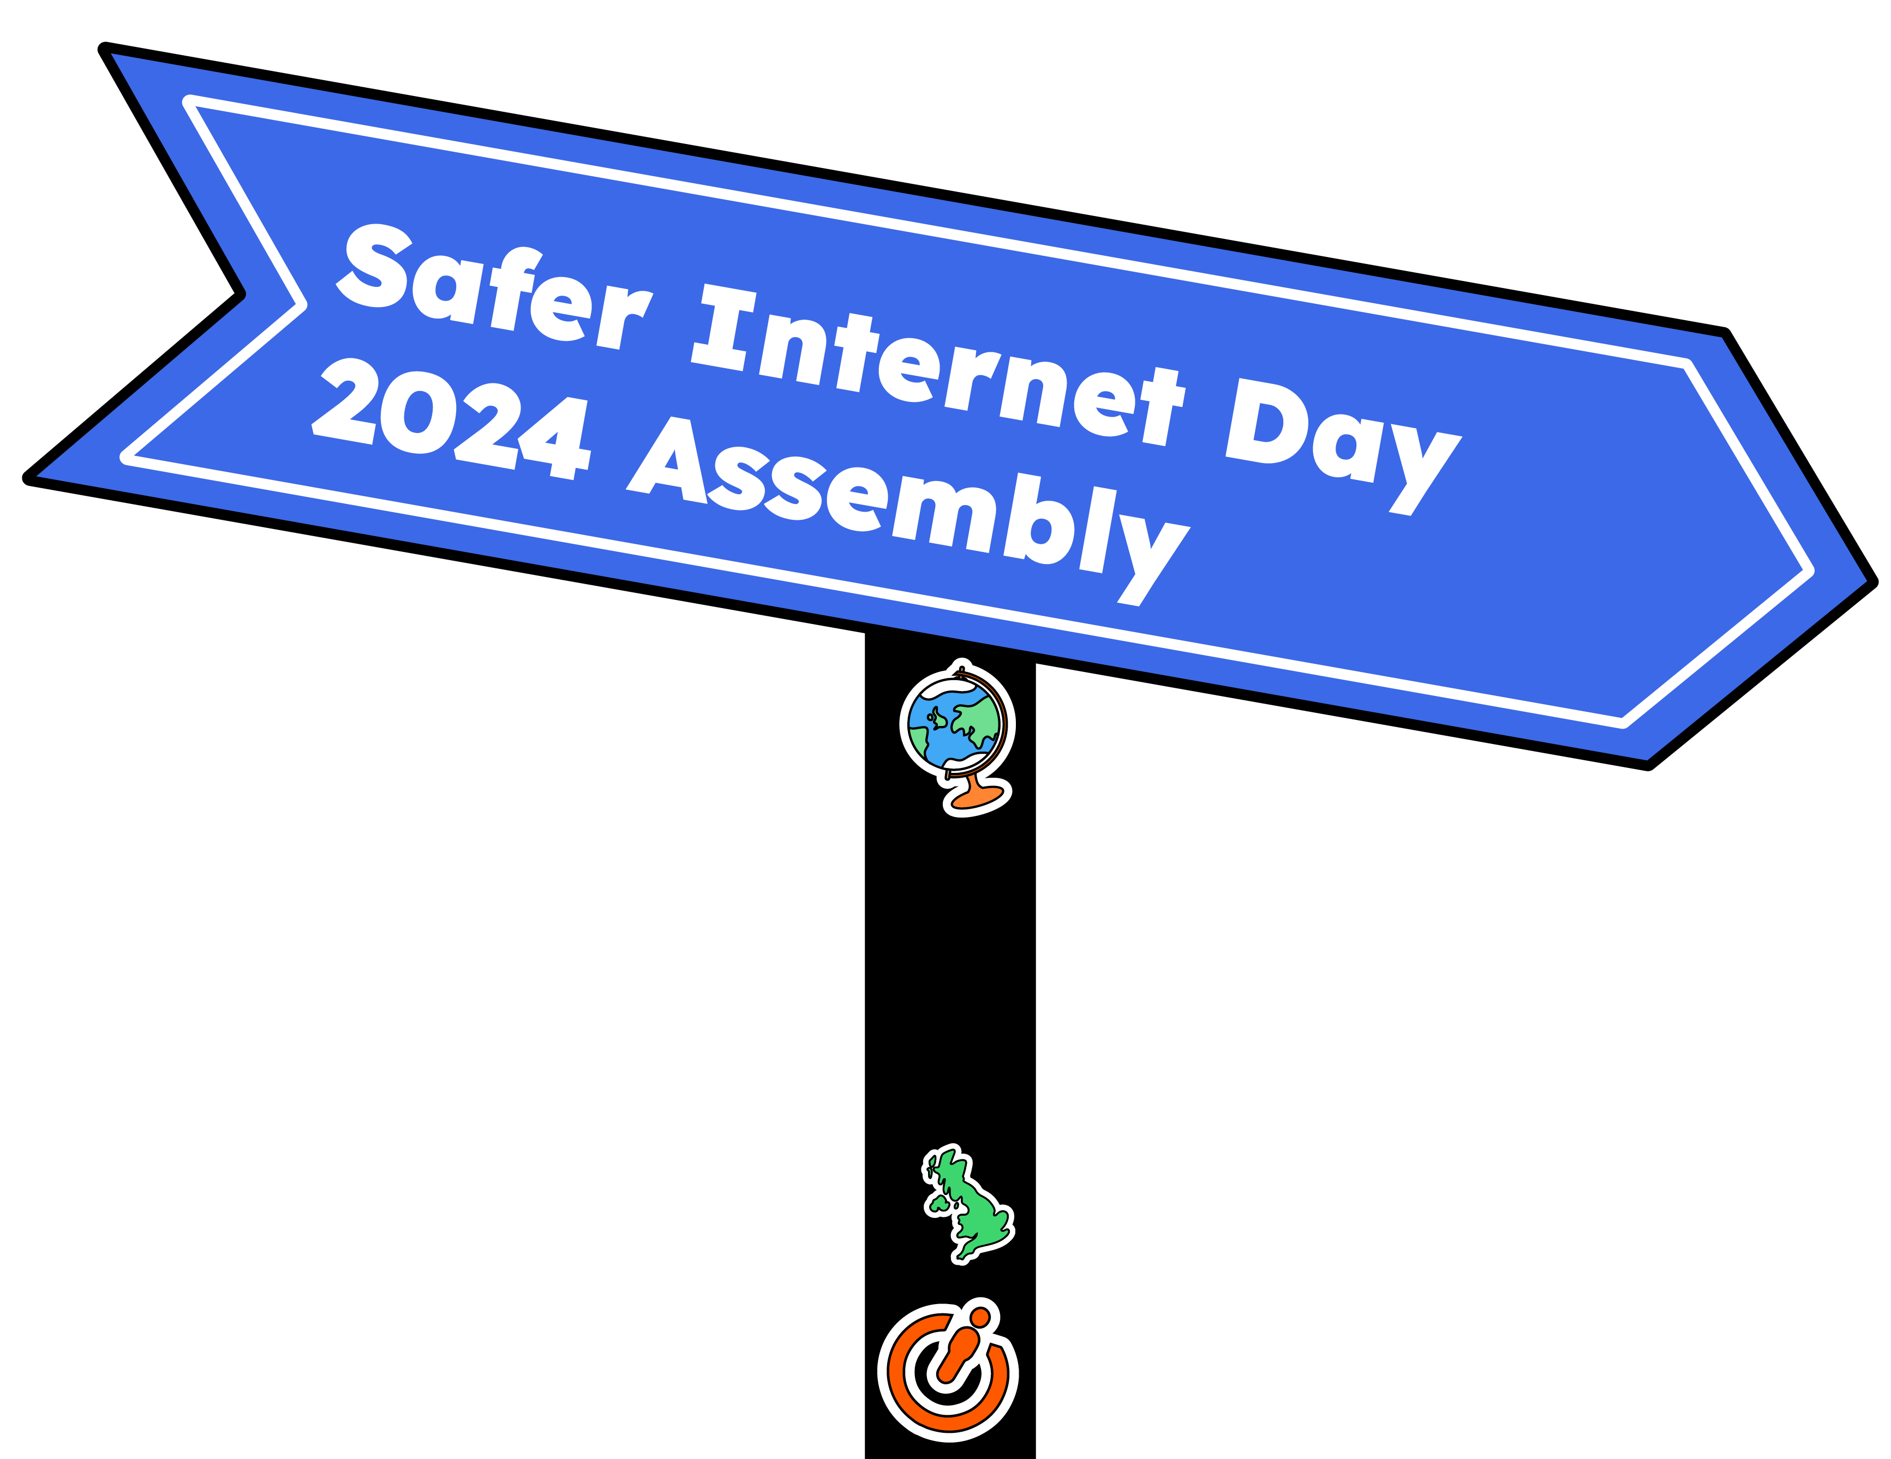
Notes:
Hello everyone. In today’s assembly we’re going to be talking about Safer Internet Day.
What do you think Safer Internet Day might be about?

Slide 3
Notes:
Safer Internet Day is held every February all around the world. Last year, over 170 different countries celebrated the day! Safer Internet Day is a chance to think about any worries we might have about using technology and the internet, but it’s also about celebrating all the fantastic things technology can help us with.
Last year, over half of the children in the UK heard about or joined in with Safer Internet Day.
Did you do anything to celebrate the day?
[Take responses from learners.]

Slide 4
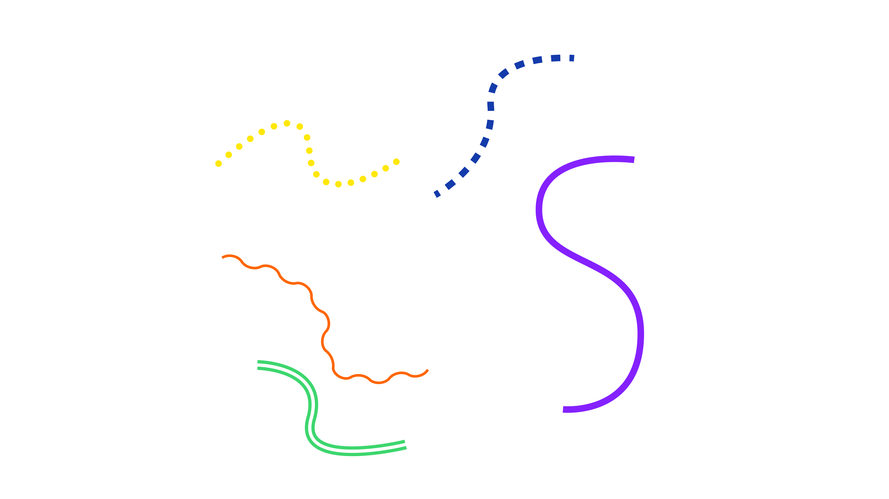
Notes:
And it’s not just schools who join in with the day, lots of other people get involved too, including the government, lots of charities, sports clubs, the police and even the companies who make your favourite apps and games.
By participating in this assembly, you’re joining thousands of others in celebrating the day!

Slide 5
Notes:
We want this year’s Safer Internet Day to be the biggest and best celebration yet! It’s so important to recognise all the exciting and amazing things we can do online… maybe you like to play games, or chat with your friends. Maybe you use the internet to learn new things, or maybe you love watching videos.
What’s your favourite thing to do online?
[Take responses from learners.]

Slide 6
Notes:
Today we are thinking about changes online. Things online look very different now than they did a few years ago...
[Click to reveal answers.]
Computers used to look like this…
Phones looked more like this…
You would play music on one of these…
Watches told us the time and date but not much else…
Gaming was a bit different too…

Slide 7
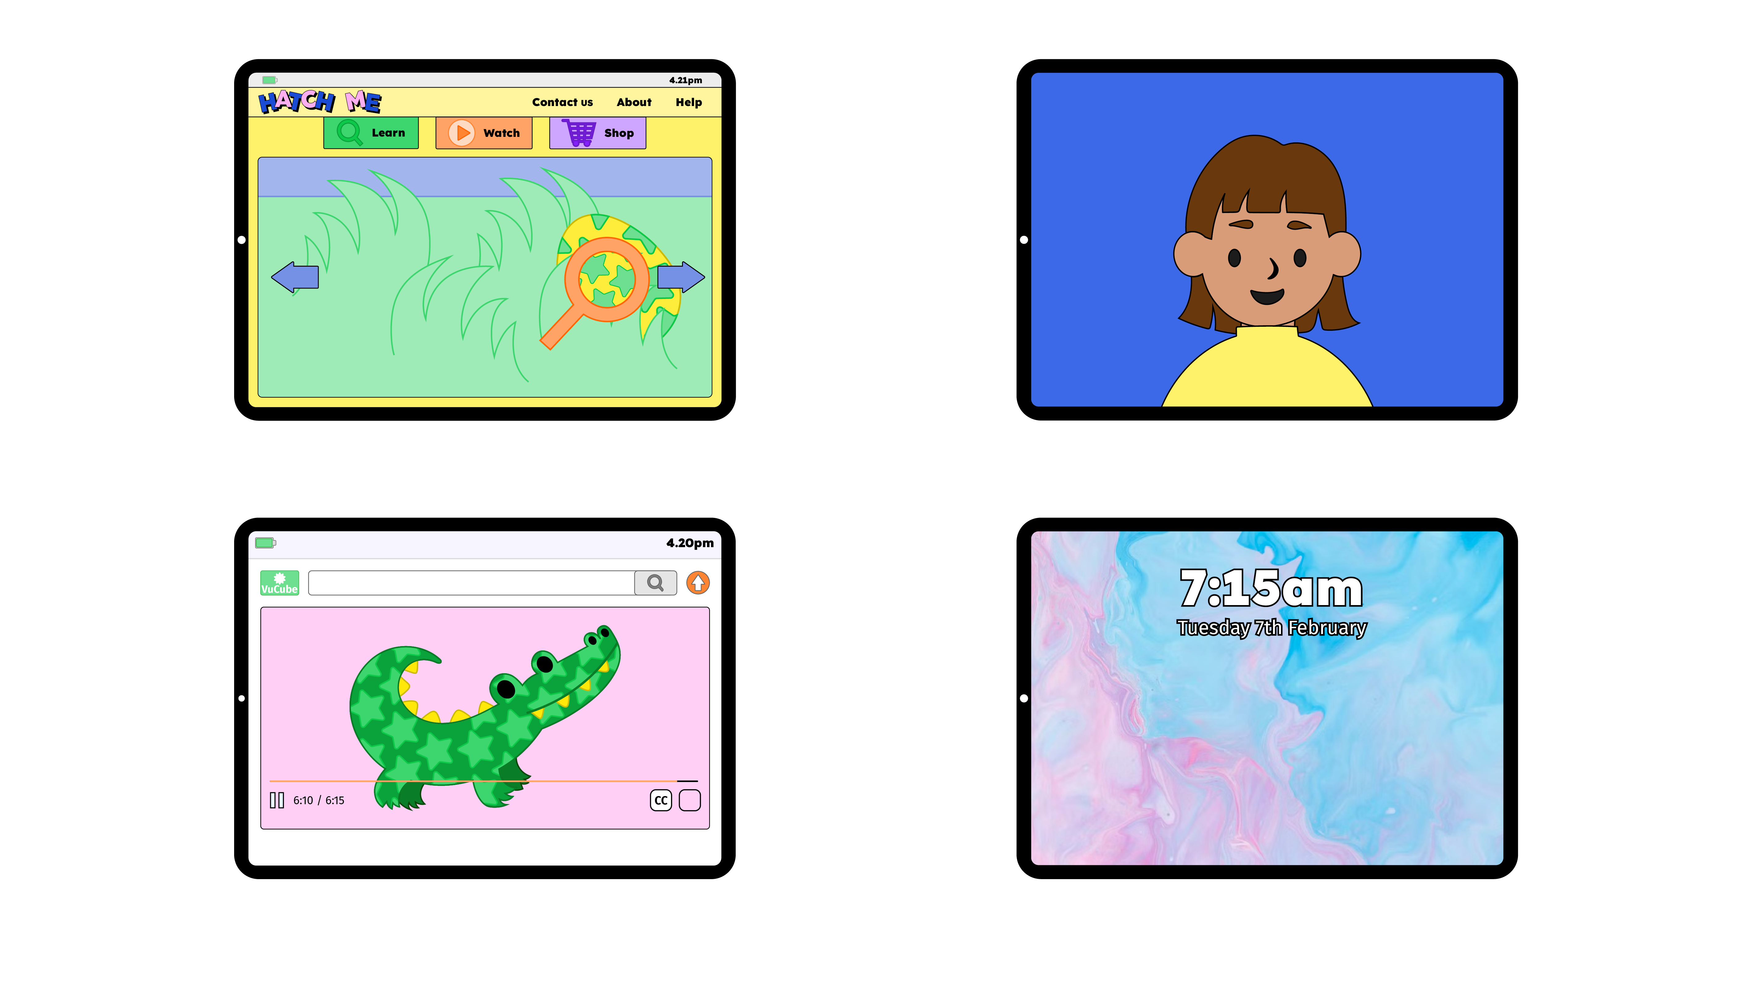
Notes:
There are lots of smaller changes that happen online and on our devices every day. Can you think of any changes you have seen?
[Take responses from learners and click to reveal answers.]
Put your hand up if you have seen…
Some settings change on your game
Something pop up on your screen
A character online look different
A video you were watching change

Slide 8
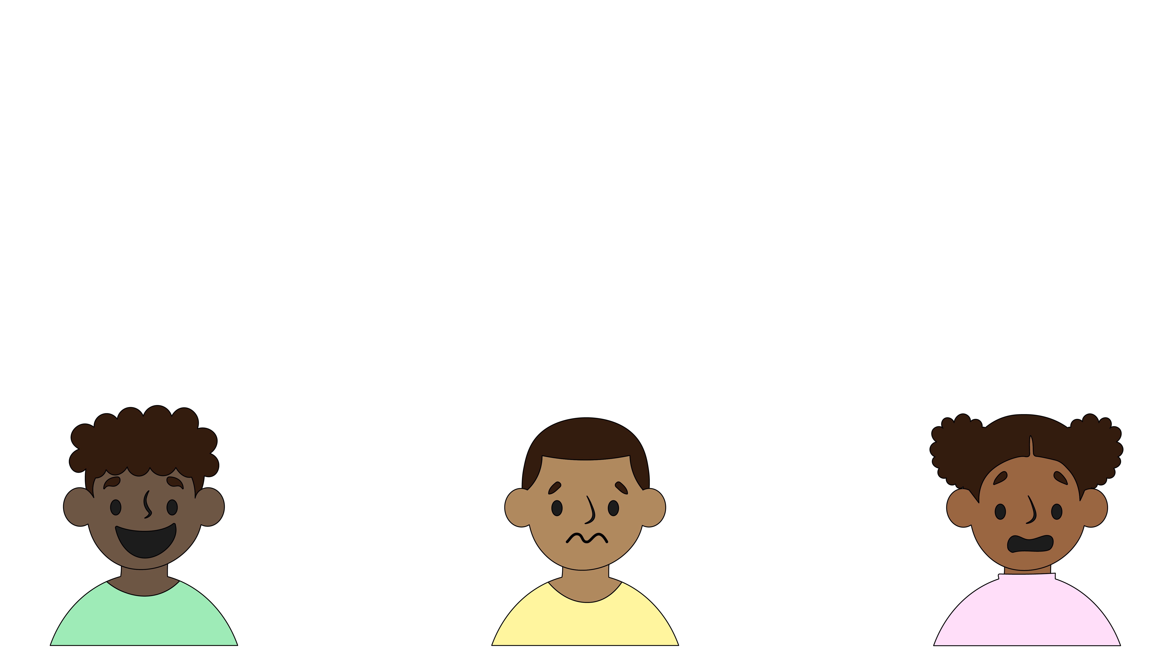
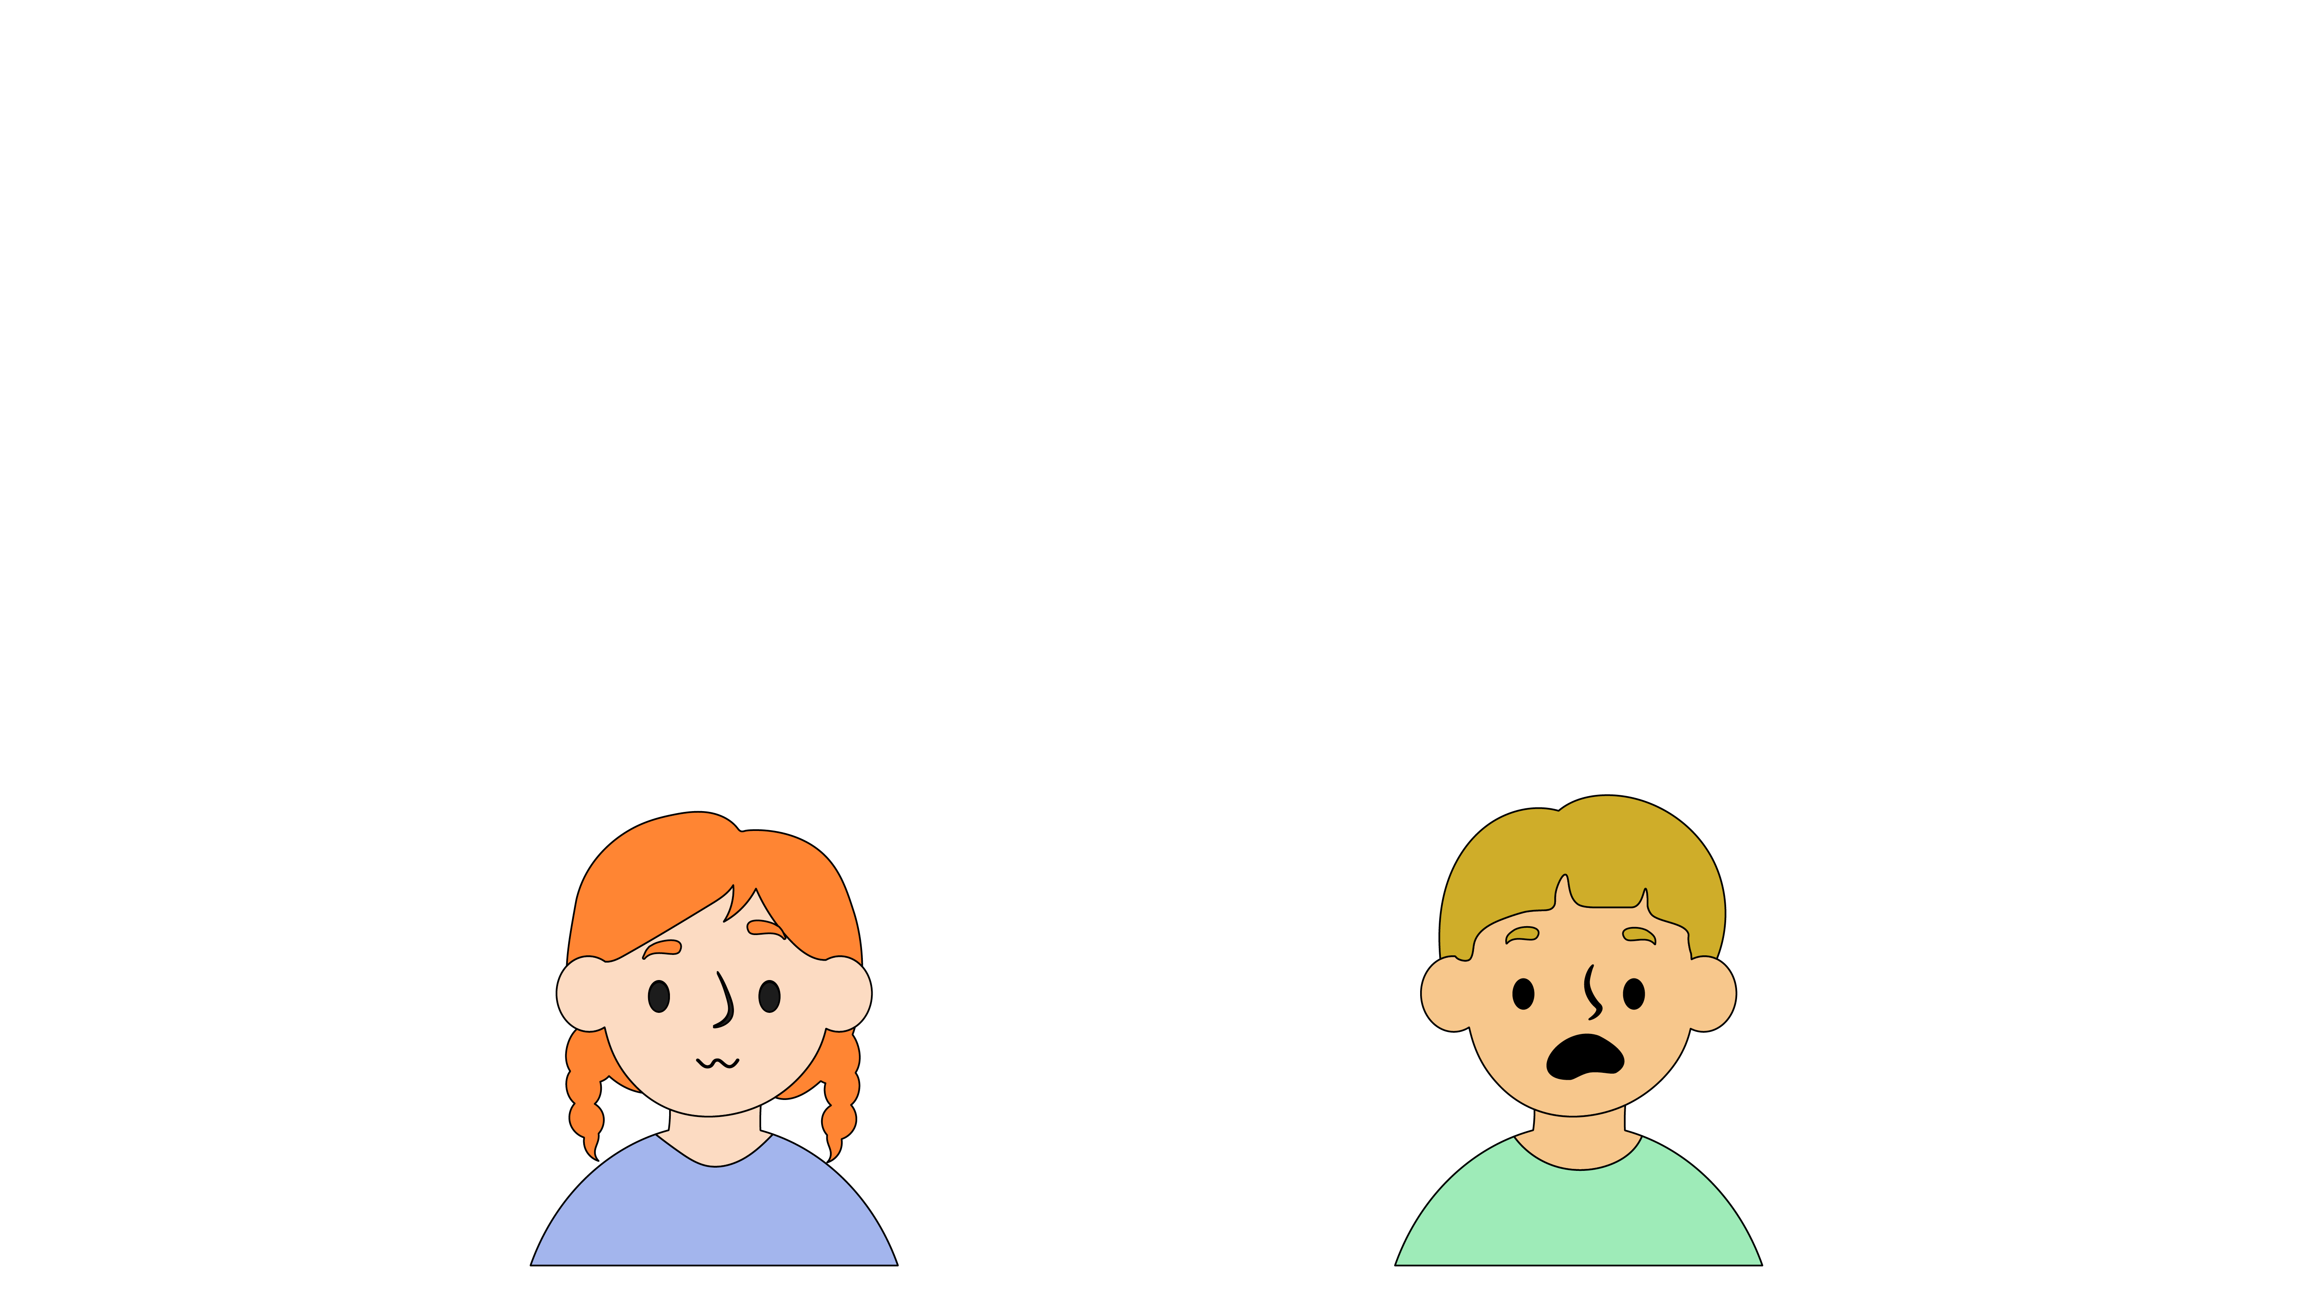
Notes:
Seeing things change can make us feel different emotions…
We might feel…
[read out emotions below]
Excited
Curious
Nervous
Worried
Scared
Some changes online can be great, but some changes that you or your friends have seen might make you feel some of the negative feelings.

Slide 9
Notes:
It’s important that everyone feels safe when they go online.
How can you stay safe even when things change online?
[Take responses from learners and click to reveal answers.]
Talk to a trusted adult…
Ask them before you download something new
Tell them about the things you see online, especially if you are worried or upset
Turn your device off, over or pause it. You don’t need to keep watching something if it’s upsetting you.
Ask them to show you where the block and report button is and for help to use it

Slide 10
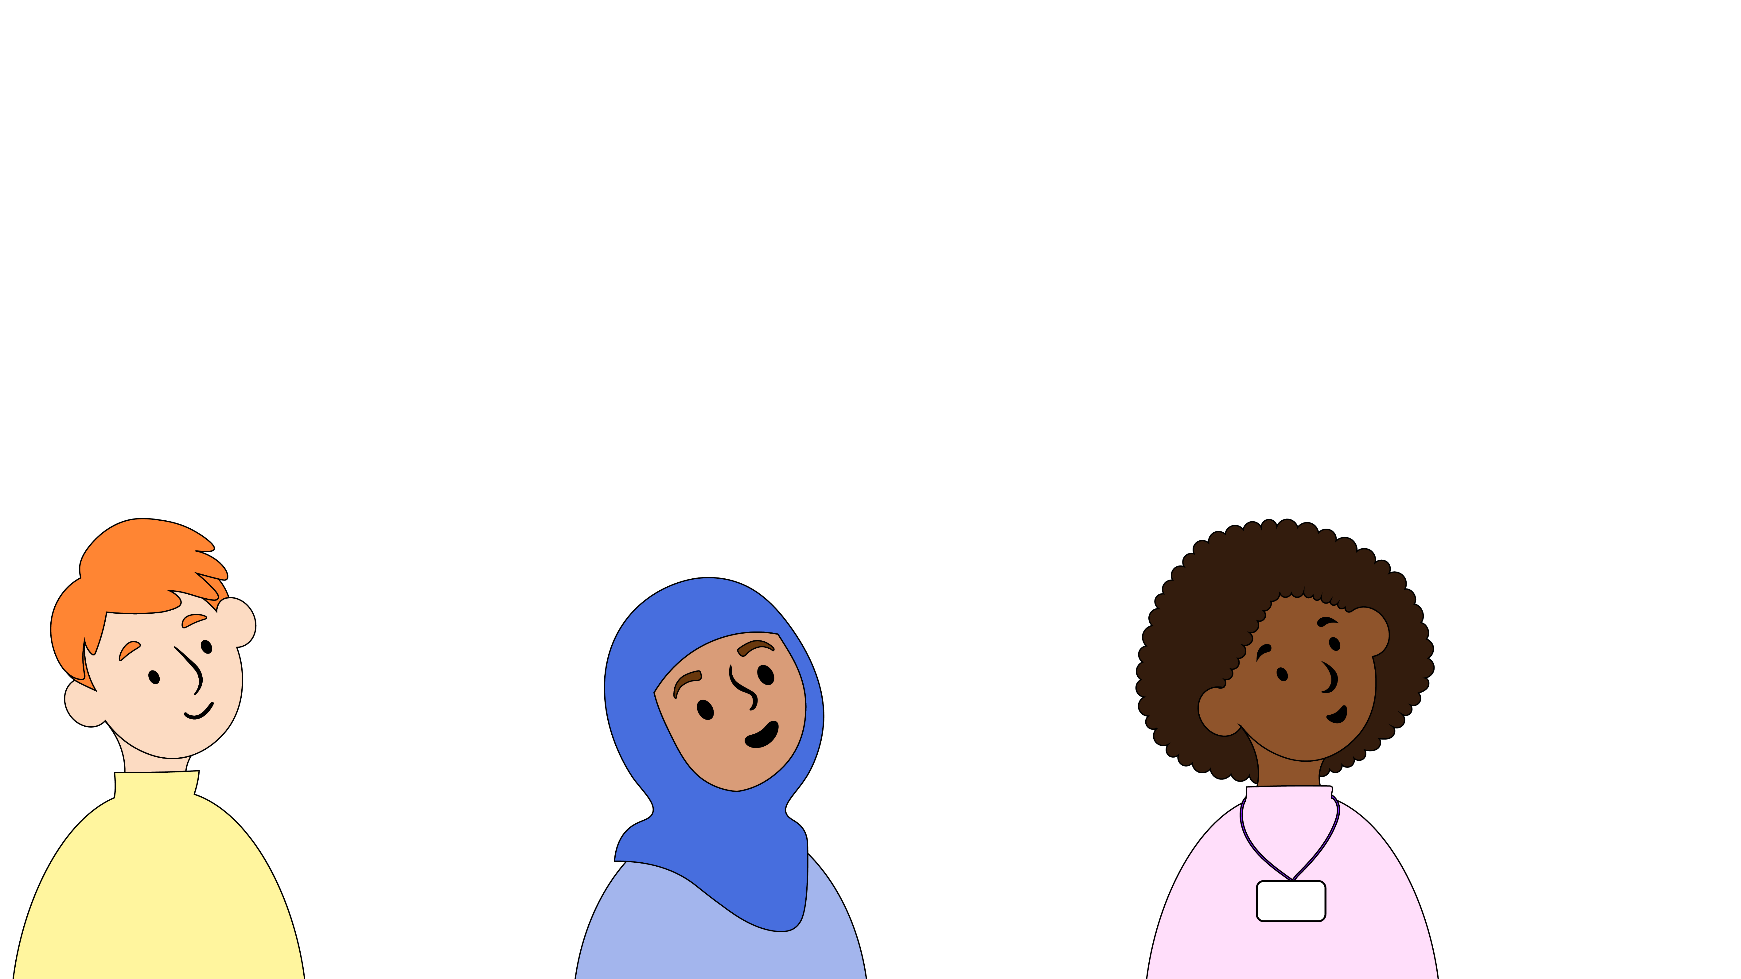
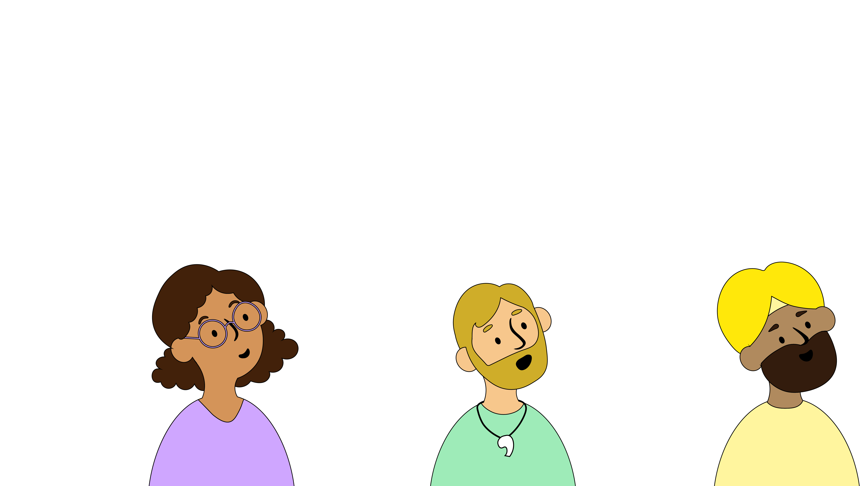
Notes:
Who are the trusted adults you could talk to about things online?
[Take answers then display on screen]
Parents or carers
Grandparents
Auntie and Uncle
Sports club leader
Teacher and teaching assistant

Slide 11
Notes:
Here at [name of school/setting], part of our job is making sure you feel safe and happy, in all parts of your life – including online!
If you ever have a worry about something that’s happened online, you can come to us for help and advice. We’ll always listen carefully and give you some ideas of what you can do. Sometimes, if we’re worried that you or somebody else might be in danger, we have to pass on what you’ve told us to a special member of staff. At [name of school/setting] that person is [name of staff member with safeguarding responsibility].
If we have to speak to them, it’s not because you’re in trouble, it’s just because they have the special job of making sure every child here is safe.
Note to educators – add names, words, or even photos to this slide to show learners who they can go to if they have an online safety concern.

Slide 12
Notes:
Happy Safer Internet Day everyone!

