Slide 1
Welcome to our Learning
Community
LIFE@Raglan
Learning is for Everyone

Slide 2
Our Raglan Leadership Team
Head Teacher Matt De Freitas
Deputy Head Teacher Danielle Mead (Currently on Maternity Leave)
Acting Deputy Head Teachers Emily Ingrey / Martin Hunter
Inclusion Leader (SEND / ARPS) Martin Hunter
Family Liaison Sam Collins

Slide 3
Children and Community
Our school develops the ‘whole child’ as individuals, so that they are ready and resilient to take on the next phases of their learning and life.
Our children feel a sense pride and belonging to our school community. Our children make positive contributions to our school, local, national and international community.
Everyone has equal access to our curriculum.
At our school, learning is for everyone in our community!
Ofsted July 2023, “Leaders have thought carefully about how to support pupils’ development beyond the academic curriculum. Older pupils proudly take on leadership roles and are positive role models for younger members of the school. Pupils do their utmost to demonstrate the Raglan values of being kind, ready, safe, resilient, confident and independent.”

Slide 4
Our Child and Community Vision
We are a forward thinking learning community where
everyone makes strong progress, feels safe,
included and valued. It is a place where staff, governors
and parents work collaboratively to provide a
creative, aspirational and inspiring learning adventure.
Our children love to learn, welcome challenge and are not
afraid to make mistakes. They are confident, curious
and questioning and will become active and informed
global citizens able to succeed in a complex, changing world.

Slide 5
Raglan’s Character Virtues
KIND
READY
SAFE
RESILIENT
CONFIDENT
INDPENDENT
Ofsted July2023, “Leaders focus on developing the character of pupils. They make sure pupils have many opportunities to lead. These include the house captains who do termly learning reports, lead assemblies, present to parents and carers, and manage the house points system.”

Slide 6
Achievement at Raglan
Historically Pre-pandemic; children at Raglan achieve very well.
In 2023 EYFS, Year 1 Phonics, KS1 and KS2 the school performed in line with, or above national averages in all areas in terms of standards.
In 2023 in terms of progress children performed in line with national benchmarks for progress.
Our children achieve very well and make strong progress.
We do not narrow our curriculum to teach towards national tests!

Slide 7
Your Child’s Raglan Learning Journey Ofsted July 2023, “Leaders understand the importance of having an ambitious and rigorous curriculum.”

Slide 8
Our Curriculum
Our curriculum is ambitious and has been designed to raise aspirations and fire children’s curiosity; create a sense of personal pride in achievement; provide a purpose for learning and ultimately to help every child discover their strengths and interests.
Our curriculum ‘drivers’ underpin the direction and development of all areas of school life and ensure our curriculum is enriched and personalised in order to meet the needs, interests and ambitions of our children and their families.

Slide 9
Our Curriculum Drivers
Initiative – Get Up and Do it!
Environment – Making a Difference!
Community and Diversity – Belonging!
Communication - Finding Your Voice!

Slide 10
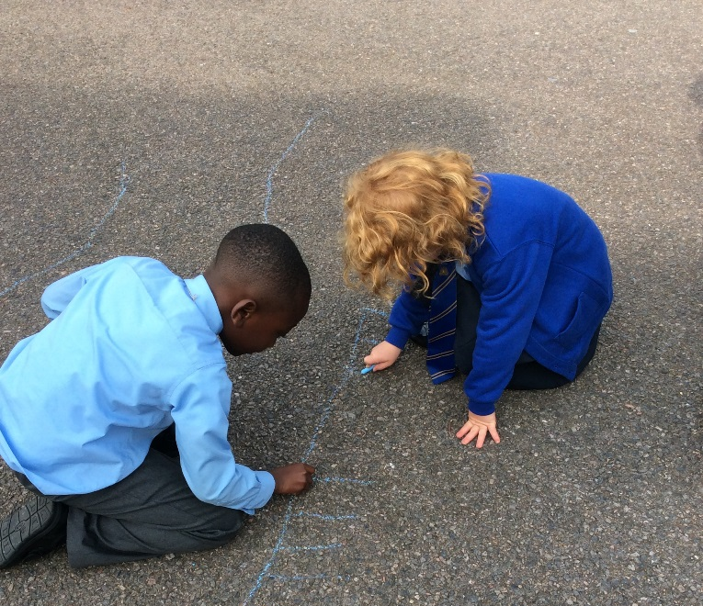
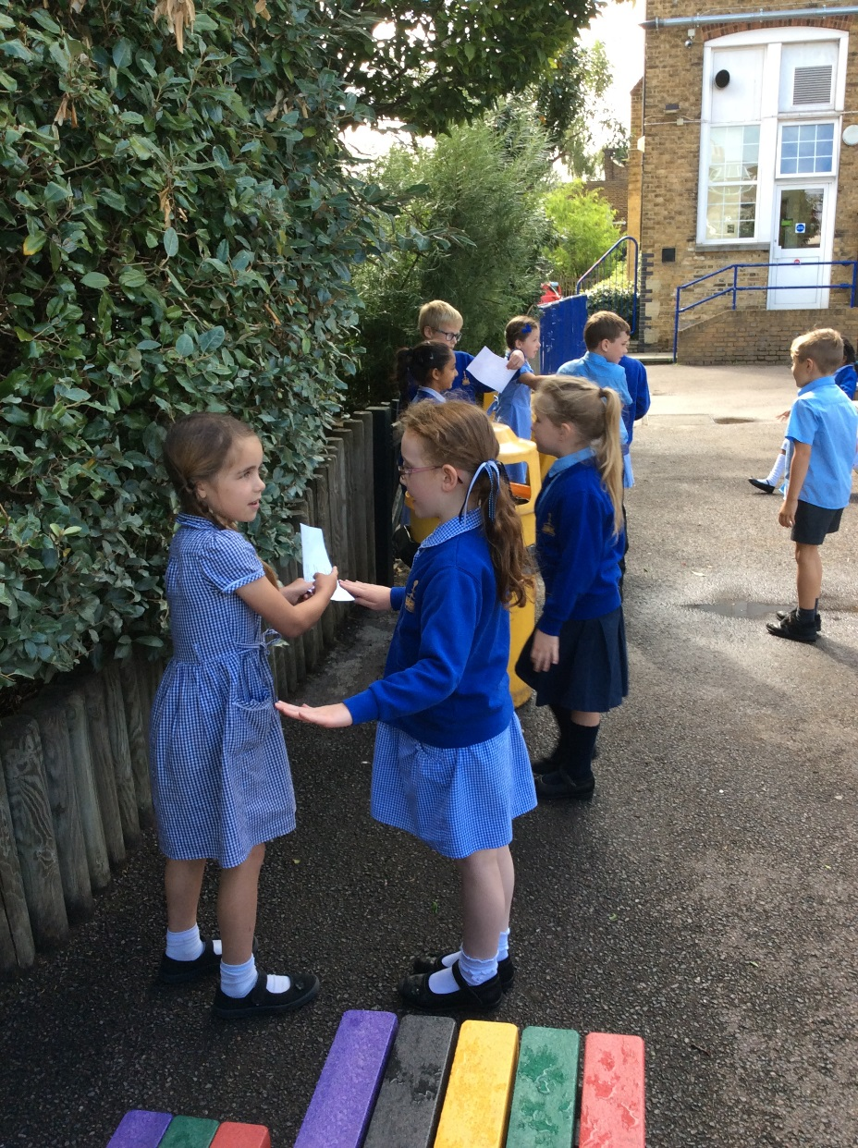
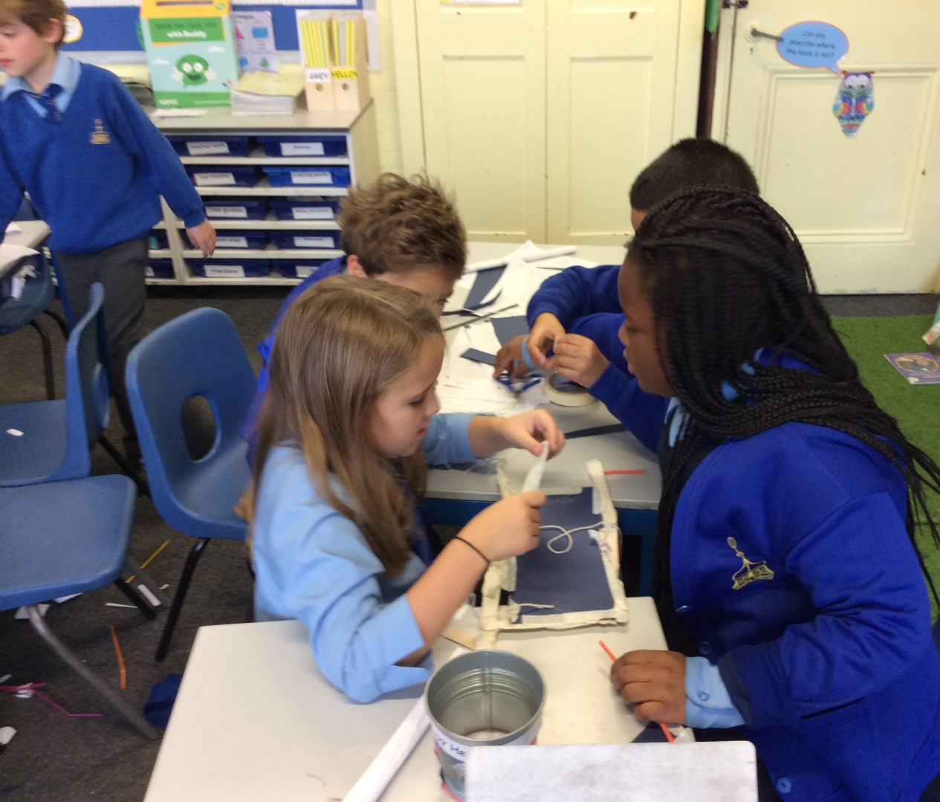
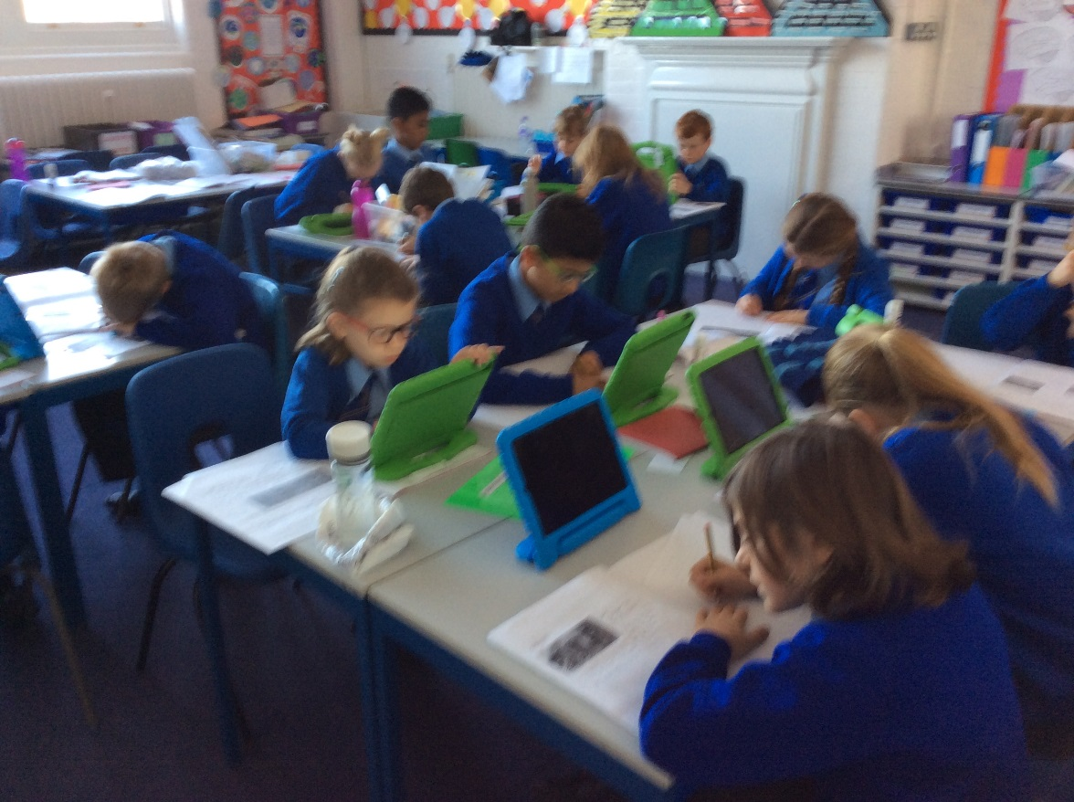
Our Raglan Curriculum

Slide 11
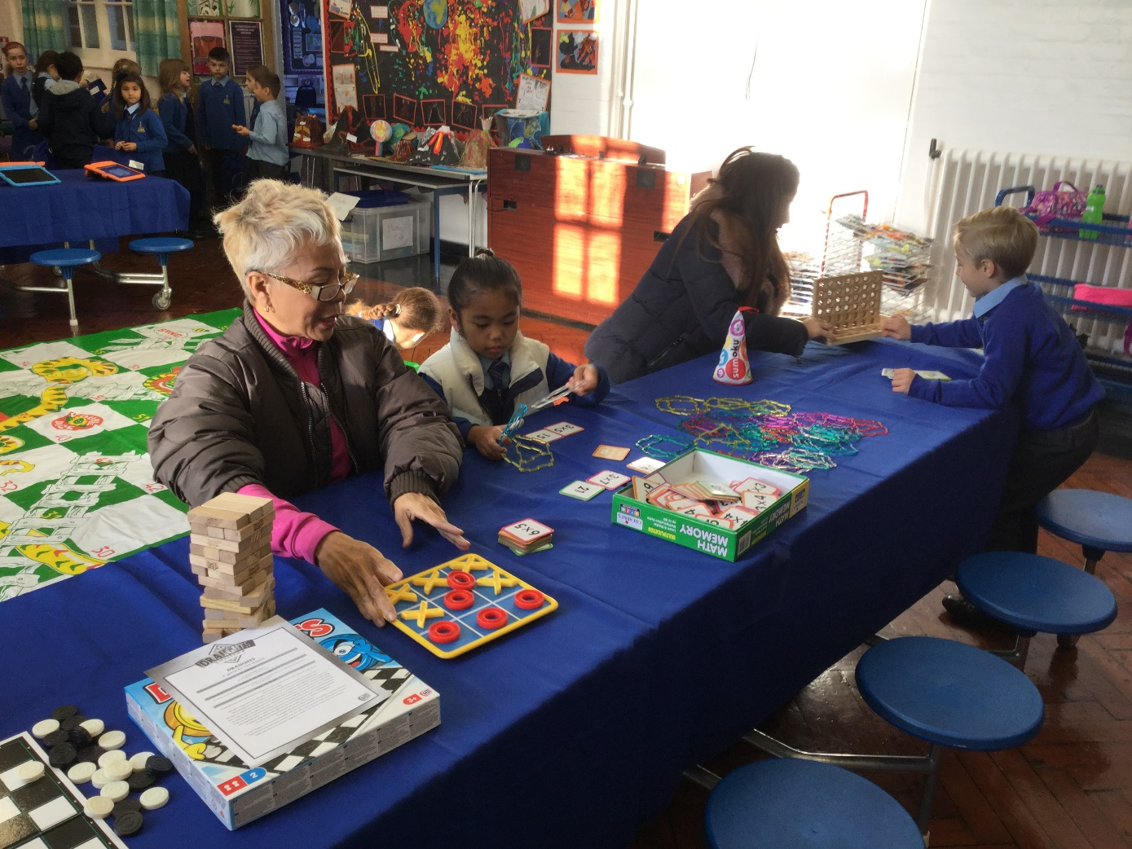
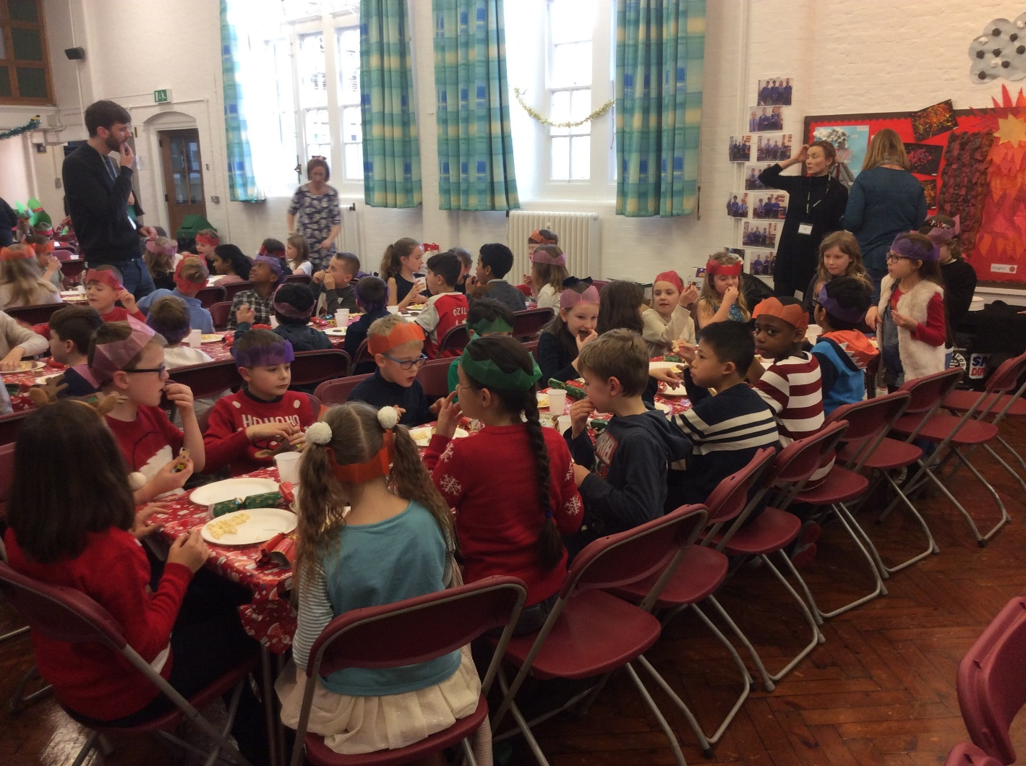
Pupils at the Heart

Slide 12
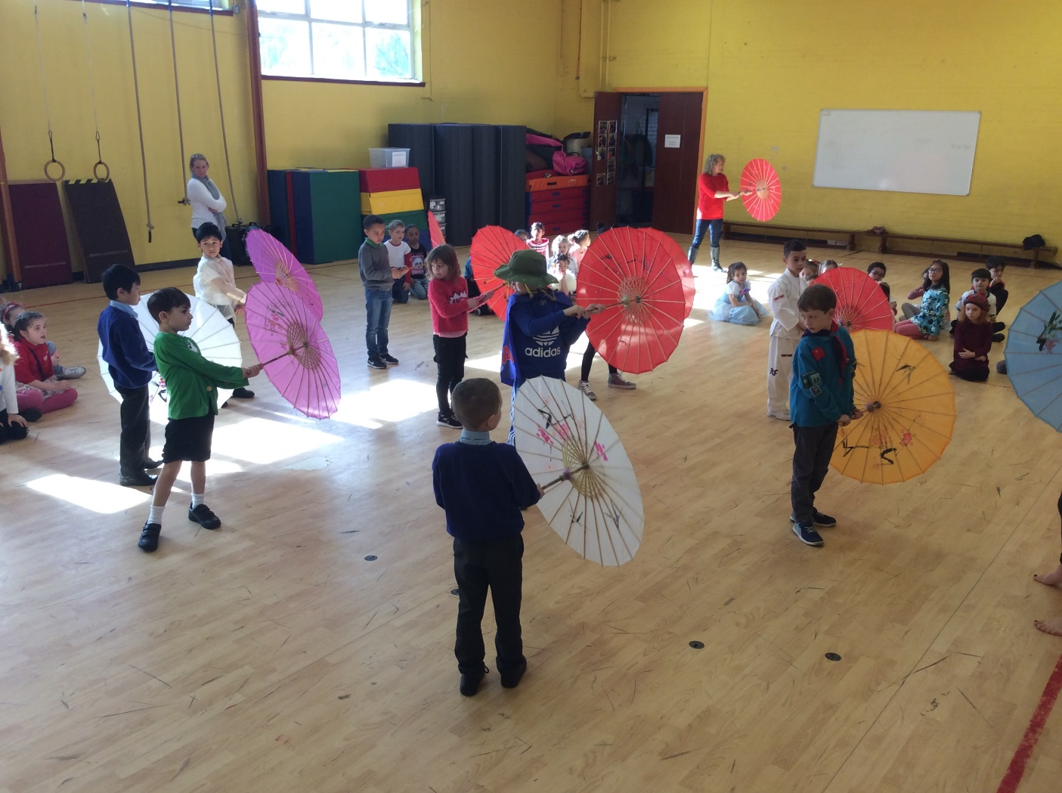

Slide 13
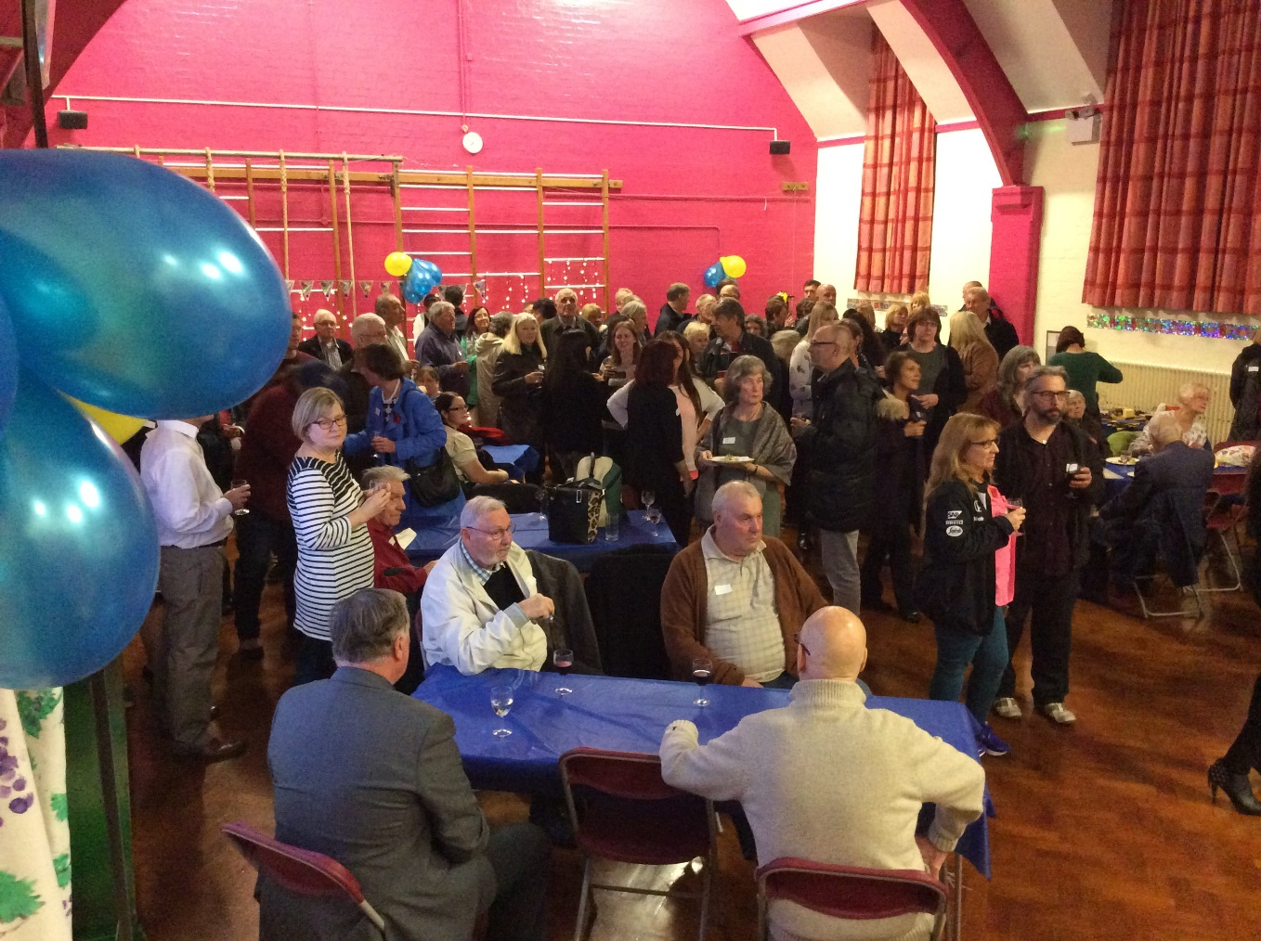
At the Heart of our Community

Slide 14
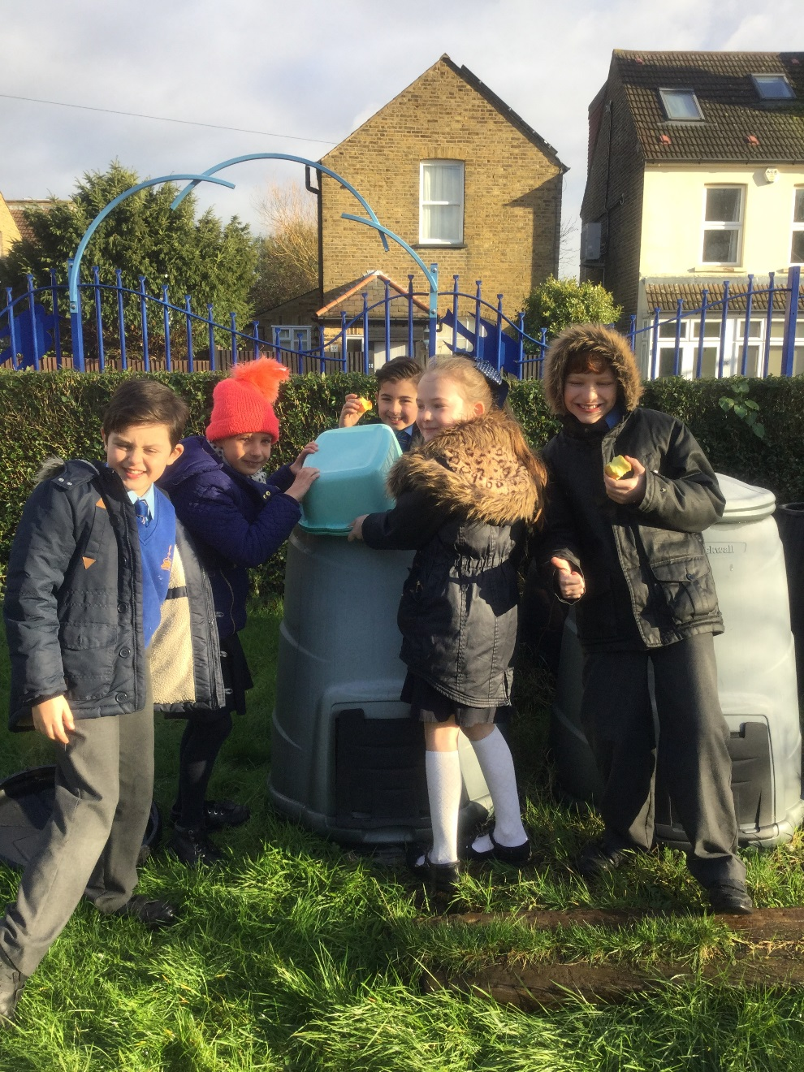

Slide 15
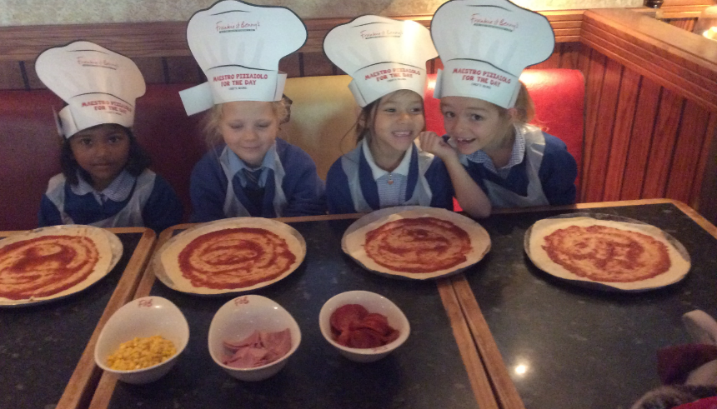
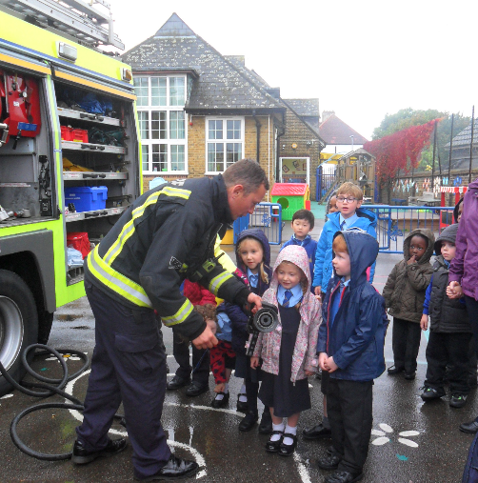
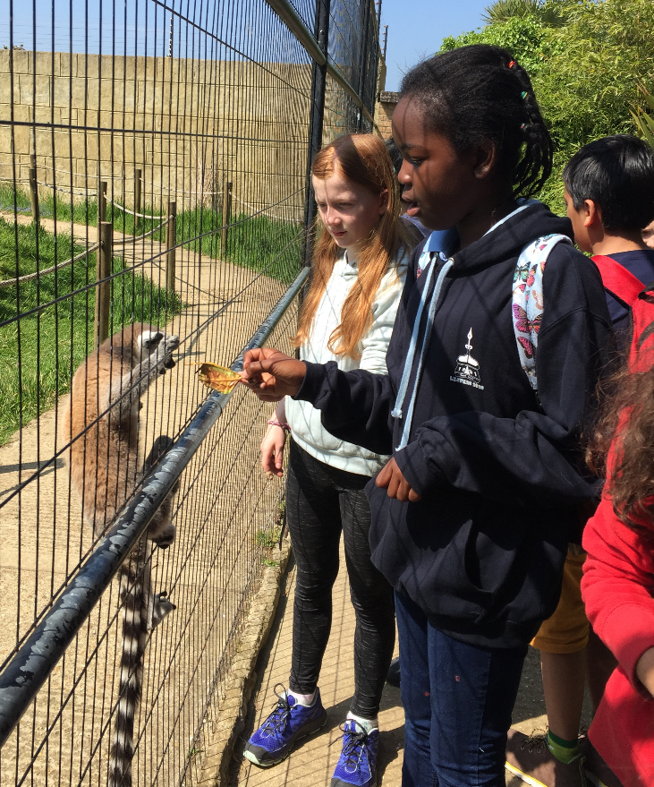
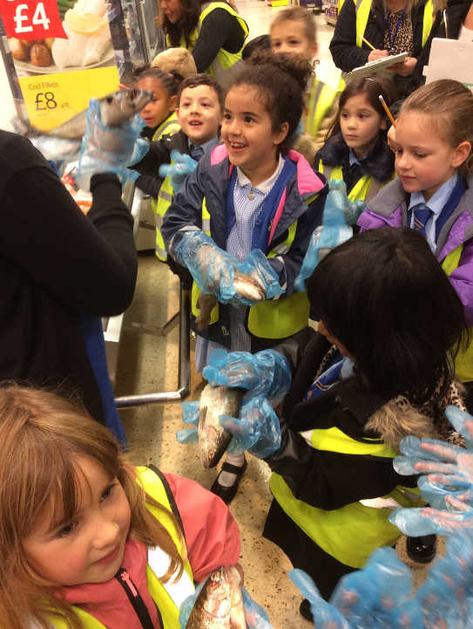
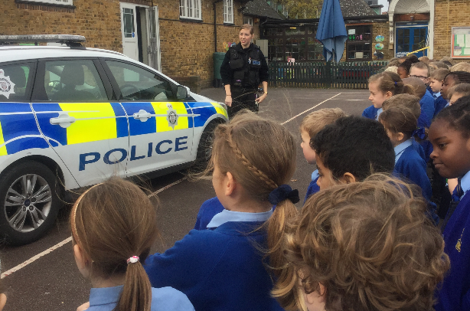
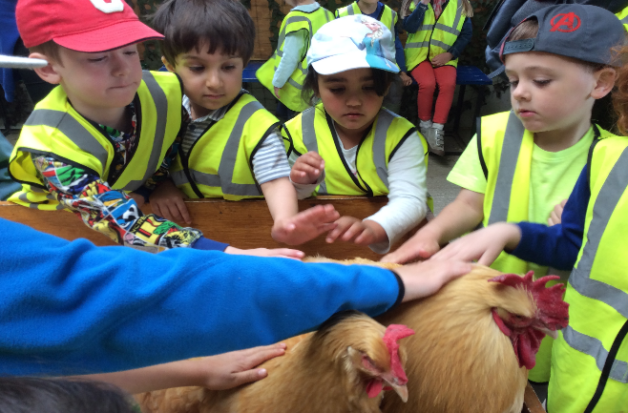
Opportunities for Learning Beyond the Classroom
and Educational Visits

Slide 16
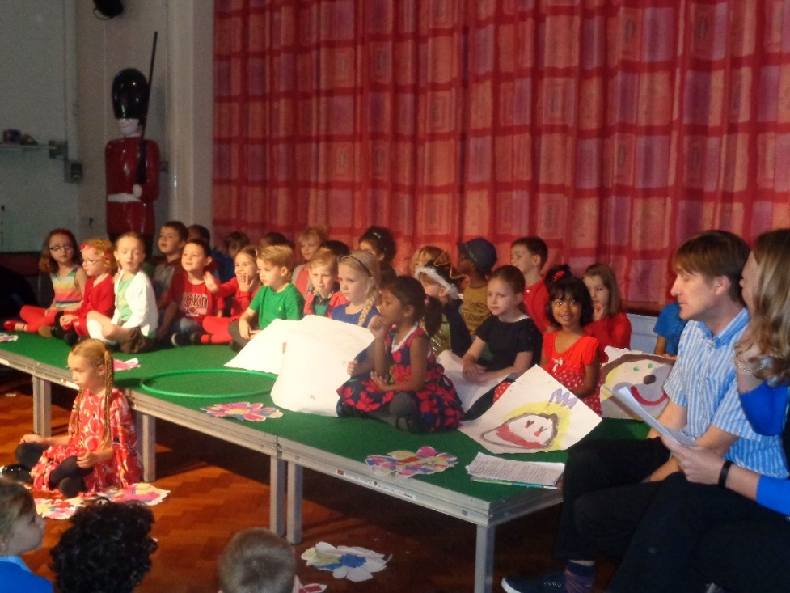
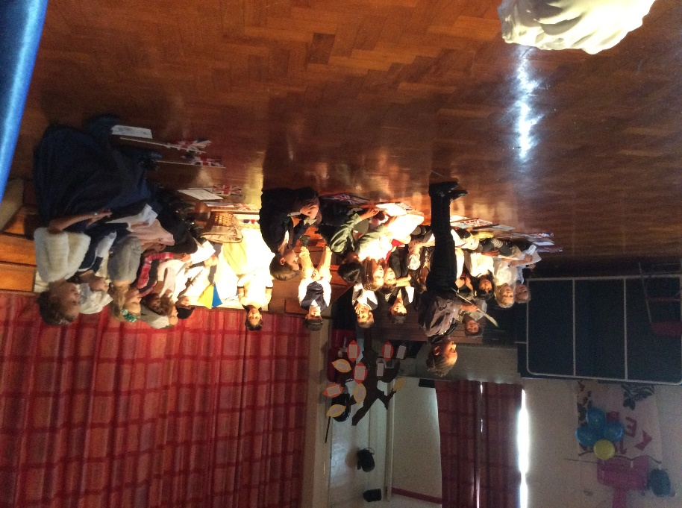
Parent Partnerships

Slide 17
The Early Years Foundation Stage
At Raglan Primary School, we offer an EYFS curriculum, which is broad and balanced and builds on the knowledge and understanding of all children whatever their starting points.
We have created a bespoke curriculum that reflects what we would like a ‘Raglan child’ to learn, know and remember by the time they leave the Early Years Foundation Stage.
Learning in the EYFS, takes place through a balance of child-initiated play and adult learning. We offer a curriculum that is child-centred and immerses the children into their learning through exciting topics that motivate and engage the children.
We take the time to get to know children’s interests to support their learning. We ensure children are taught reading, writing and maths in well-planned structured activities.
The children follow a structured phonics and early reading programme which builds on from what they have learned in nursery. They have a reading book at their appropriate phonic level which is changed weekly. Structured language interventions are in place to ensure that all children make progress.
Development of language is a key priority for us at Raglan.

Slide 18
The Early Years Foundation Stage and Learning Beyond!
Our Curriculum is progressive, and we build upon children’s knowledge day by day, week by week, month by month and year by year! This is done so that children can know more, do more and remember more!
Ofsted July 2023, “Children are well prepared by the early years curriculum to be successful in their later learning in Year 1 and beyond. This includes making sure that children obtain the foundations they need in their physical development, as well as in early reading and mathematics.”
Ofsted July 2023, “The curriculum is carefully planned to build on pupils’ prior knowledge and experiences, from Nursery all the way to Year 6. Leaders are thorough in their work to secure further improvements in what pupils learn.”

Slide 19
SEND at Raglan
Our school has a rigorous approach to supporting pupils with SEND.
We make sure that needs are quickly identified and that appropriate plans are put in place.
Teachers regularly adapt to make sure that pupils’ are able to access learning.
Our SEND Leader provides appropriate training to all staff so they can support pupils with SEND, including those who attend our Language Provision.
Alongside learning an appropriately demanding curriculum, pupils who attend the Language Provision receive a range of therapeutic support tailored to their needs.
Ofsted July 2023, “Children with SEND access all of the same opportunities as others, including joining in with clubs and taking on leadership roles.”

Slide 20
Our Year 6 Team Captains

Slide 21
The Application Process
If you want our school place us down as number 1 choice.
Do not assume that you will not get a place because the catchment is small.
Be sure that you apply through Bromley Admissions and meet the deadlines for this.

