Slide 1
Starting Reception
Welcome to Raglan Primary School

Slide 2
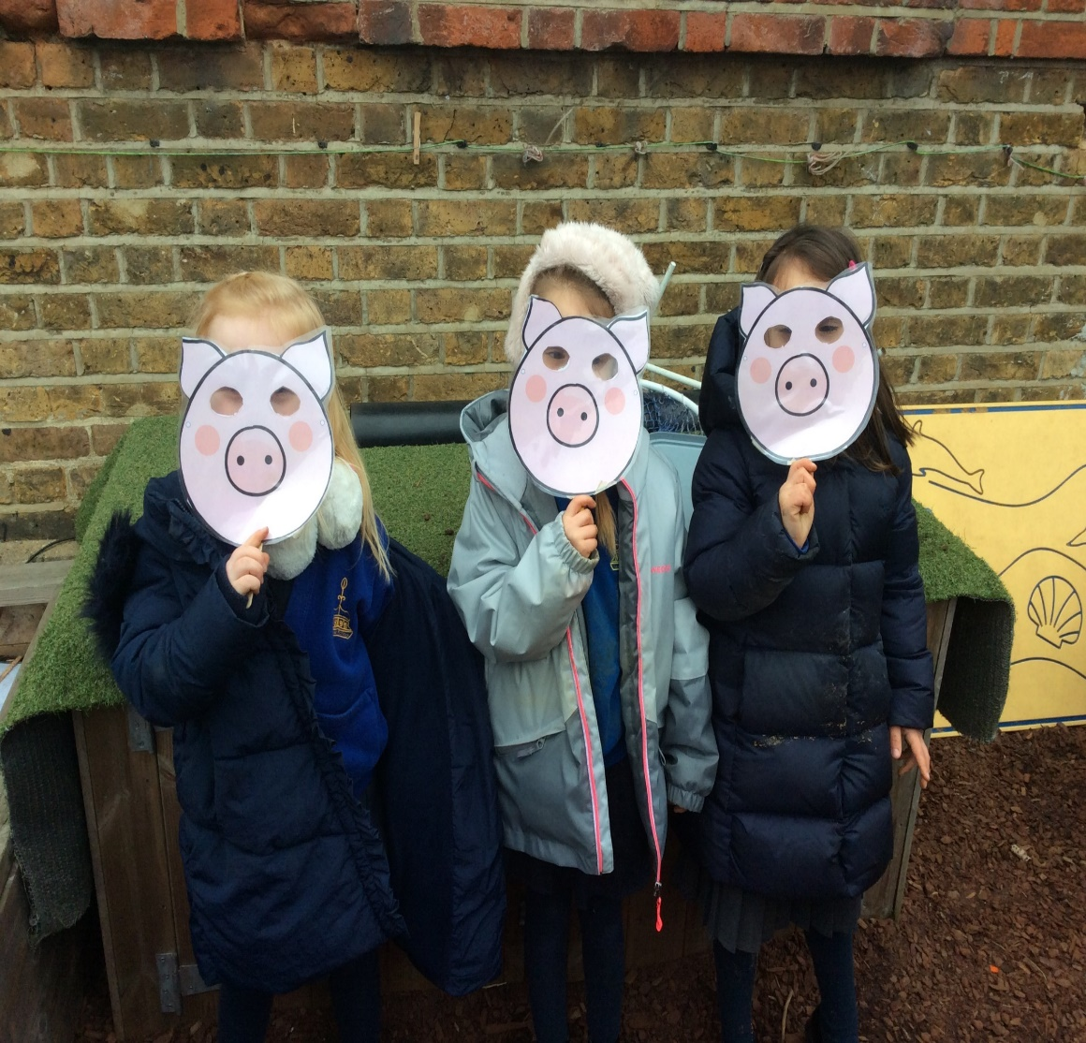
Our Expectations:
In Reception we expect parents to take an active role in your child's education. Here are the following ways you can support at home:
Reading – this is of huge importance and will benefit your child's overall development.
Stories, high frequency words, information texts, basically anything! Reading is the key to a good start in Reception. We run reading mornings for you to come and read with your child at school so please take advantage of these we love to see you.
Tricky words and New Sounds- these will be given out regularly for children to take home to learn. Once these are embedded the standard of your child's writing will be pushed to another level.
Enthusiasm and support! We are a team that loves to hear your feedback please keep talking to us about your child we are here to listen!

Slide 3
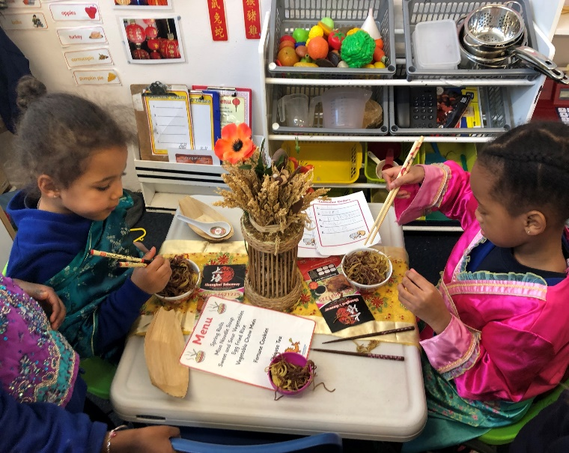
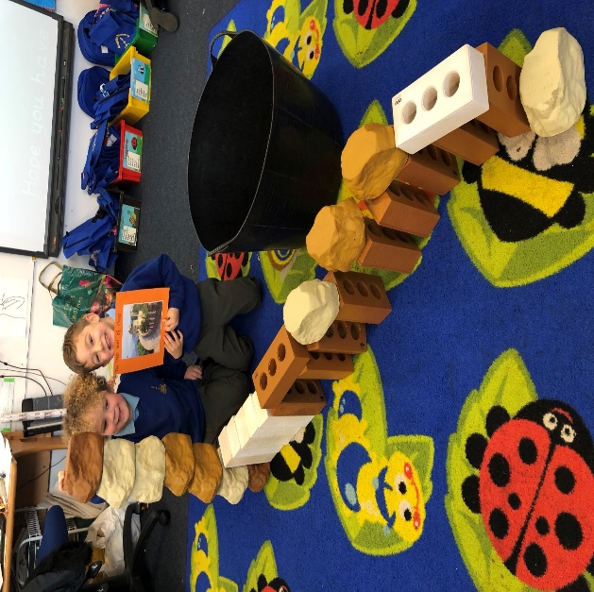
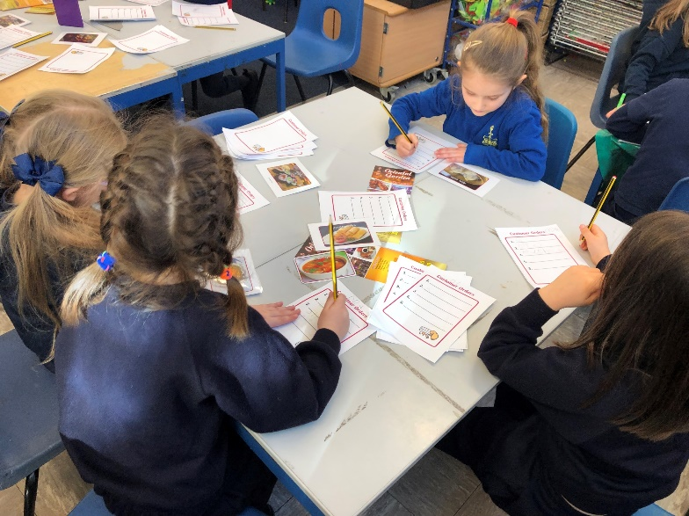
How we learn in Reception:
We learn through STRUCTURED play!

Slide 4
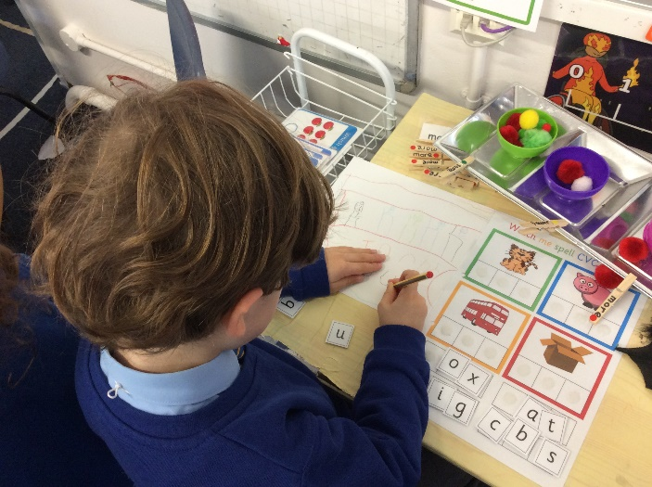
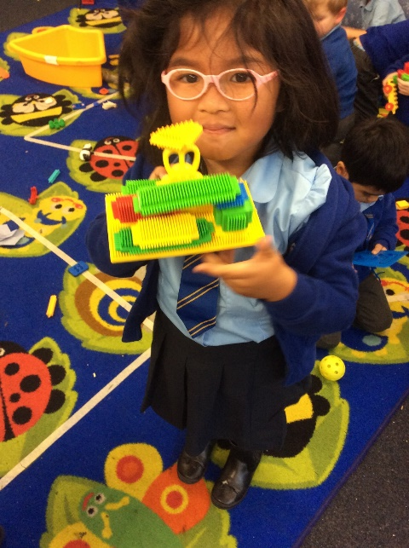
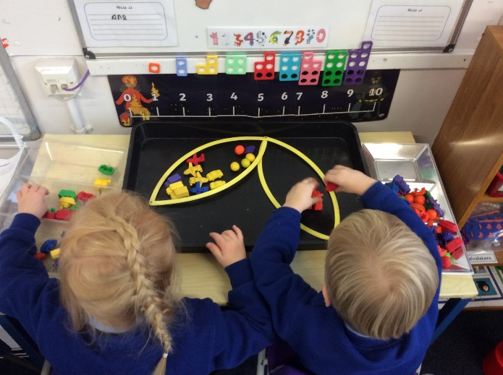
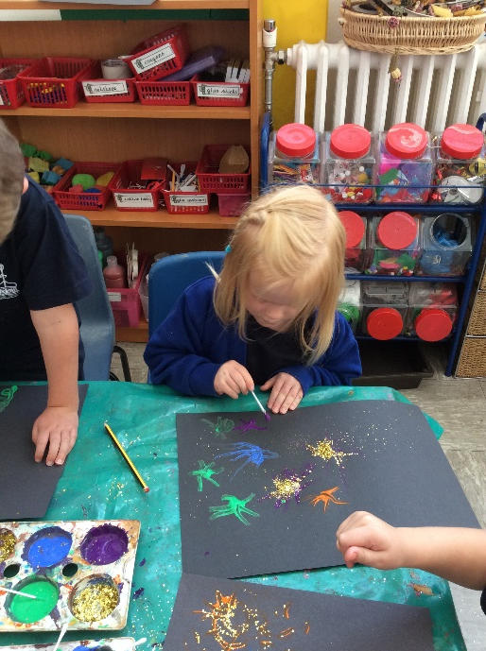
The content of the Curriculum
The E.Y.F.S. curriculum is a curriculum designed specifically for children from birth to 5 years of age which covers several key aspects of learning:
Personal, Social and Emotional Development
Communication, Language and Literacy
Physical Development
Literacy
Mathematics
Understanding the World
Expressive Arts and Design

Slide 5
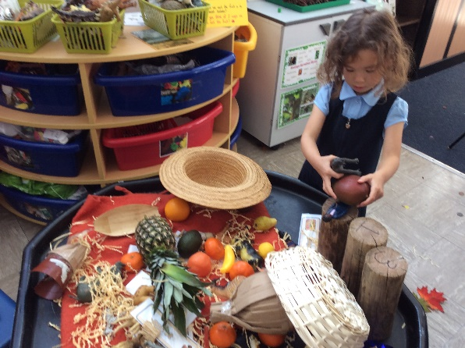
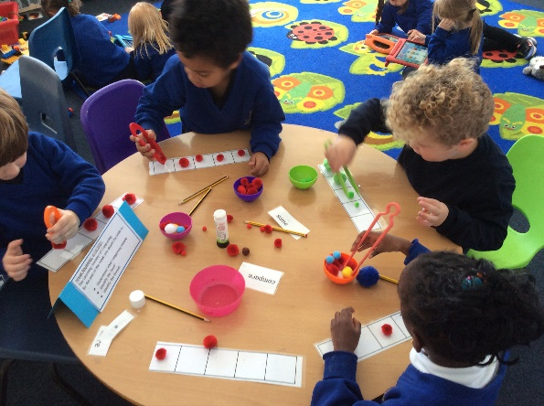
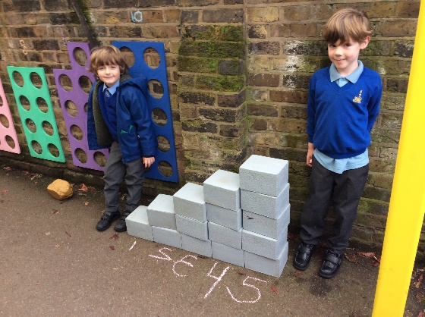
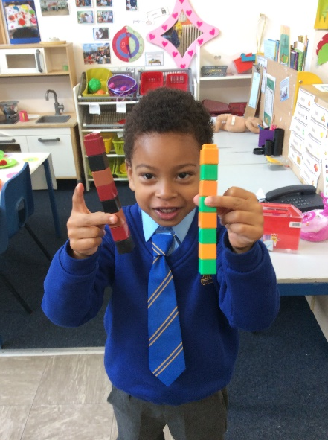
The curriculum is designed to meet the needs of young children and ensures that all learning is
based on practical and experiential activity.
The type of provision offered in our reception classes is very similar to the provision offered in nursery, although it differs in structure and formality as children progress through the year.
Children will be given opportunities to work under teacher direction using focused groups and also independently within a highly structured environment.

Slide 6
Engaging!
Challenging!

Slide 7
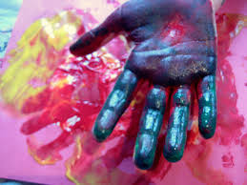
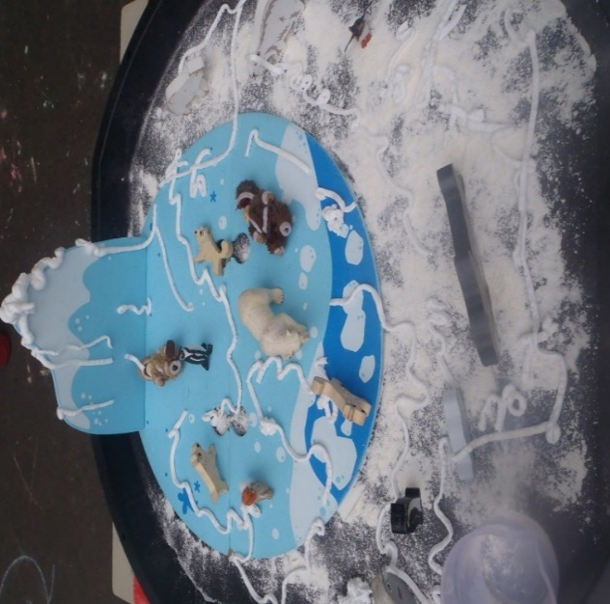
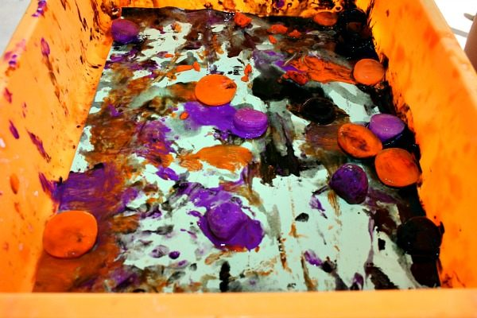
Messy Play!
In Reception we do encourage your child to participate in messy multisensory activities. Your child is encouraged to wear an apron but all of the provision we use is generally easy to wash out!

Slide 8
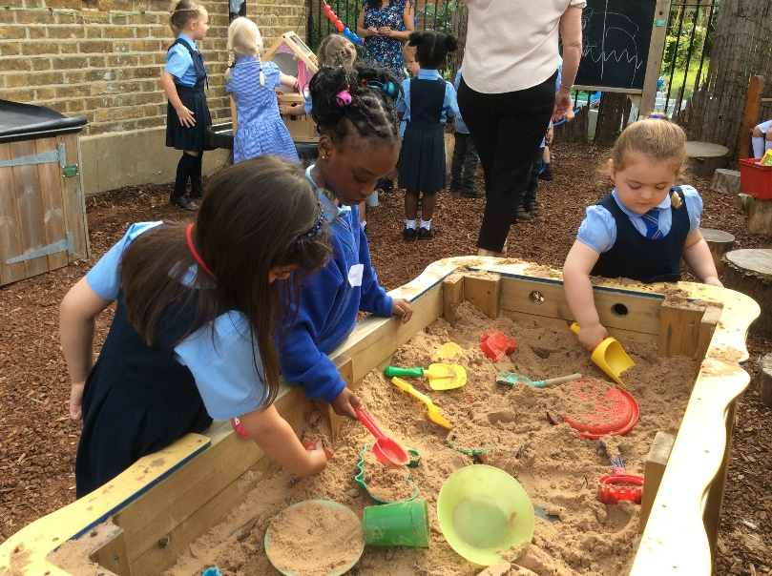
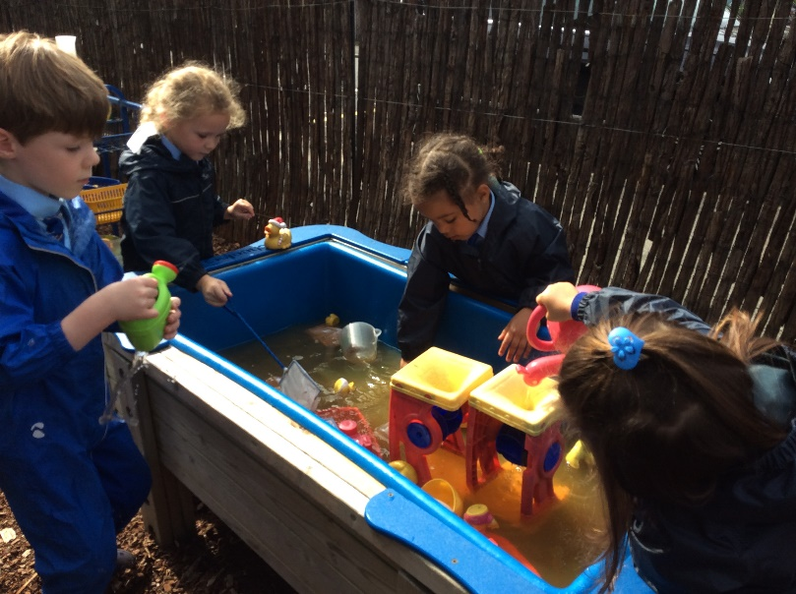
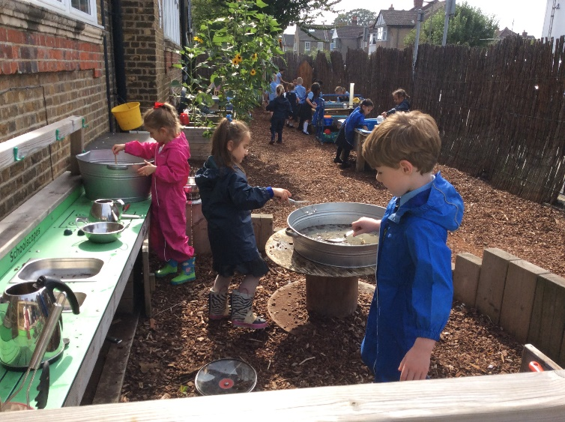
Outdoor Learning
The children have regular access to our outdoor area. Our outdoor learning supports the development of healthy and active lifestyles by offering children opportunities for physical activity, freedom and movement, and promoting a sense of well-being.

Slide 9
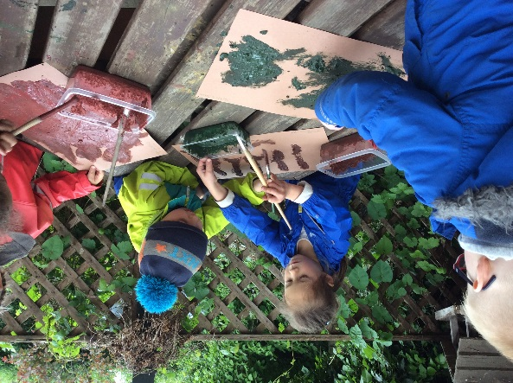
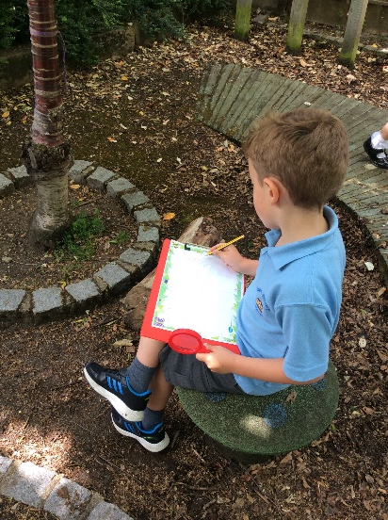
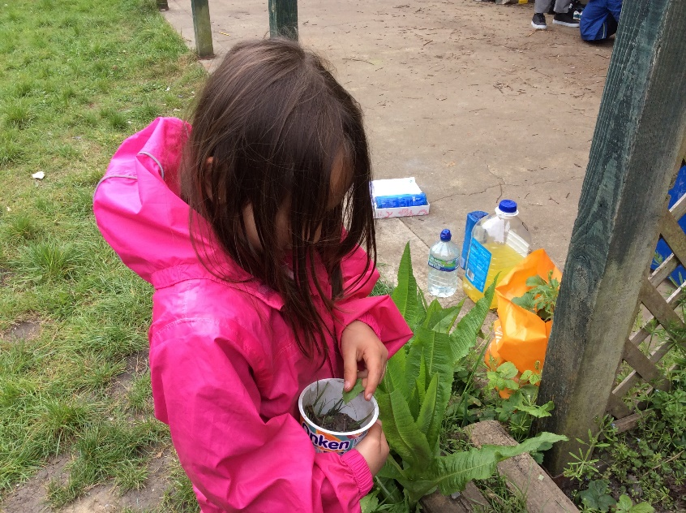
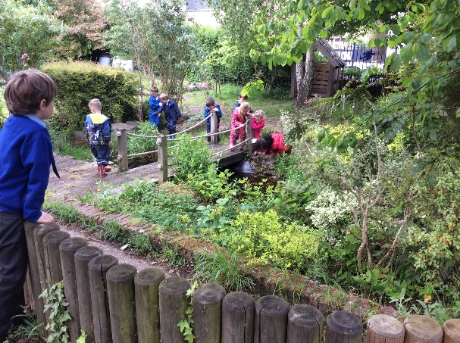
Forest School
Our Outdoor learning sessions take place later in the 2nd half of the Autumn term. Our outdoor learning sessions enable the children to take risks, develop problem solving skills and demonstrate teamwork.

Slide 10
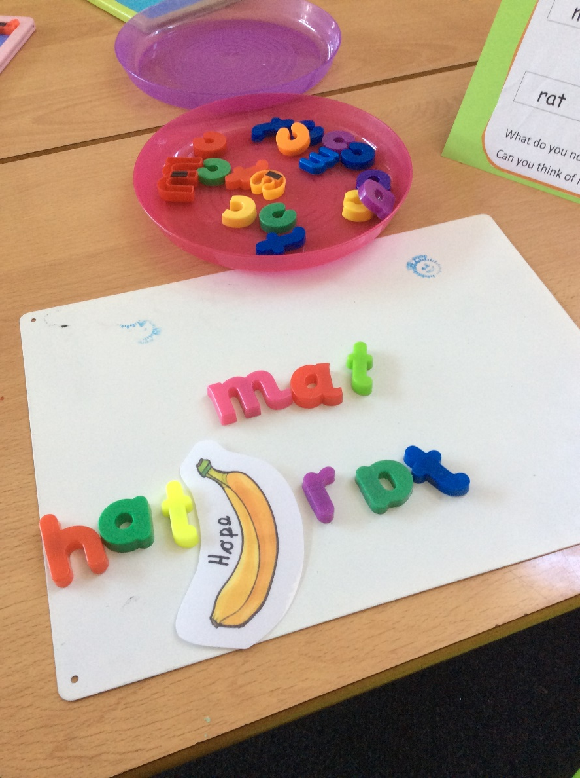
Phonics:
Your child will be taught phonics using the Letters and Sounds phonic scheme.
At Raglan we teach the letter sounds first, this helps your child to read and write a range of simple and more complex words.
The EYFS team will be running phonic sessions for parents later in the year. We encourage all parents to come along as it will give you a greater understanding of how we teach reading and writing skills and support you to support your child.

Slide 11
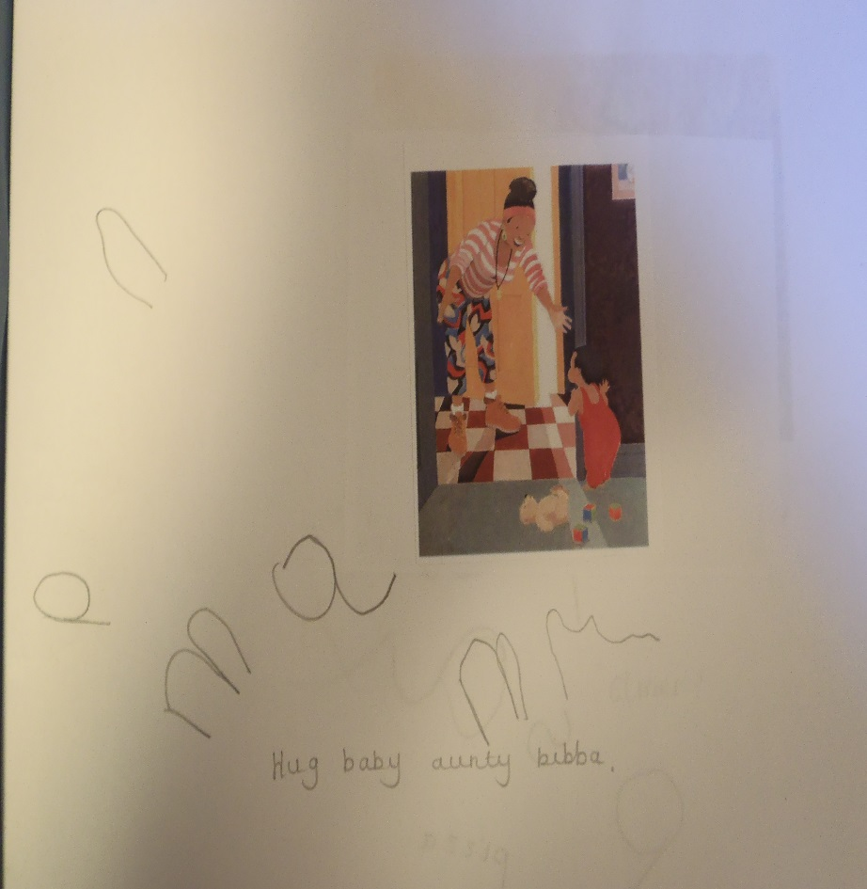
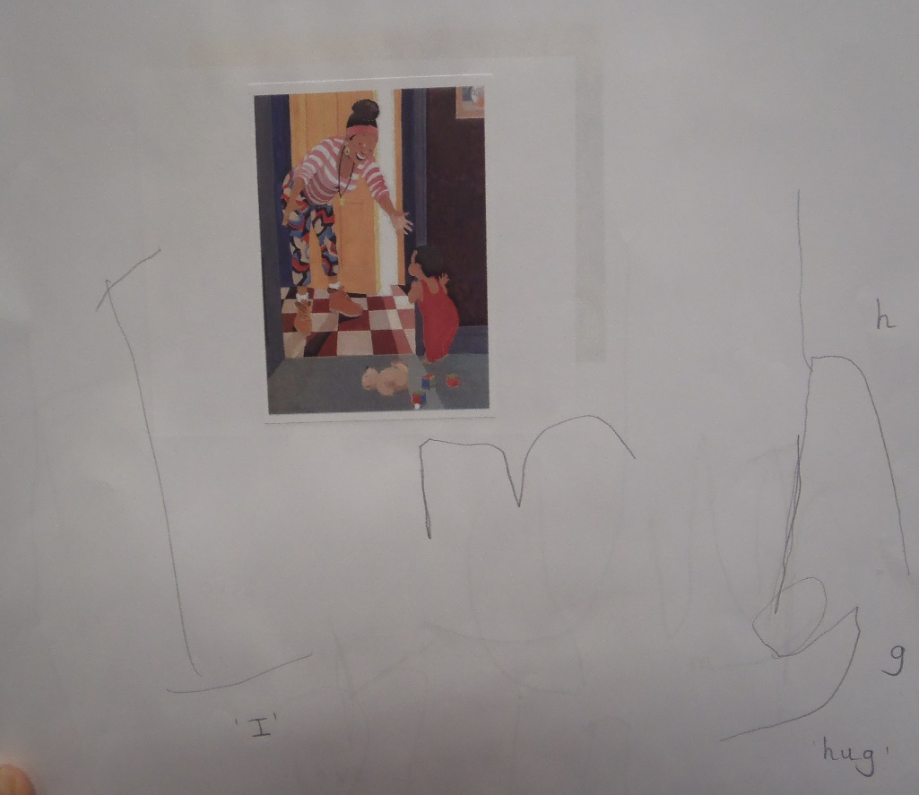
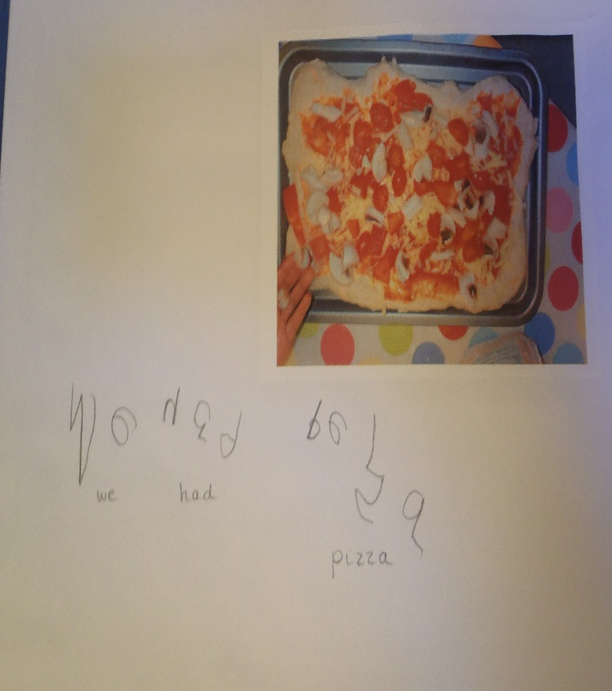
Writing:
Emergent writing is to be encouraged! Please don’t be concerned if your child is still mark making at the beginning of Reception, this is a natural stage of their development.

Slide 12
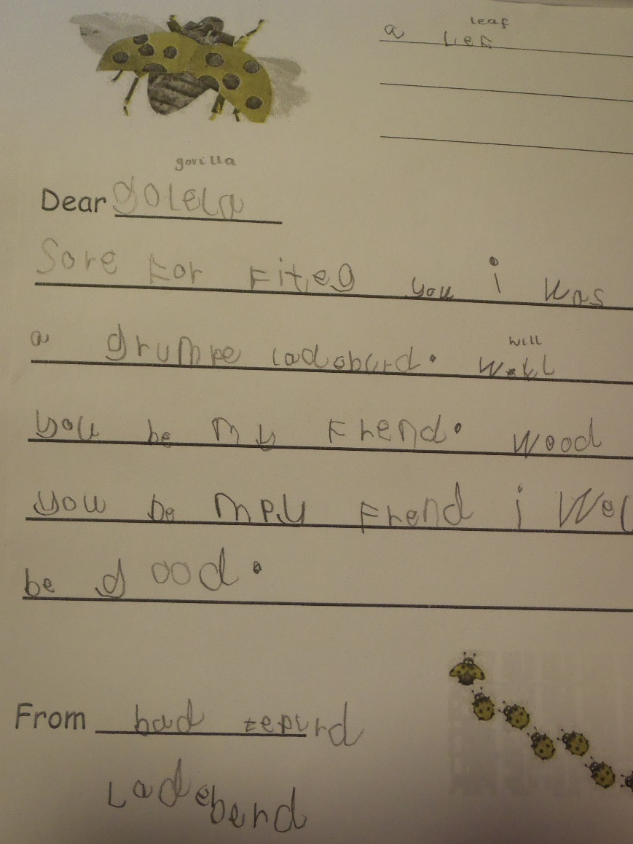
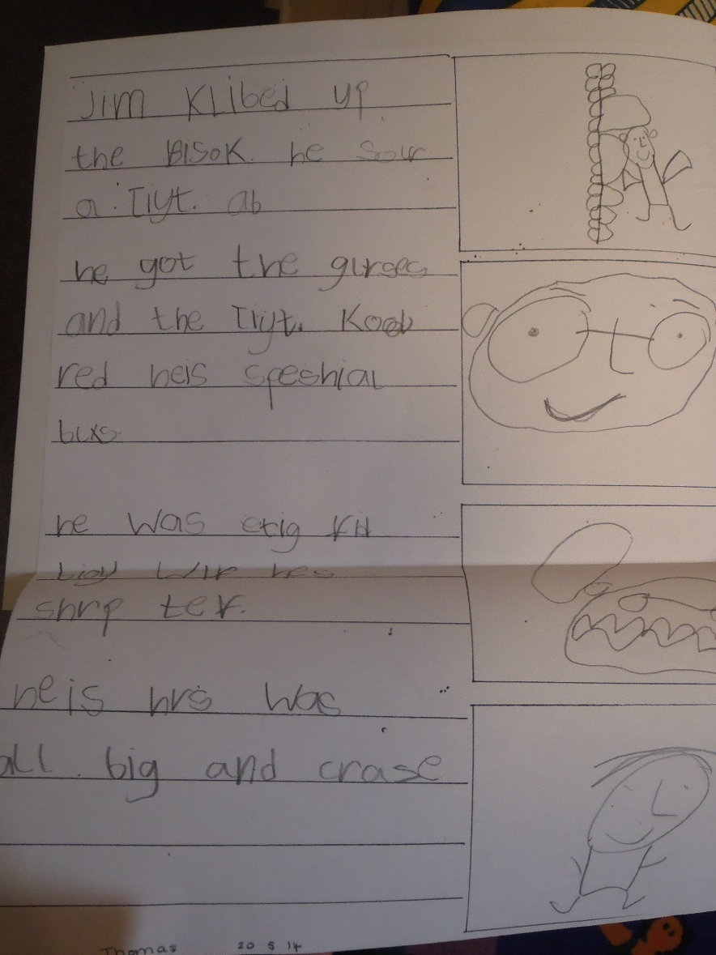
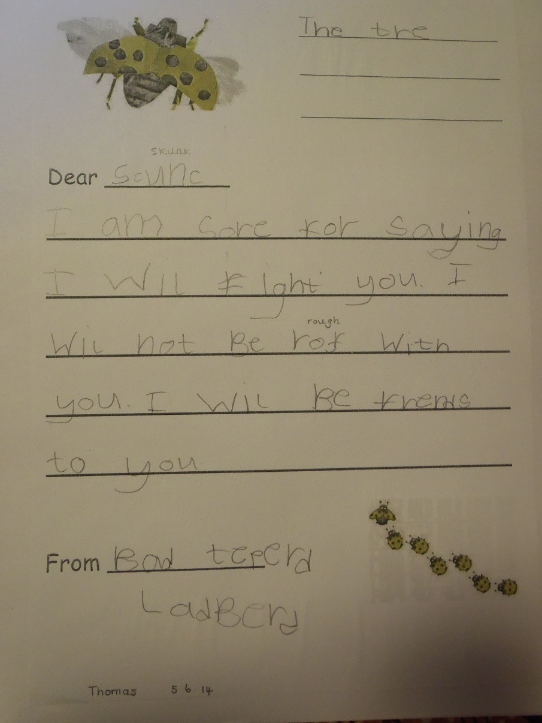
At the end of the year…

Slide 13
Maths
In Reception, your child will learn to: Count reliably with numbers from 1 to 20, place them in order and say which number is one more or one less than a given number. Use quantities and objects to add and subtract 2 single-digit numbers and count on or back to find the answer.
By the end of the children will have a good composition of numbers up to 10. This means that they will understand that numbers are made up of other numbers. They’ll ‘see that all numbers are made up of ones, and then that they can be made up of pairs of bigger numbers. So for example, 5 is made of ‘five ones’, or of ‘1 and 4’, or of ‘2 and 3’.
The children will learn how to add, subtract, halve and double over the year.

Slide 14
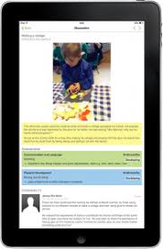
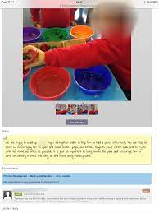
Monitoring Progress
Each of the 7 areas of learning has its own set of Early Learning Goals which determine what most children are expected to achieve by the end of Reception.
This profile is used throughout the year and provides a well- rounded picture of your child's knowledges, understanding and abilities.
At Raglan, we use Tapestry. This is an online learning journey which enables staff to record your child’s unique learning journey.

Slide 15
Transition into Reception
There are 60 children starting in reception.
Staggered transition will take place during the first few weeks of the new term to ensure all children are safe, secure, familiar and happy in their new routine.
Each child will be given a date for starting school.
Parent teacher conferences begin at the end of August.
If a child takes longer to settle into the routine of full -time school, staff will work in partnership with parents to extend and modify the transition arrangements in September.

Slide 16
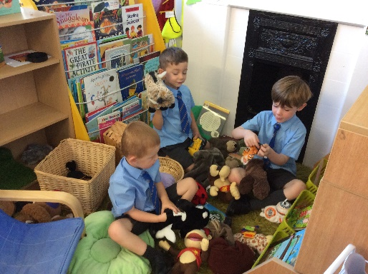
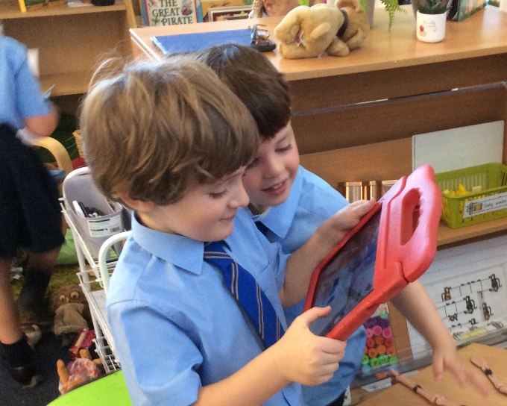
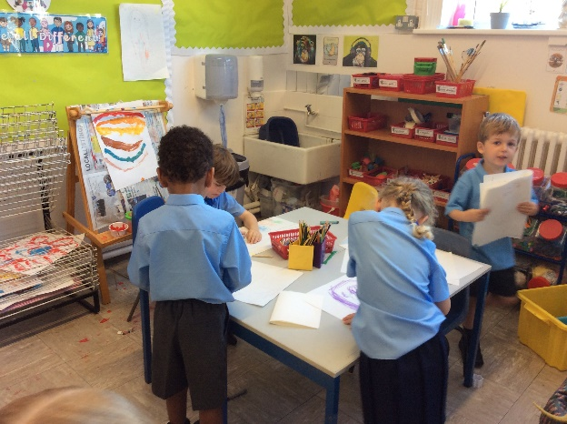
Transition into Reception
.
To make the transition into Reception a smooth process the children will be staggered in over 3 days. 10 children will start each day until all 60 children are in and will stay until 11:45.
The children will Stay for Lunch on Thursday and Friday and will be collected at 1:30 for the remainder of the week.
By the second week, all children will be in full time.

Slide 17
Organisation
Start of the day: A soft start is operated at Raglan Primary school. The Reception gate is opened at 8.40 and children are welcomed in by the Teaching assistants. However on your child’s first day all Reception Staff will be present to welcome your child into school.
The children are supervised at Lunchtime by designated early years midday assistants. All children are supported and supervised when choosing their lunch or accessing their lunchboxes. They are encouraged to eat or try most things. After lunch children will have access to the designated E.Y.F.S. Playground.
The children will be brought out to the Reception gates by their class teacher and teaching assistant. Children will be dismissed one by one, once they have waved to their grownup.
All children MUST be collected by a familiar adult (over the age of 16
years).

Slide 18
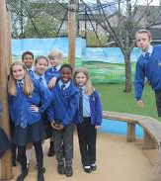
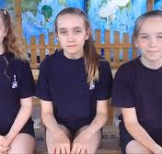
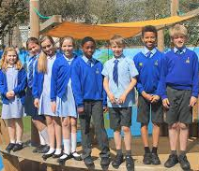
School uniform
Children can choose from the following items:
Grey trousers – short or long
Blue shirt
School tie with logo
Blue v–neck sweatshirt with logo
Grey socks
Plain black, brown or navy shoes
Navy skirt/navy trousers or pinafore dress
Blue blouse
Blue/white check dress (summer)
Blue v–neck sweatshirt/cardigan with logo
School tie with logo (winter)
White socks or navy tights
Plain black, brown or navy shoes
Plain navy jogging bottoms may be worn by children in KS1 who have difficulty with zips etc.
Fleeces are available to purchase as an item for outdoor use only. Available, but not compulsory: blue baseball caps, rain jackets and school backpacks
Uniform is available from:
Bromley School wear 51 High Street, Bromley 020 8460 0032 www.bromleyschoolwear.co.uk
Or
myclothing.com online store, CLICK HERE.

Slide 19
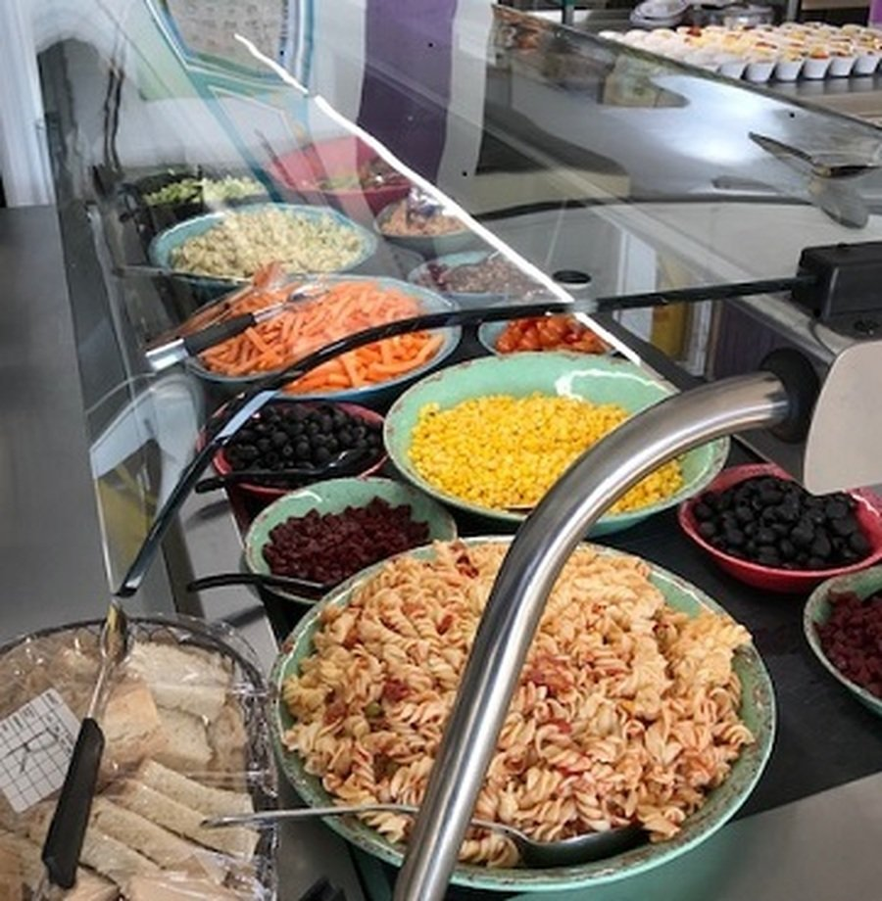
Lunch times
School meals
All children in Reception are entitled to a free school meal at lunchtime.
The children will have a variety of food to choose from. A menu of what is on offer can be found on the school website.
If your child has an allergy or any special dietary requirement please let the school office know and so that kitchen staff are aware.
The first two weeks of school- a member of the EYFS team sit with children when they have their lunch.
The children have dedicated members of staff that look after them during lunch time.

Slide 20
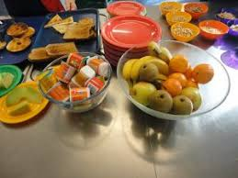
Wrap around care
We provide breakfast and after school club during term time.
Our breakfast leader is Ms Carberry
Our After school club leader Ms Bridge
You can download an application form via our school website

Slide 21
School ready
1. Encourage independence
Reception children will be expected to know the basics of looking after themselves. Encourage your child to dress on their own – tackling buttons, zips and taking off and putting on jackets. Plus they should know how to eat using a knife, fork and spoon independently and be able to go to the toilet without help.
2. Help them learn about making friends
Having friends is hugely beneficial for children. Those who have already been to pre-school or a nursery will already be proficient in socialising, so do encourage your child to talk to other children at play sessions or at the park and invite young friends over for play dates.
3. Develop speaking and listening skills
School children are expected to listen to what the teacher says, without interrupting, and to also answer when spoken to. Get your child ready for ‘circle time’ – a time when the teacher and class sit together every day to discuss topics – by trying it out at home. Either make your own ‘circle time’ with siblings – or use teddies and dolls – and encourage family discussions at the dinner table, taking turns to listen and to speak.
4. Teach them to recognise their written name
Some children will already be able to read and write simple words by the time they start Reception; others will be new learners. It’s important that your child can recognise their name so they can pick up the correct name-labelled uniform or jacket, and also find their own drawer in the classroom. With your child, explore what the letters in their name look like and help them try writing their name, too.
5. Talk enthusiastically about school
Children's thoughts about school can vary enormously. Some can hardly wait to start while some find it stressful to leave their parents for the day. Start helping your child look forward to school by talking enthusiastically about it now. Visit the classroom, admire other pupils' pictures and projects together and talk about what your child will be doing and who they will meet in positive terms.
You can find more information on how to be school ready by clicking on the link below
https://www.pacey.org.uk/Pacey/media/Website-files/school%20ready/PACEY_preparingforschool_guide.pdf

Slide 22
Reminders:
Book bags available at a cost of £5.00 from Office.
Water bottles available for £2.50 from the office.
Please complete all paperwork and hand in to the office by the required deadline.

Slide 23
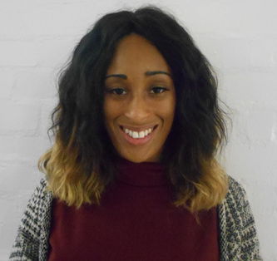
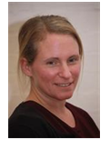
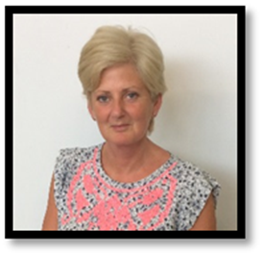
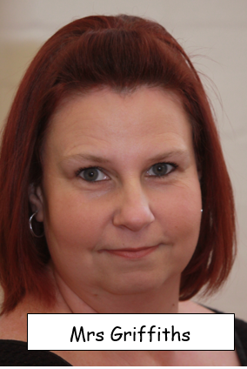
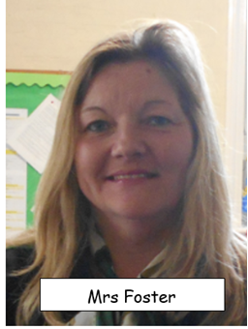
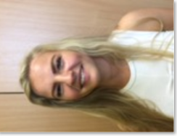
Reception Staff waiting to welcome you
Ms Ezinwa
Monkey Class Teacher
EYFS LEAD
MISS Donnelly
LIONS Class TEACHER
Miss Nash
Monkey Class Teaching assistant
MRS nye
LION Class Teaching assistant AND MIDDAY SUPERVISOR
MRS griffiths
Learning Support ASSISTANT AND Midday supervisor
MRS fOSTER
MIDDAY SUPERVISOR

Slide 24
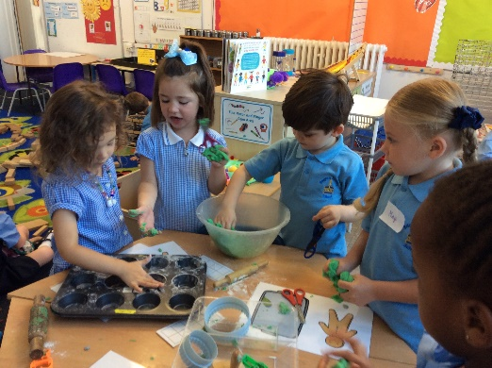
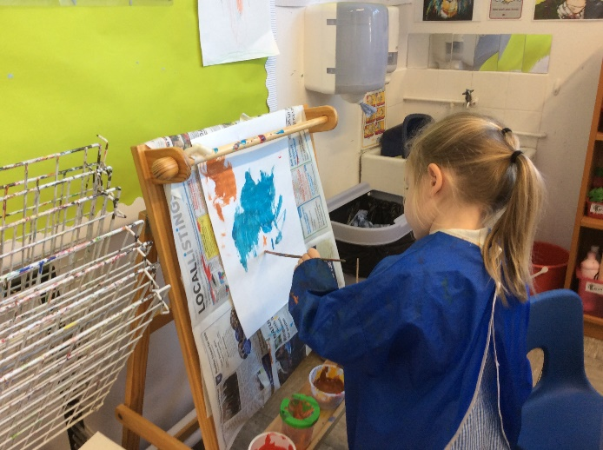
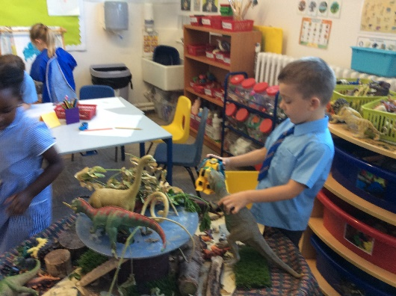
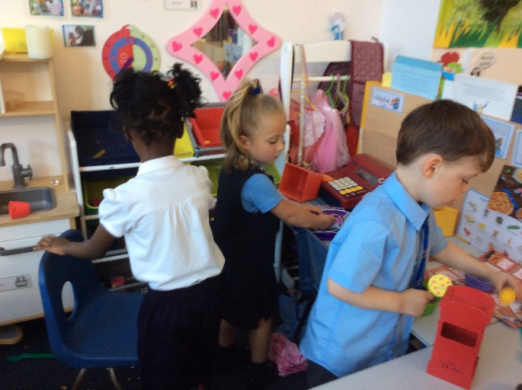
If you have any questions or queries please contact the school office.
Thank you for your continued support ☺

